Slide 1
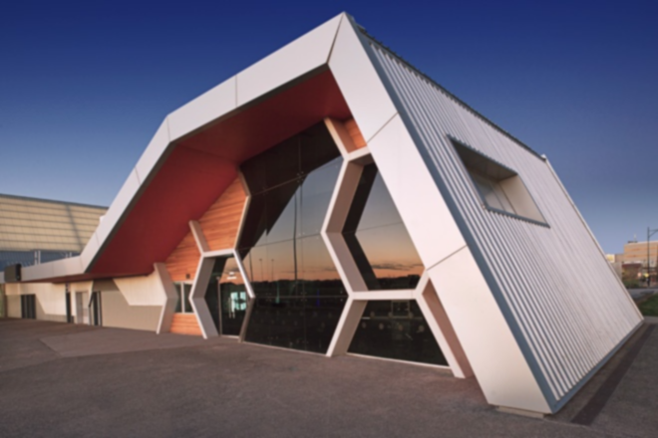
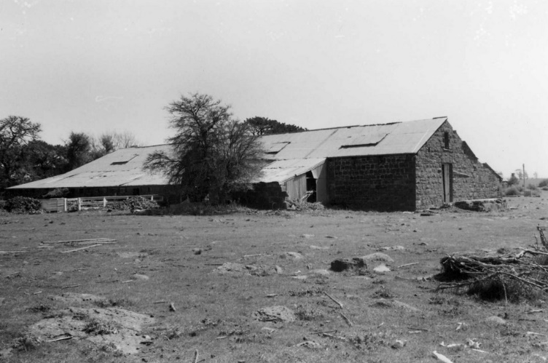
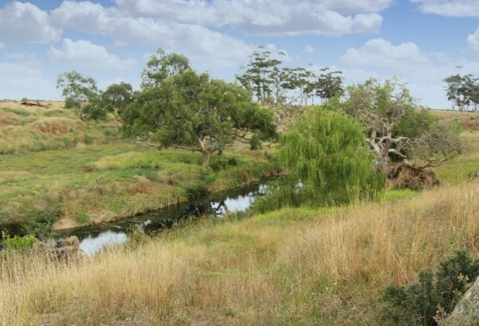
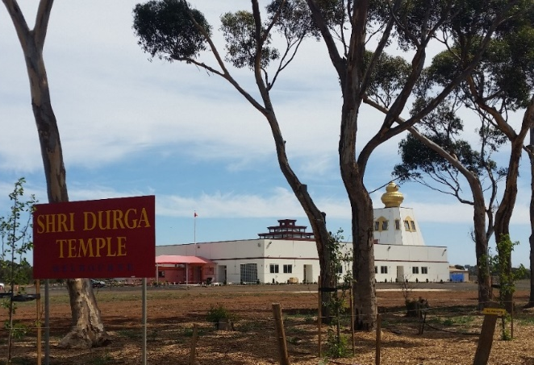

Plumpton and Kororoit PSPs
28 October 2016
Notes:
Presentation demonstrates process of developing these Precinct Structure Plans, and what has been considered in their preparation.

Slide 2
Demand for Melbourne’s greenfield growth areas
Greenfield growth area population is growing at around 40,000 people p.a.
Its proportion of total Melbourne growth changes over time
VICTORIA
VICTORIA
TOTAL
TOTAL
MELBOURNE
MELBOURNE
TOTAL
TOTAL
MELBOURNE
MELBOURNE
REST OF
REST OF
GREENFIELD GROWTH AREAS
GROWTH AREAS
REST OF VICTORIA
REST OF VICTORIA
Notes:
Why are we preparing these PSPs in Melbourne’s western growth corridor?

Slide 3
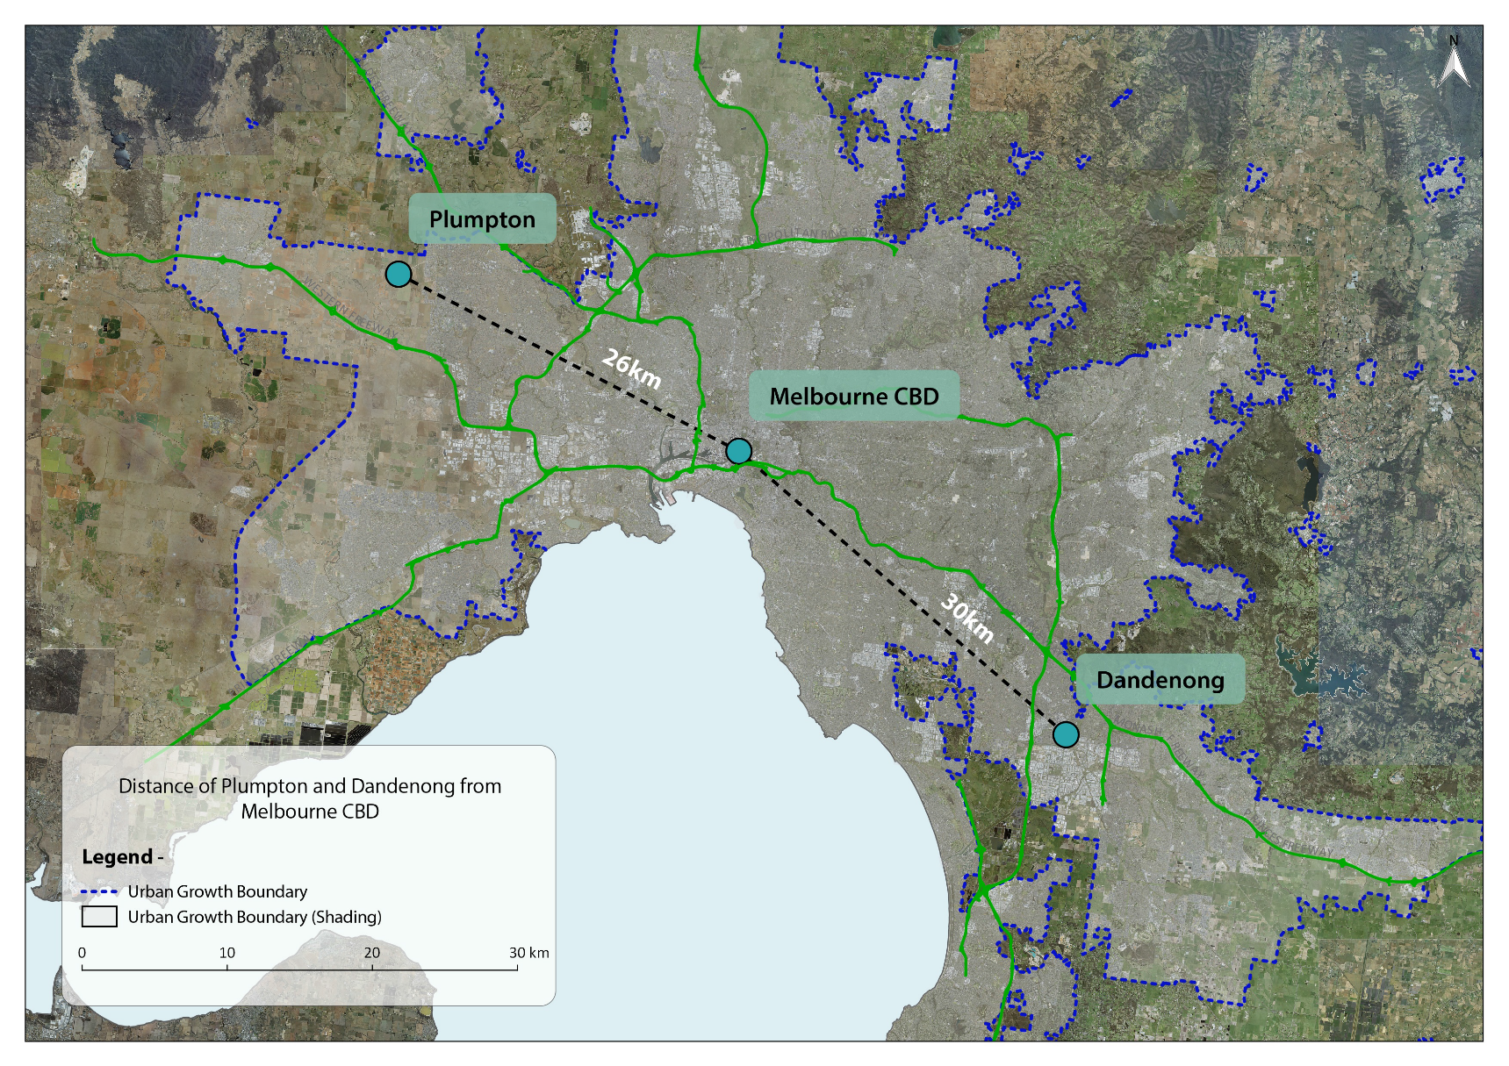
Plumpton and Kororoit PSPs are at the next development front
Centre of the West Growth Corridor
Infill area between Caroline Springs, Taylors Hill West and Rockbank North
Melton
Plumpton & Kororoit
Rockbank
North
Caroline Springs
26km
Melbourne CBD
30km
Dandenong
Notes:
Plumpton and Kororoit are at the growth front in Western Growth Corridor – and can also be seen as infill development between Caroline Springs and Rockbank North PSP area.

Slide 4
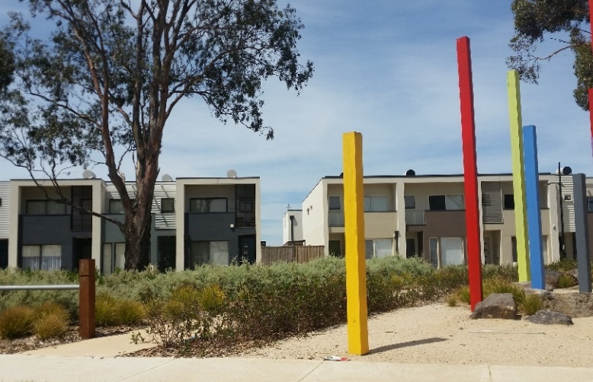
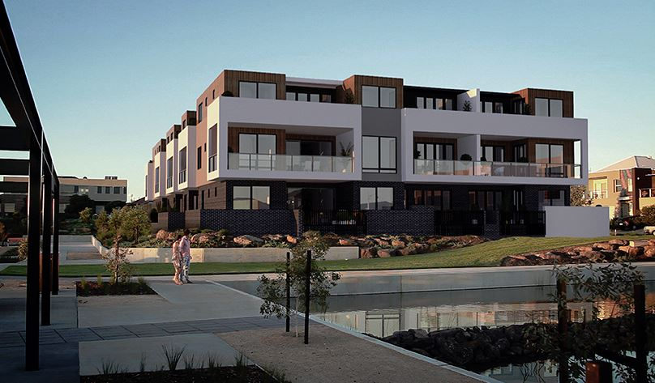
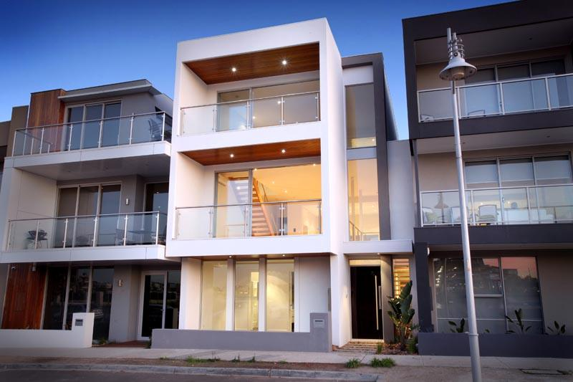
… and adjacent to areas nearing full build out
Taylors Hill West
Caroline Springs
Notes:
Kororoit and Plumpton PSPs are a logical next growth front in the west of Melbourne as there is:
Some capacity in existing services to allow early development;
An arterial road network already partly in place;
A new station recently completed at Caroline Springs to the south east, and existing station at Rockbank to the south west.

Slide 5
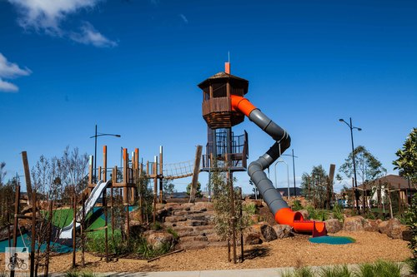
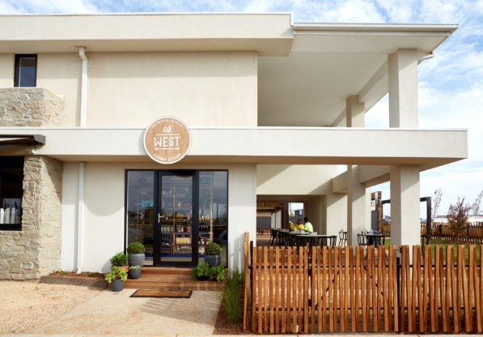
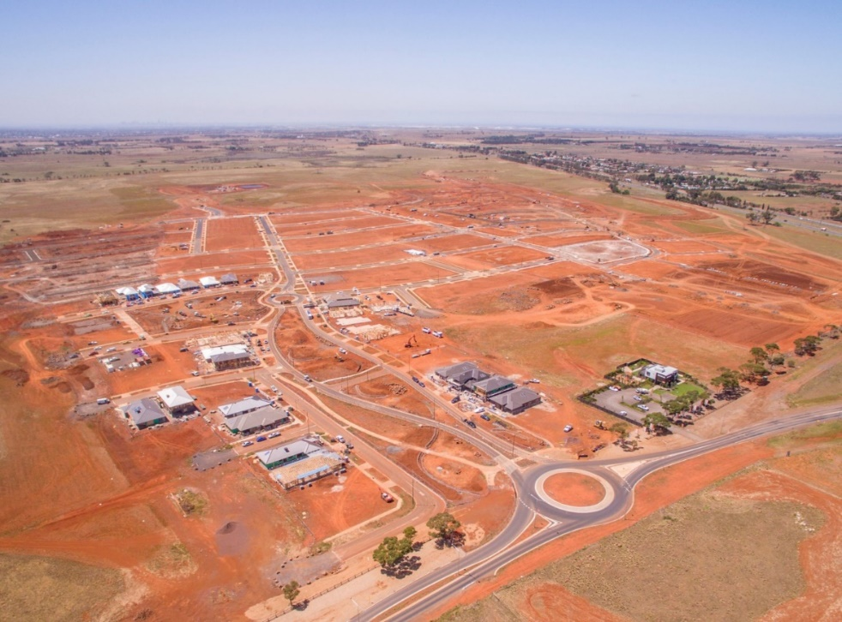
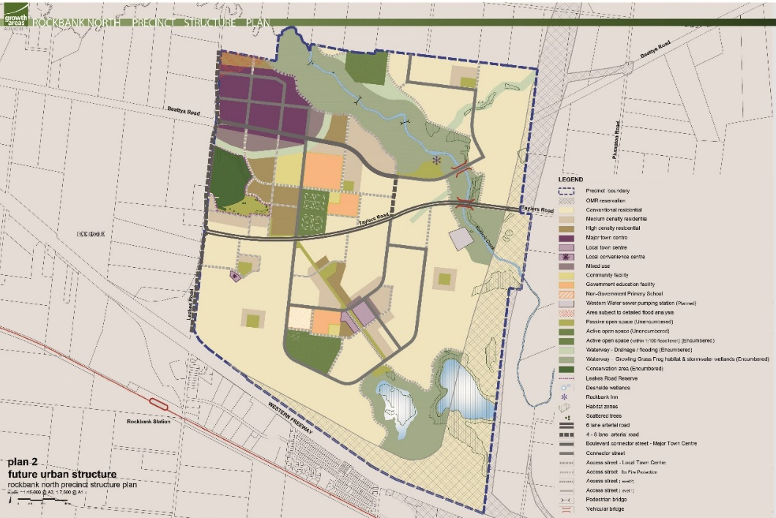
High level of demand for nearby land releases
High take up rate of land at Rockbank North (‘Woodlea’)
Selling 75 lots/ month since March 2015
Notes:
Woodlea development within the neighbouring Rockbank North PSP, west of Kororoit PSP:
75 sales/ month since release in March 2015
Prices around $150,000 - $279,000 for land with lots of 350sqm – 1000 sqm in size.
Note this photo from a drone is perhaps not a very inspiring view….

Slide 6
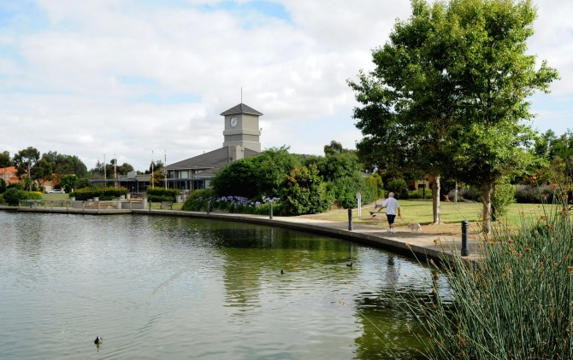
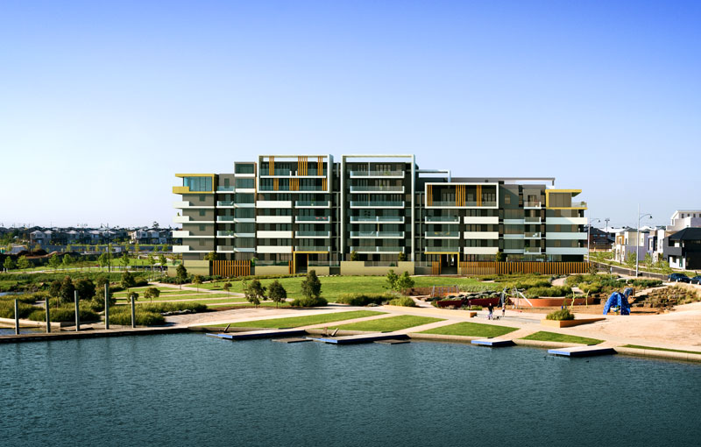
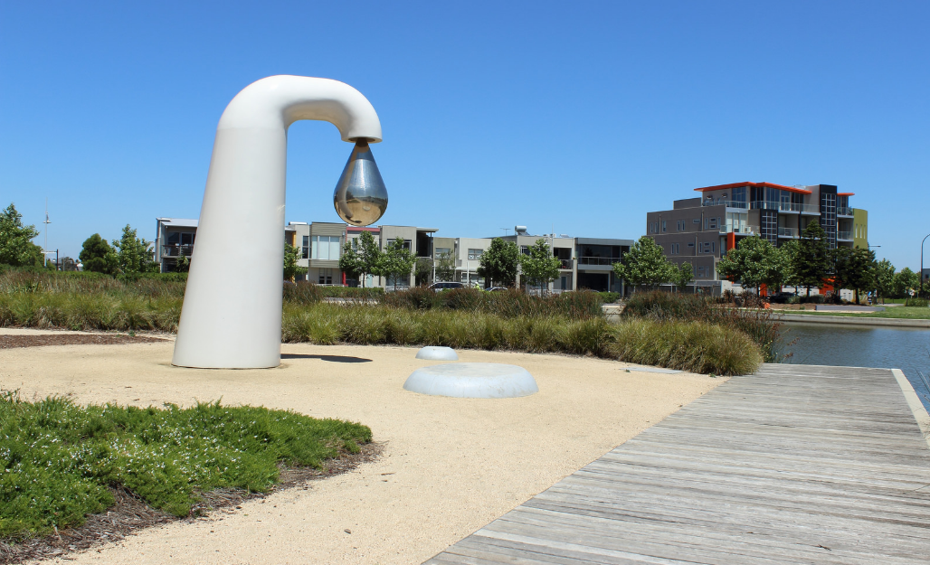
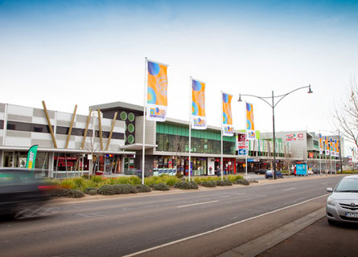
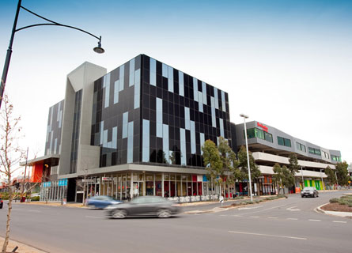
Caroline Springs
Nearing 20 years after development commencement
Source: Domain 2015
Source: Boom Property Group 2012
Source: Andrew L 2013
Source: Metaxasarch
Source: Metaxasarch
Notes:
However these new parts of the city transform quickly – these photos show Caroline Springs, just under 20 years after development commenced.

Slide 7

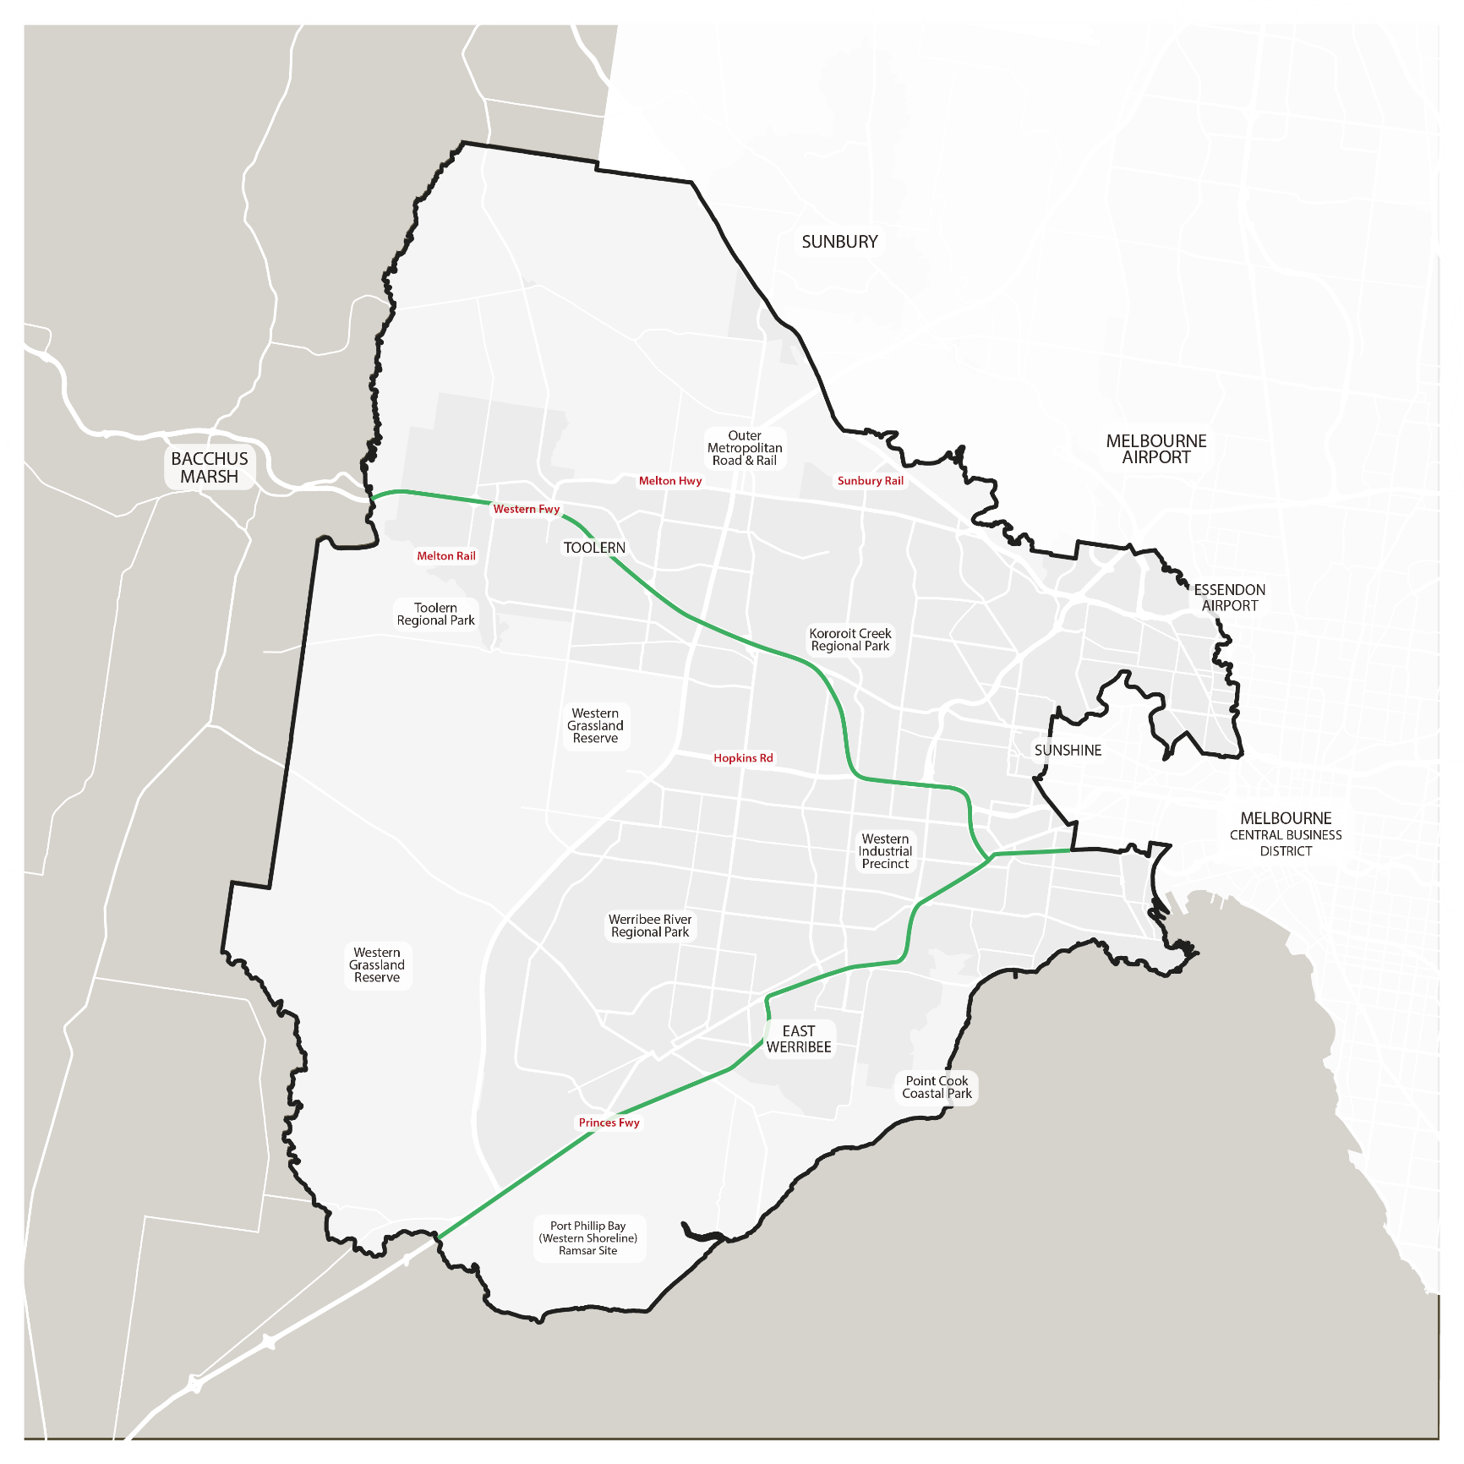
West Growth Corridor: Sunshine to Melton
Plumpton and Kororoit
Notes:
In terms of size:
Plumpton 1015 Ha
Kororoit 1180 Ha

Slide 8
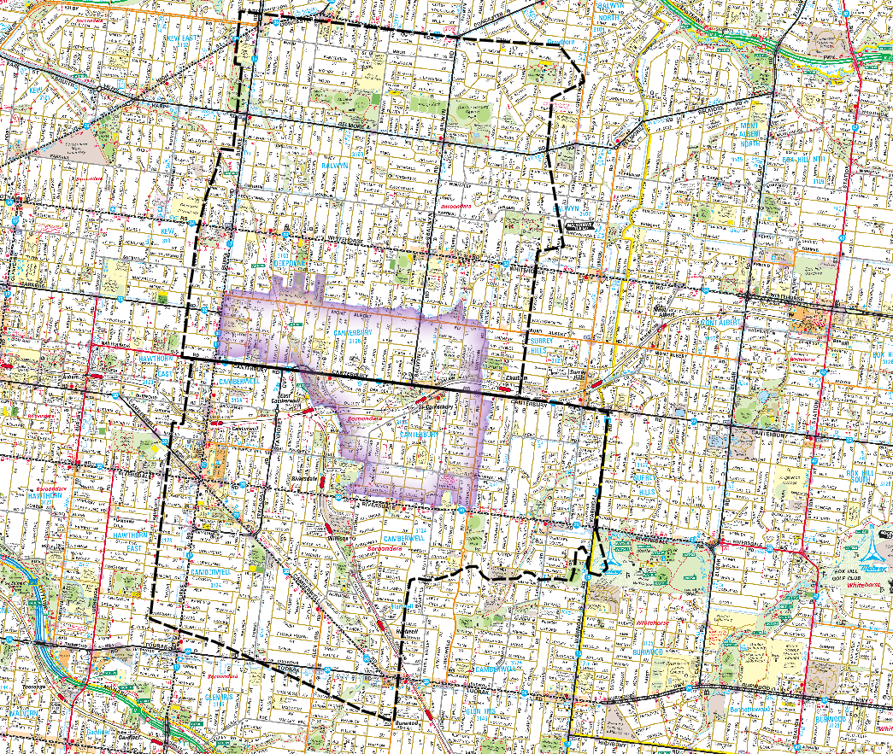

2,200 hectare comparison
DONCASTER ROAD
1078
WARRIGAL ROAD
Wattle Park
1080
BURKE ROAD
1080.2
Canterbury
TOORAK ROAD
Notes:
To put this area in perspective….
Overlay the areas onto some of the eastern suburbs of Melbourne (Toorak Road to Doncaster Road)
Note: Kororoit PSP has been separated into 2 parts as highlighted on this map – from here on the presentation will be discussing part 1 only as planning for part 2 will be completed later this year.
(if asked:
Canterbury: Total of 3,169 dwellings (ABS, 2016)
Approximately 315 hectares
Plumpton and Kororoit : 19,800 dwellings

Slide 9
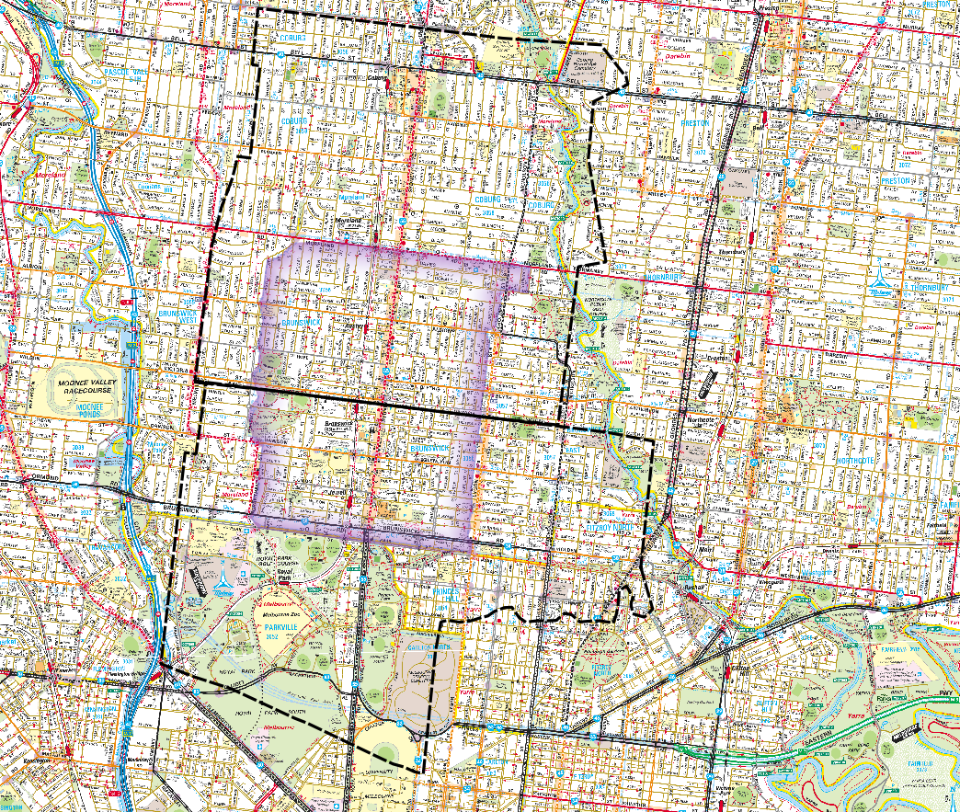
2,200 hectare comparison
BELL STREET
1078
ST GEORGES ROAD
TULLAMARINE FWY
1080
1080.2
Brunswick
FLEMINGTON ROAD
Notes:
Or again - overlay these PSP areas onto some of the northern suburbs of Melbourne (Bell Street to Flemington Road)
If asked:
Brunswick:
Total of 10,709 dwellings (ABS, 2016)
Approximately 496 hectares
Plumpton and Kororoit: 19,800 dwellings

Slide 10
High level planning decisions made during Growth Corridor planning
Plumpton and Kororoit
Notes:
In terms of preparing the PSP, many of the high level planning decisions were made during preparation of the Growth Corridor plan – here re-presented based on the version of the western region in Plan Melbourne.

Slide 11
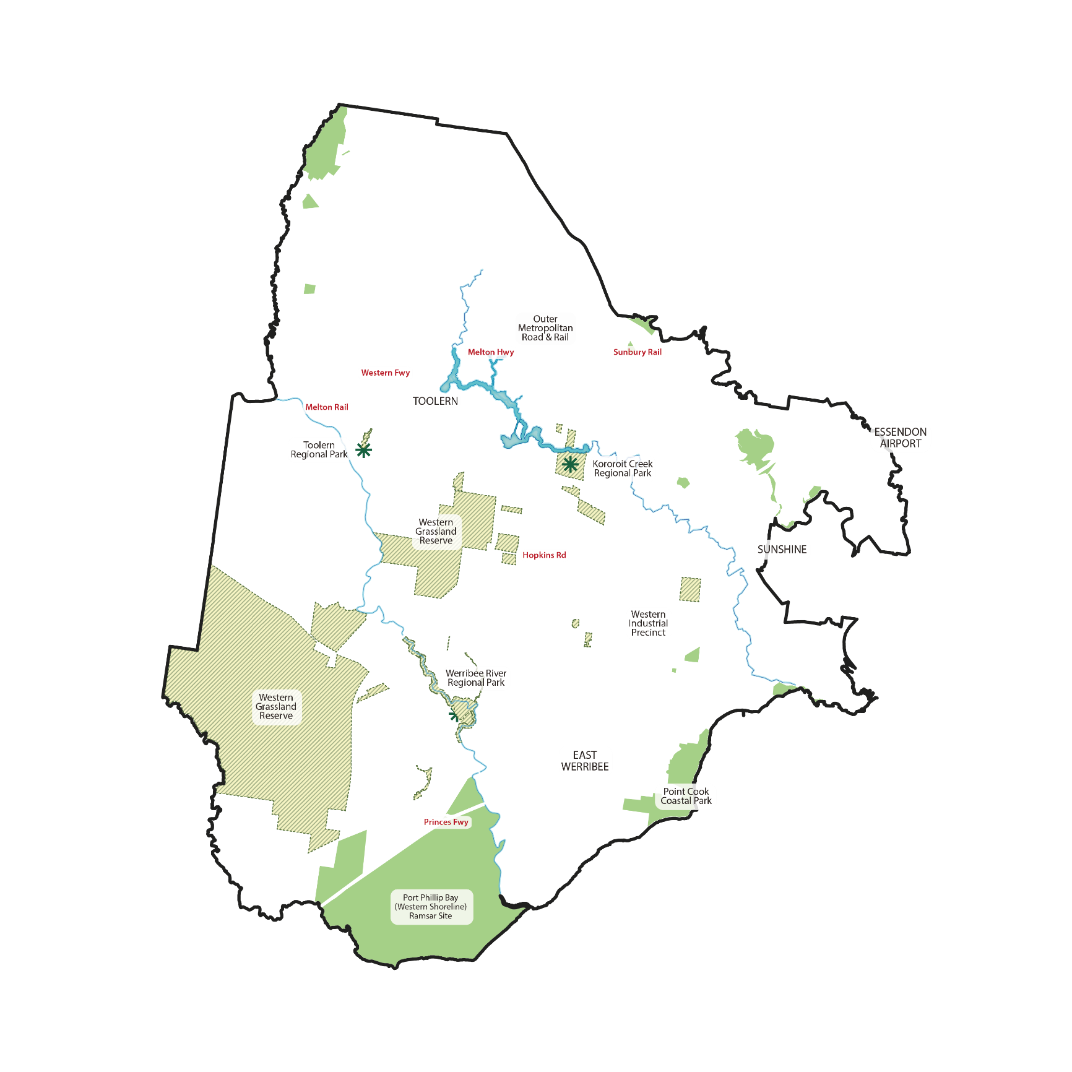
High level planning decisions made during Growth Corridor planning
Conservation and waterways
Notes:
High level planning decisions made at the time of the Growth Corridor Plans (completed in 2012) laid the foundations for the planning on the PSPs, with relation to:
Conservation and waterways (as shown in this slide at a high level)
Approval was signed in 2013 by the Commonwealth to enable urban development in Melbourne’s growth corridors, as long as the State agreed to protect Matters of National Environmental Significance as required under the Commonwealth Environmental Protection and Biodiversity Conservation Act (1999)
This approval specified areas along waterways, native grasslands and other areas for conservation.
A number of these are found in the Kororoit PSP as shown in this plan.
This plan highlights major open space for both recreation and conservation (eg Werribee Park and proposed Kororoit Regional park); important conservation sites in the region (eg Port Phillip RAMSAR site and the Western Grassland Reserves)

Slide 12
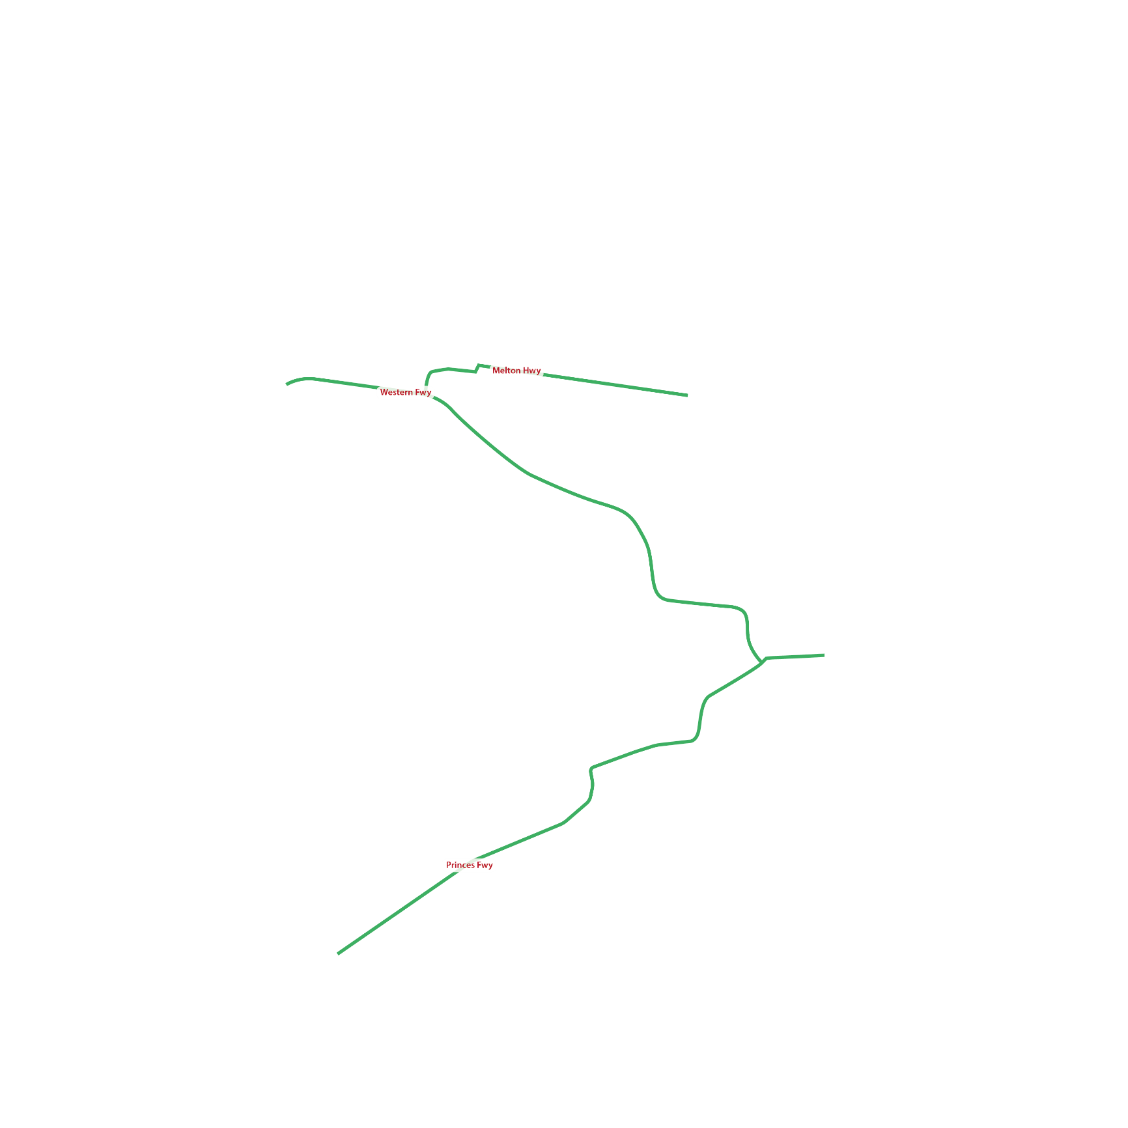


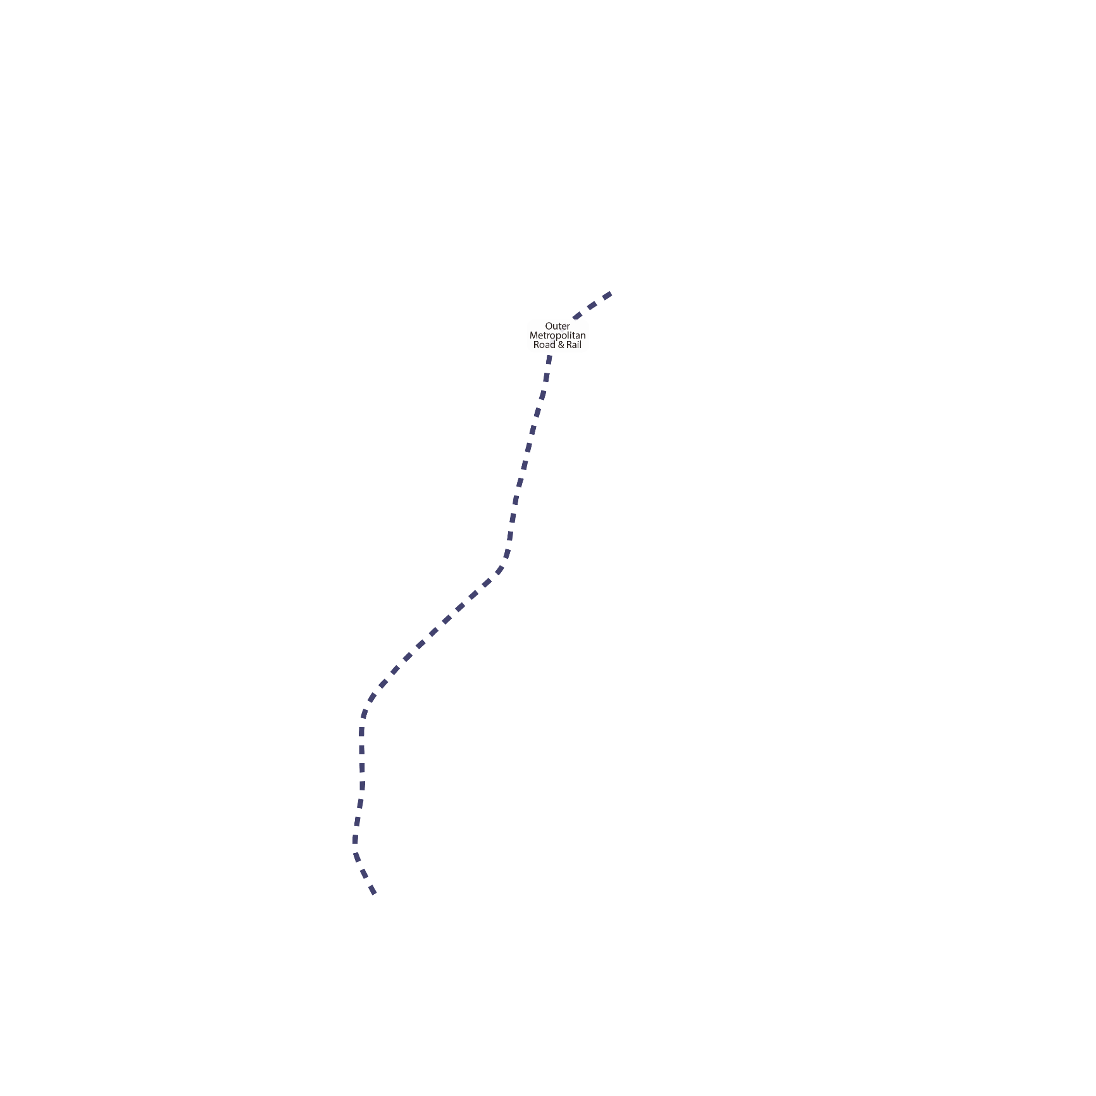

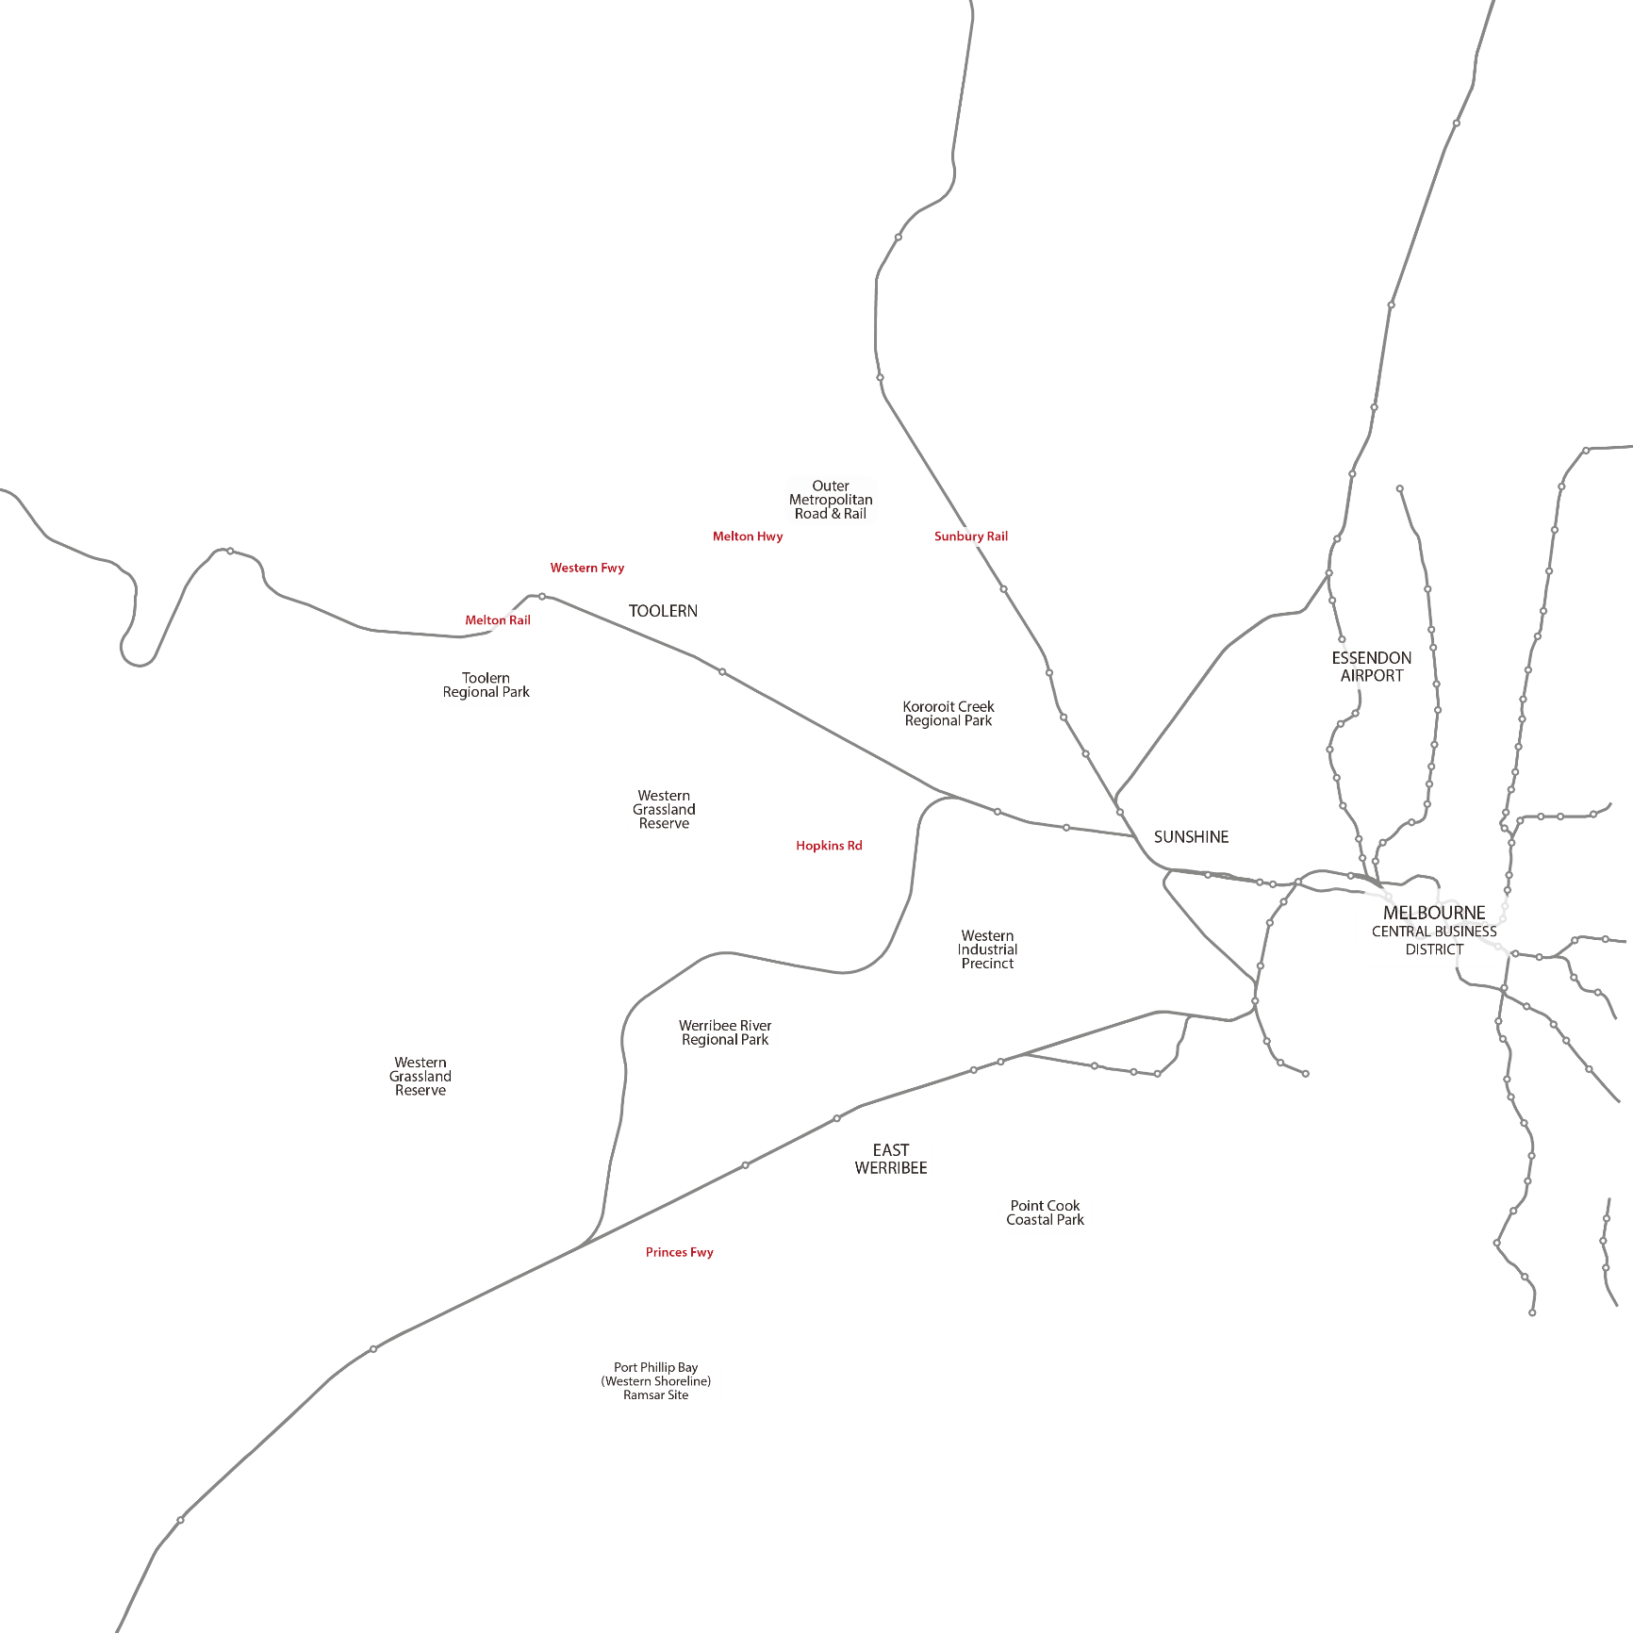
High level planning decisions made during Growth Corridor planning
Rail and transport links
Notes:
High level planning decisions made at the time of the Growth Corridor Plans laid the foundations for the planning on the PSPs, with relation to:
Rail and transport links (as shown in this slide at a high level)
These are existing other than Hopkins Rd extension (major north south road) and OMR (Outer Metro Ring transport corridor – road and rail)

Slide 13


High level planning decisions made during Growth Corridor planning
Activity centres and East Werribee
Notes:
High level planning decisions made at the time of the Growth Corridor Plans laid the foundations for the planning on the PSPs, with relation to:
Identifying the network of activity centres, to respond to the local and regional catchments
Existing activity centres shown in purple
Proposed activity centres (usually called ‘local town cetnres’ and major town centres’ in PSPs) in light pink

Slide 14
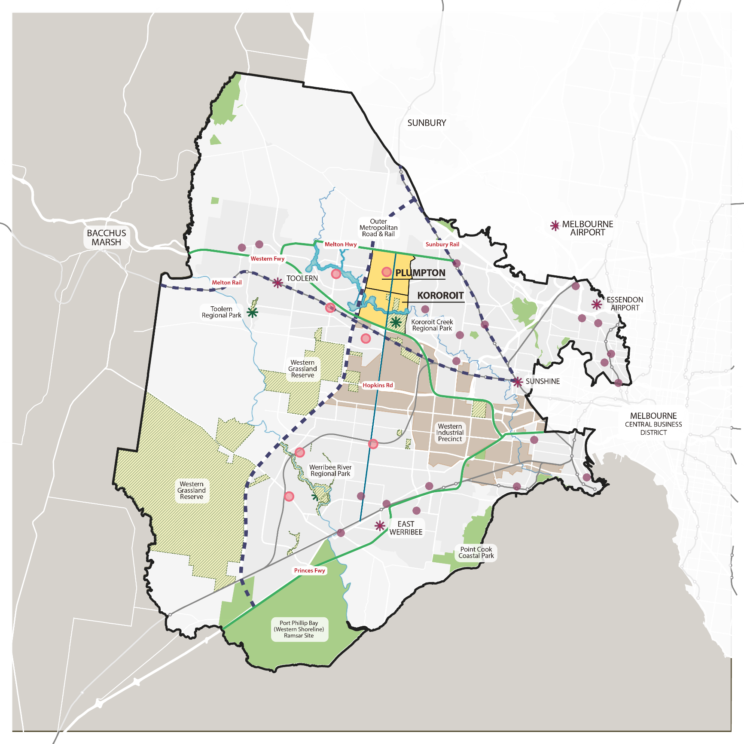
High level planning decisions made during Growth Corridor planning
Industrial areas
Notes:
High level planning decisions made at the time of the Growth Corridor Plans laid the foundations for the planning on the PSPs, with relation to:
Major employment/ industrial land
Western industrial precinct stretching from Altona across to the Mt Atkinson and Tarneit Plains PSP, south of the Kororoit PSP.

Slide 15
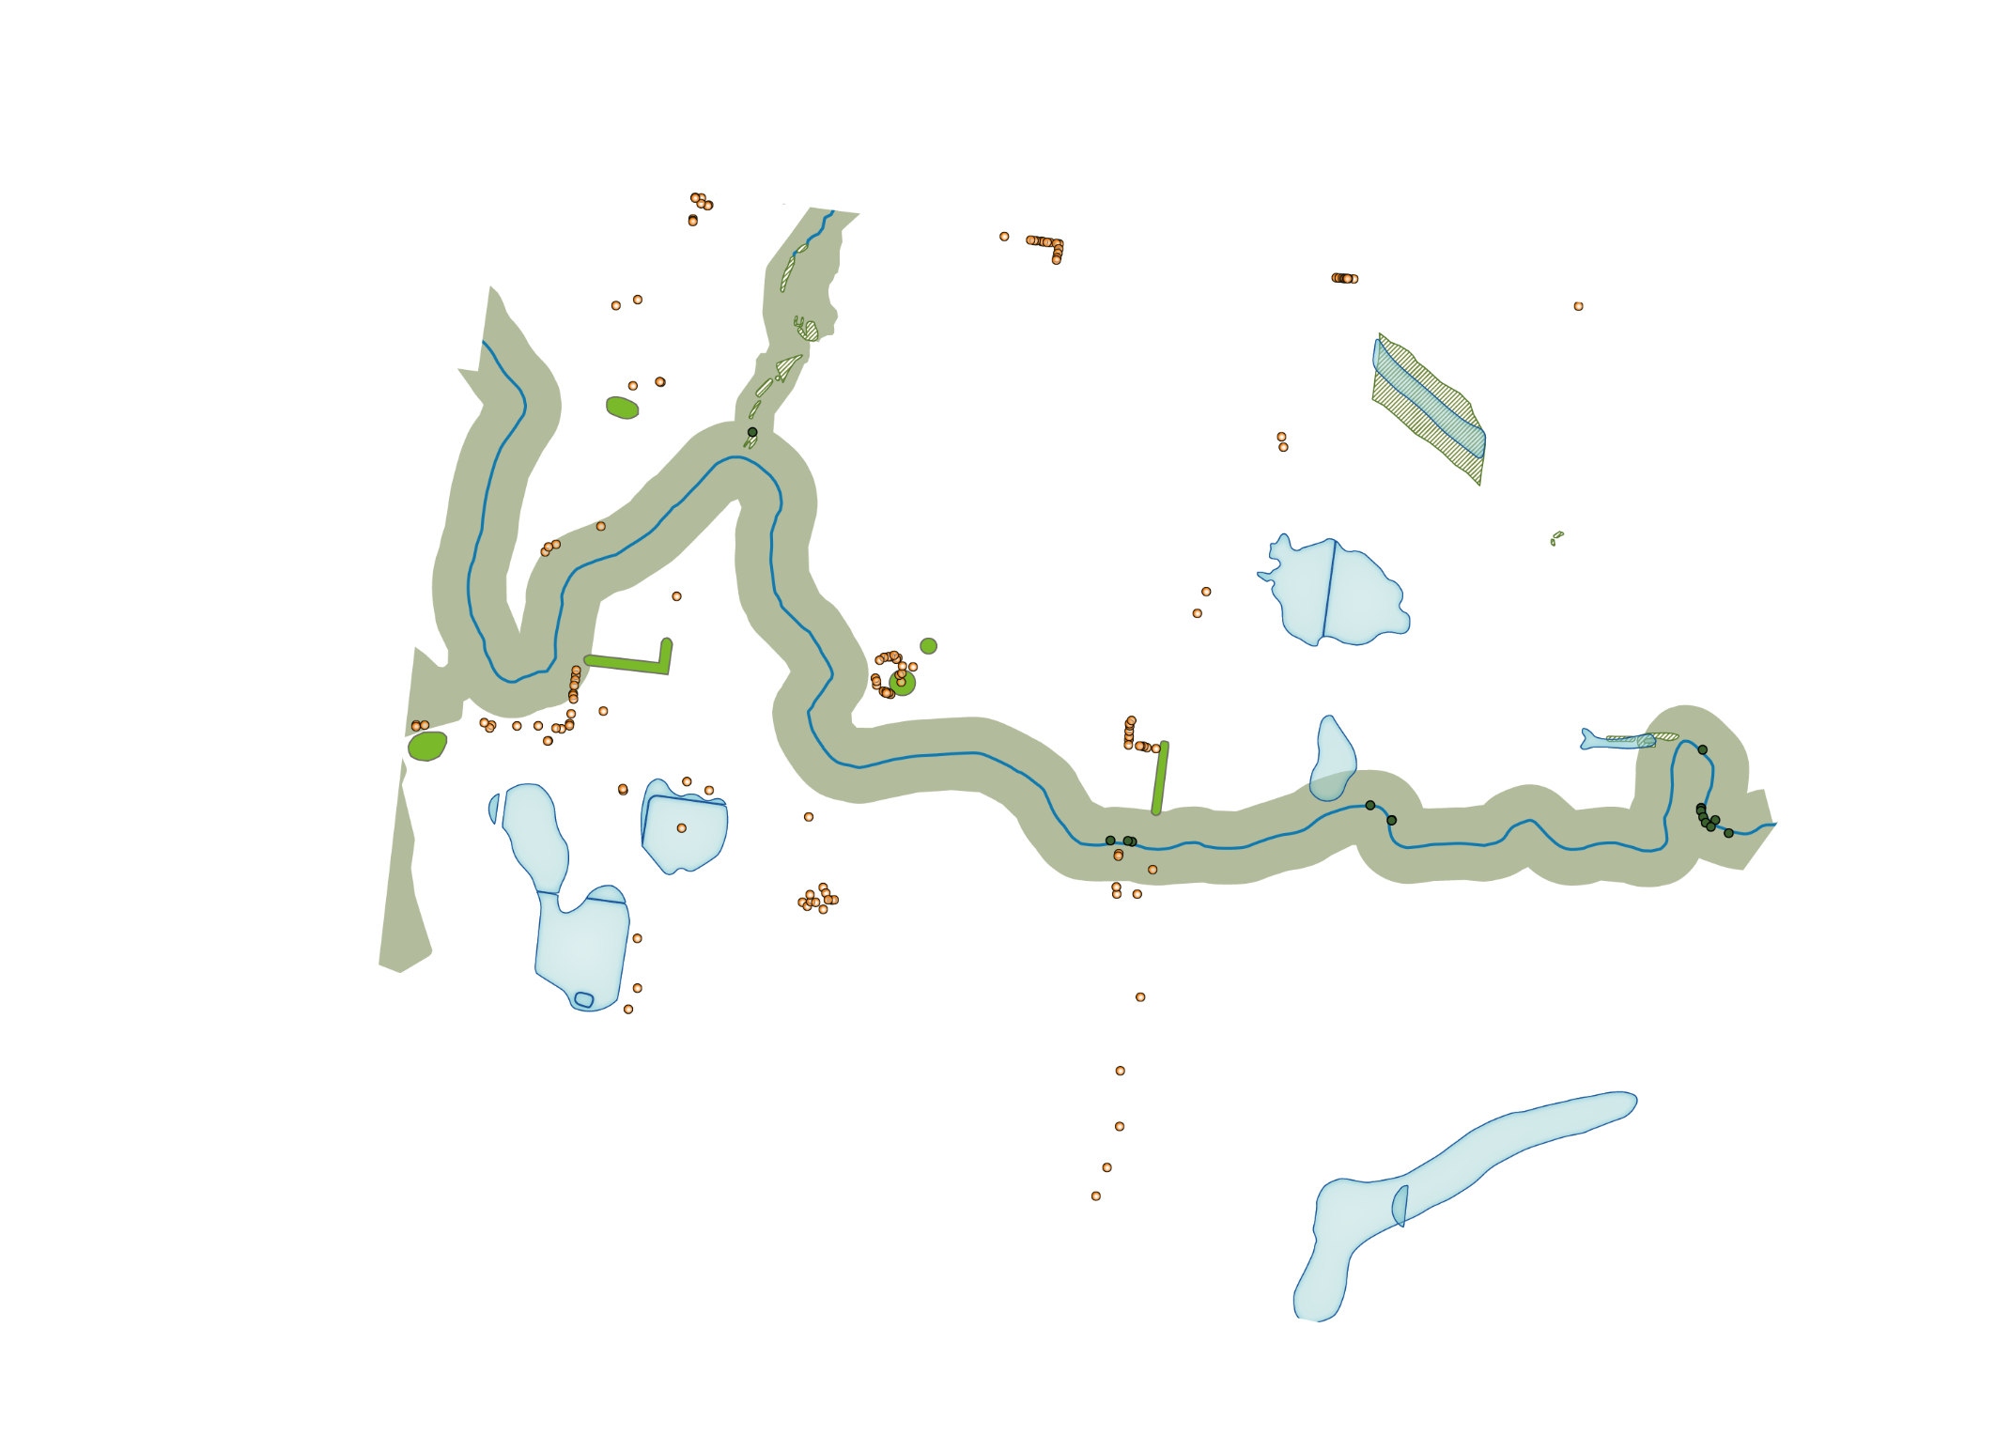
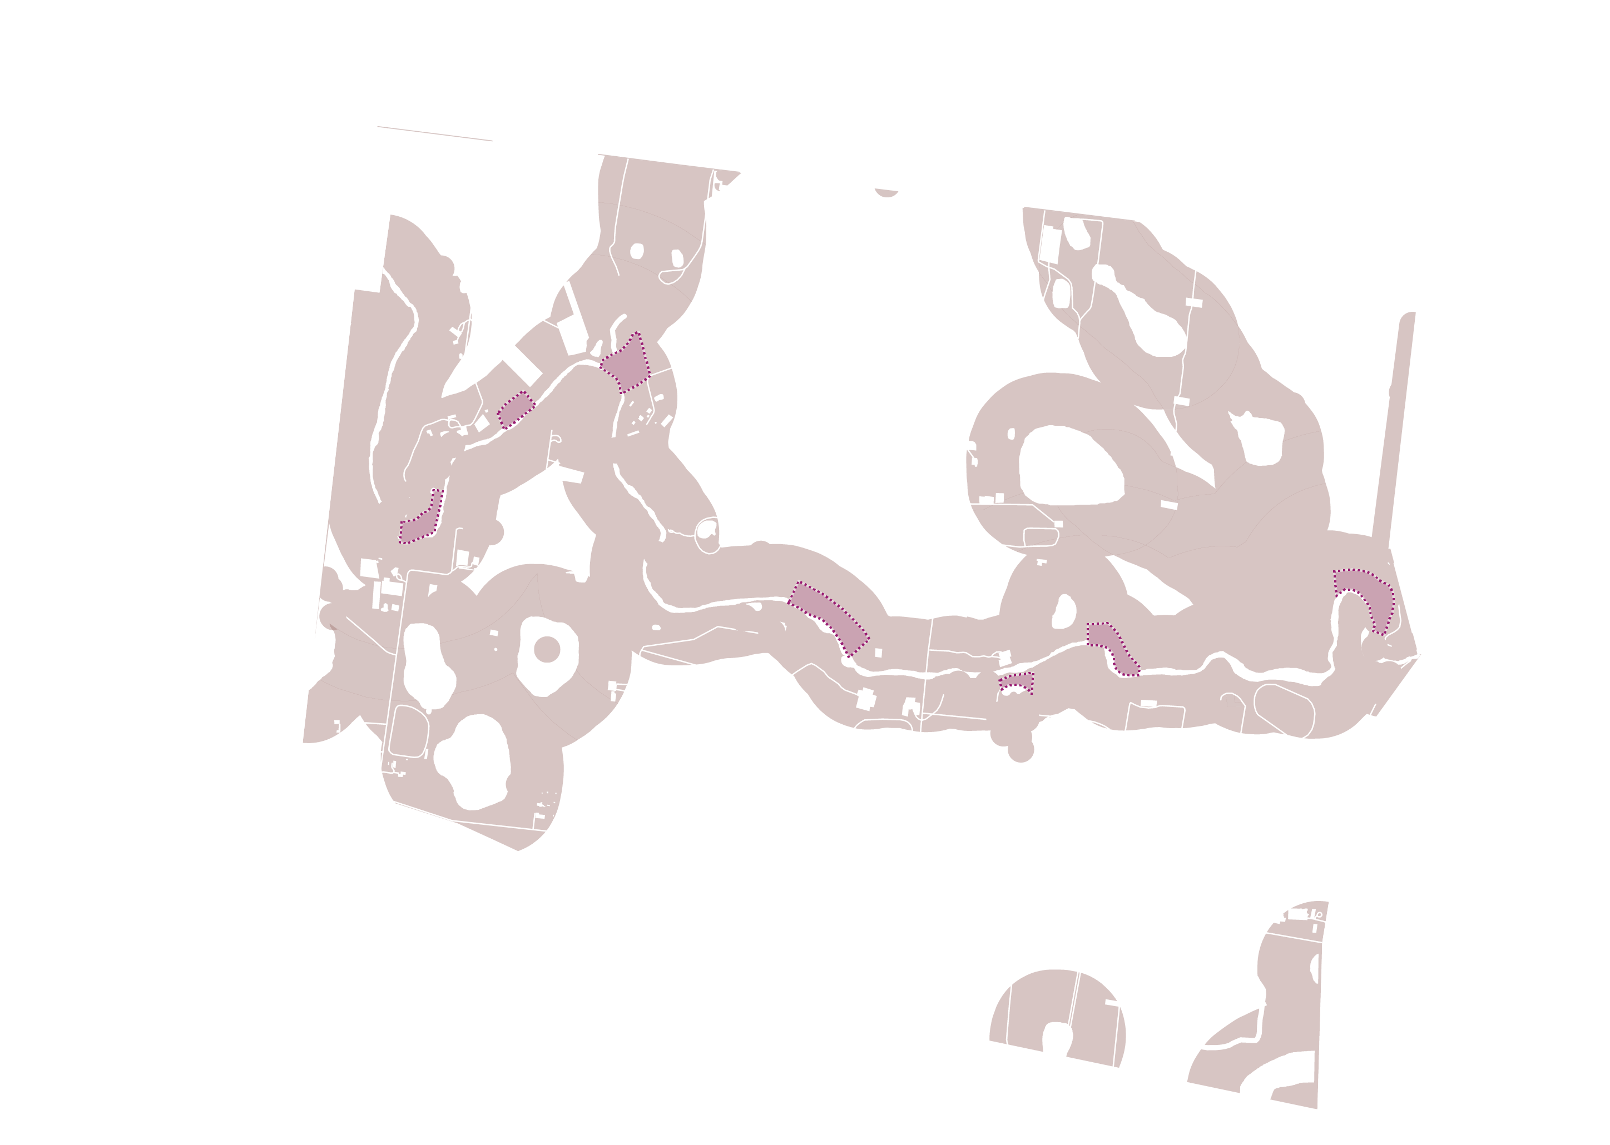
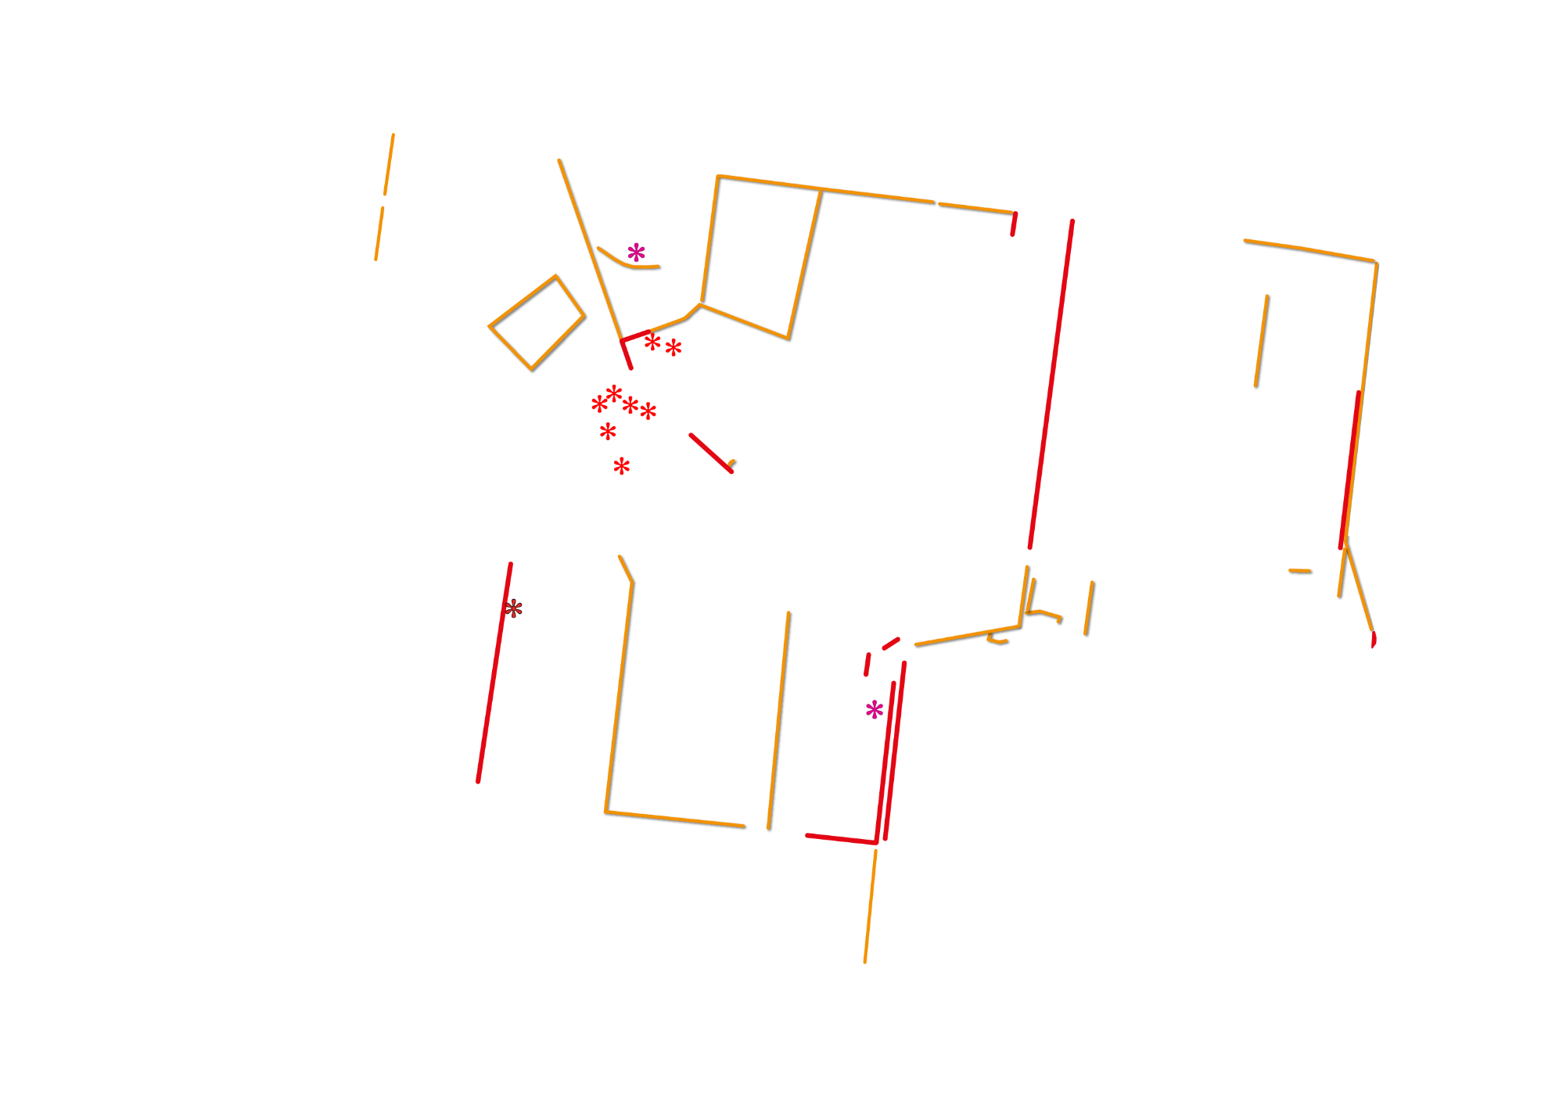
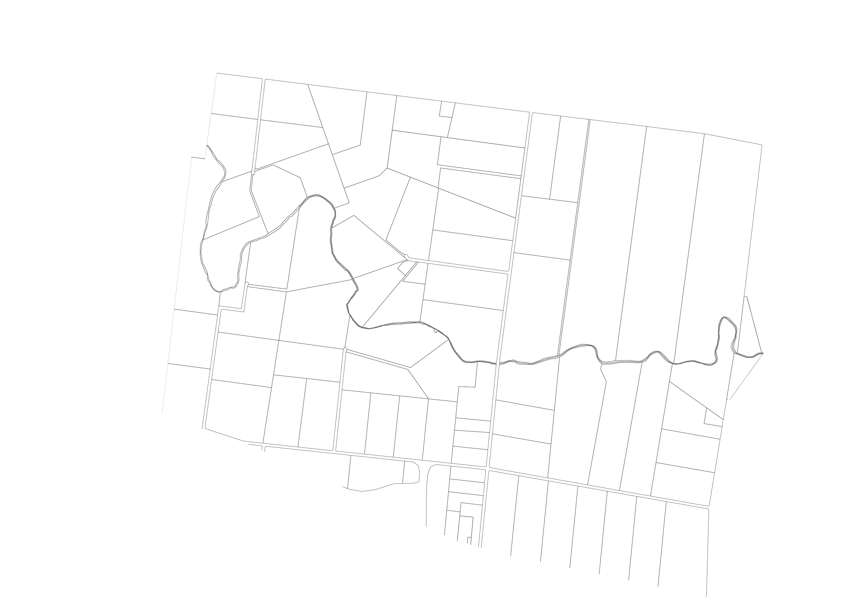
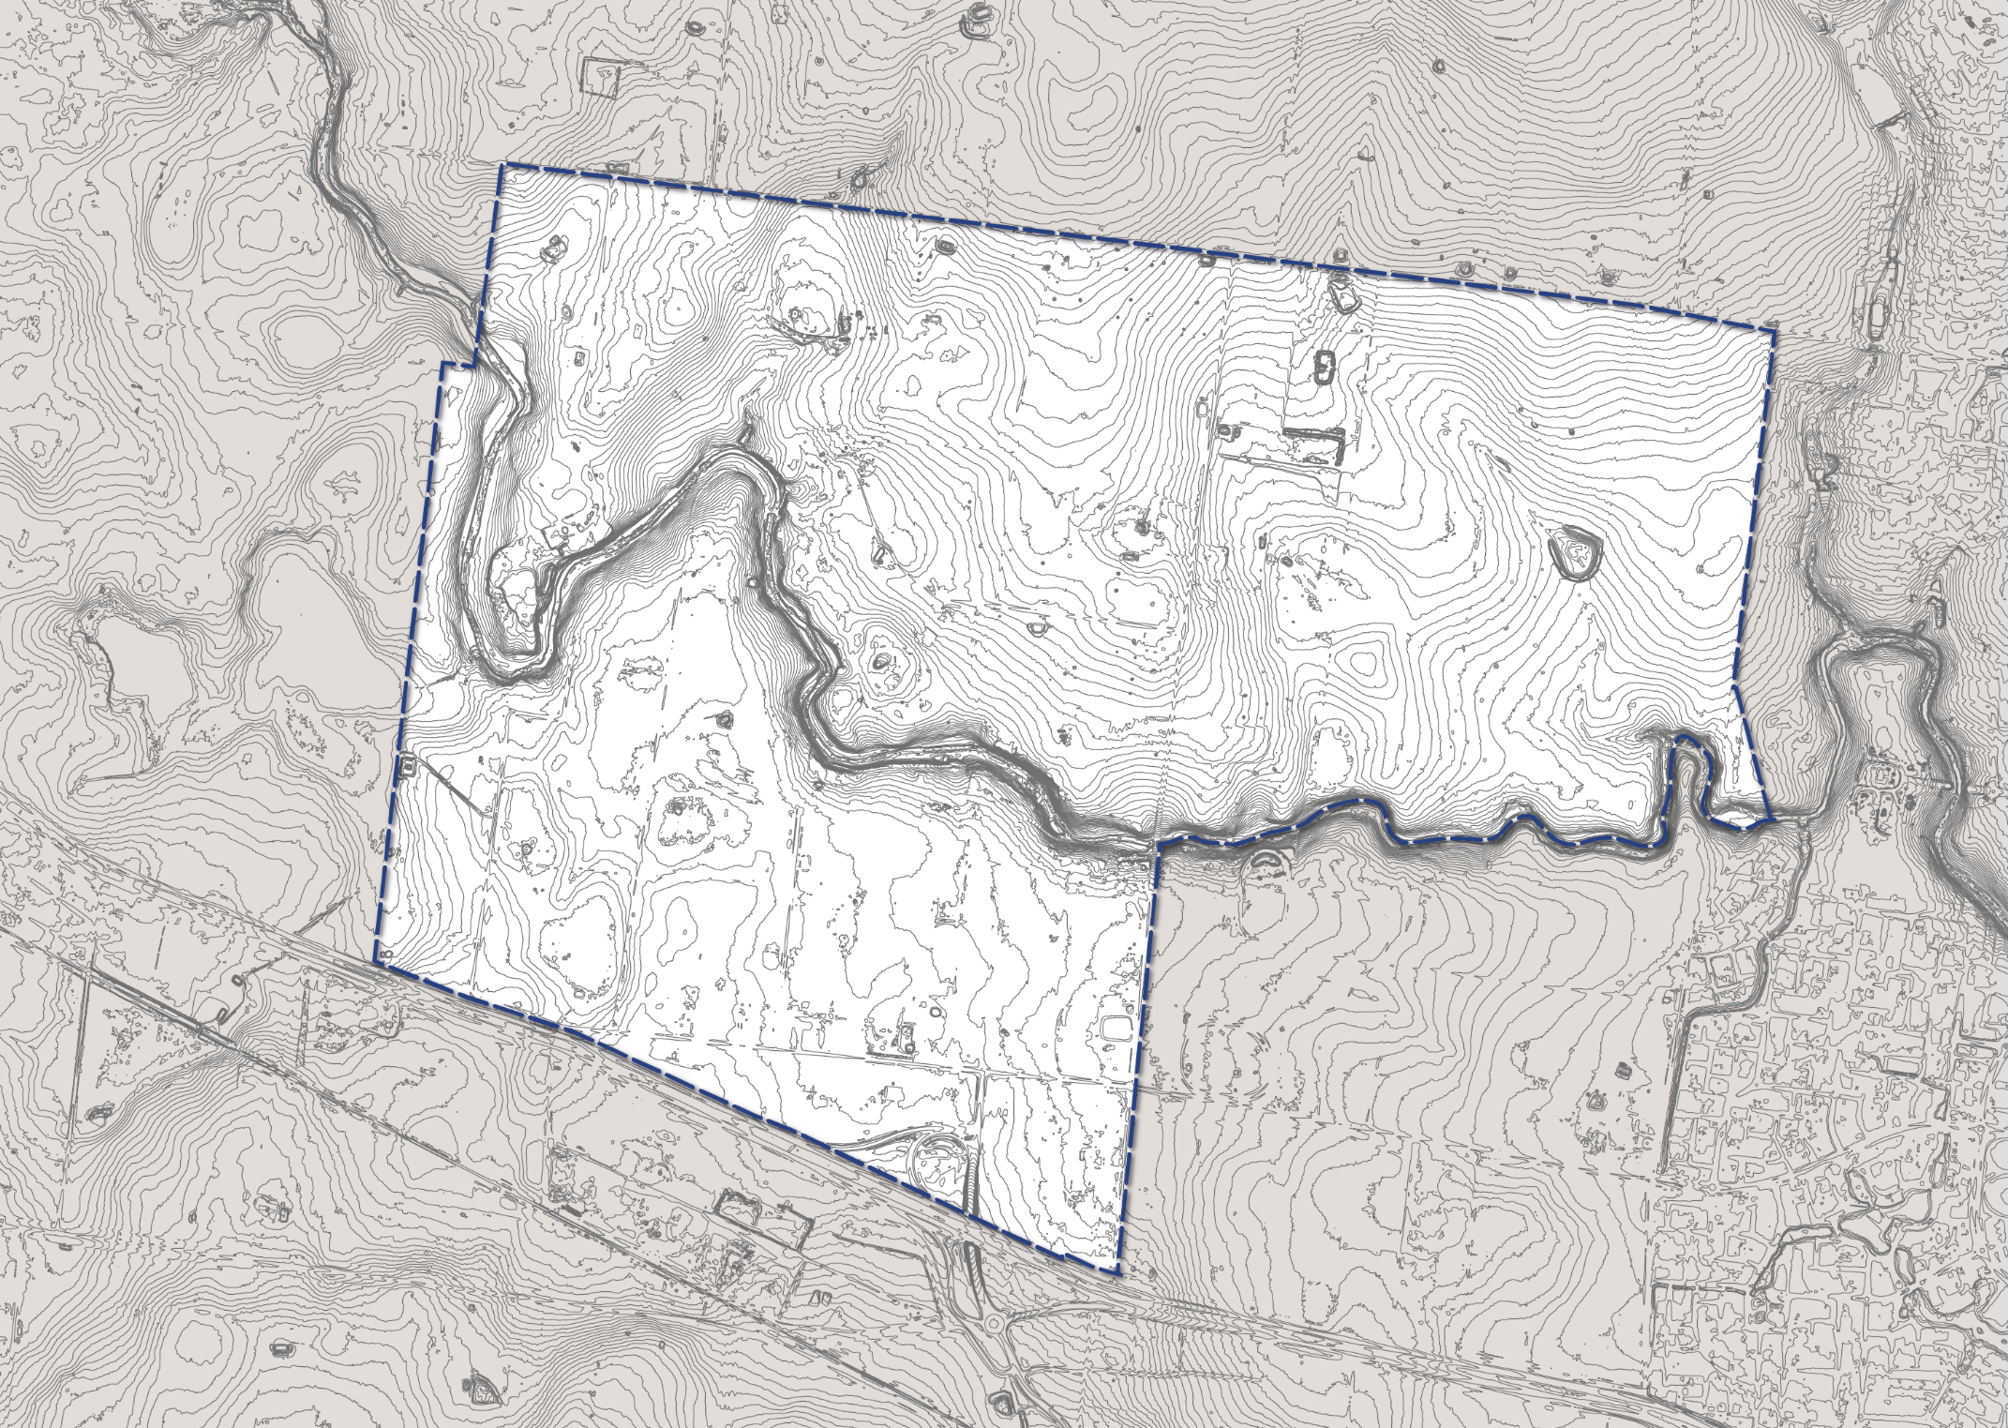
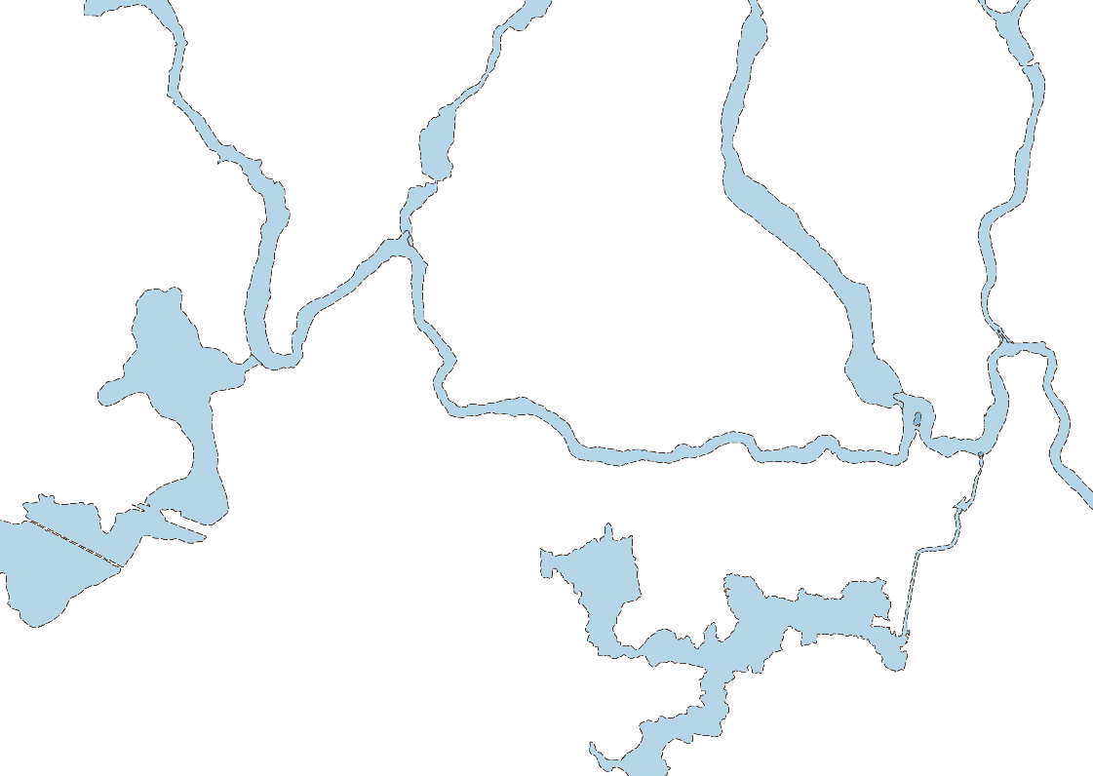
Precinct boundary, contours, and surrounding area
A rich environment and cultural history – Kororoit ( Part 1 )
Areas of Aboriginal cultural heritage sensitivity and landscape values
Cadastre
Dry stone walls, local & state heritage
1 in 100 year flood protection
Conservation areas (Growling Grass Frog & Seasonal Herbaceous Wetlands)
Notes:
Important to remember that the growth areas are not a blank canvas.
We undertake background technical reports to understand the place, so that the design of the PSP can respond to the unique aspects of the place.
Aboriginal heritage significance:
Areas in darker purple indicate rocky basalt outcrops along the creek identified as potentially important for local story-telling through site visit with local Aboriginal representatives (no single Registered Aboriginal Party for these PSPs at present).
These areas were therefore important to avoid locating bridge crossings, which the PSPs did avoid.
Post-contact heritage:
Lines on the plan indicate dry stone walls, which are prevalent in this area. Farmers/ squatters in the early days cleared the rocky land and used the rocks to make dry stone walls, which are now a place-making local feature so the PSP seeks to conserve these wherever possible.
Asterisks on the plan show heritage places – most significant (on Victoria Heritage Register) is the Deanside homestead complex. MPA worked with Heritage Victoria in consultation with Council and the landowne, to update the statement of significance and extent of registration for this site.

Slide 16
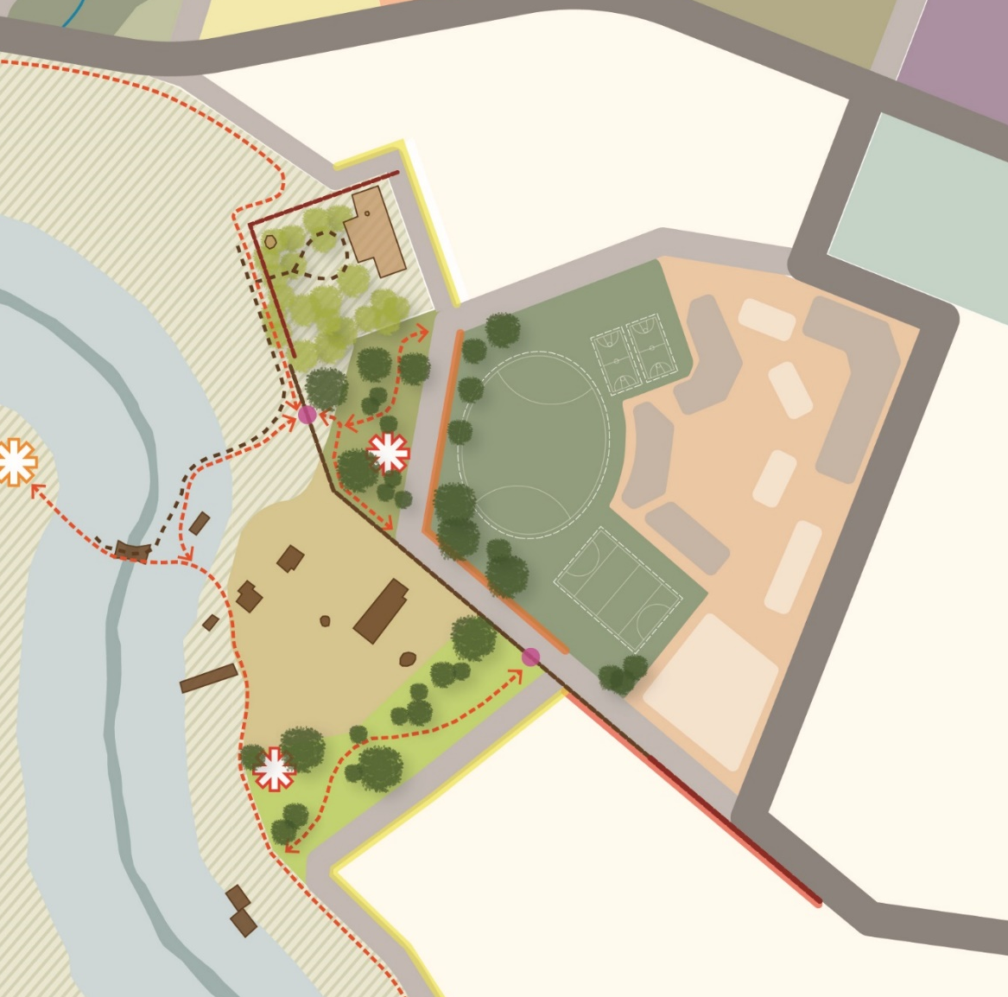
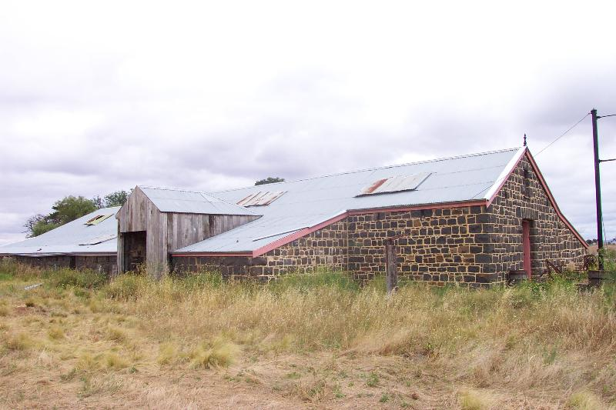
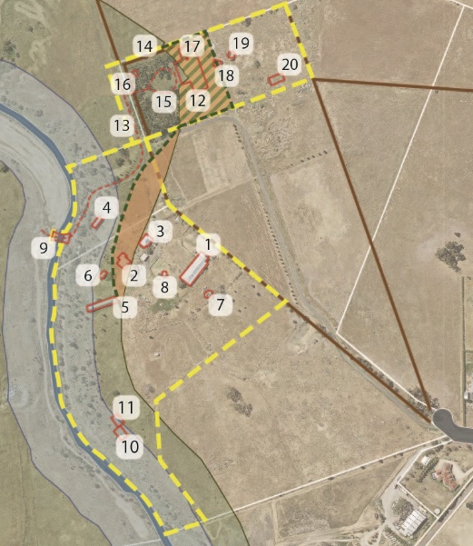
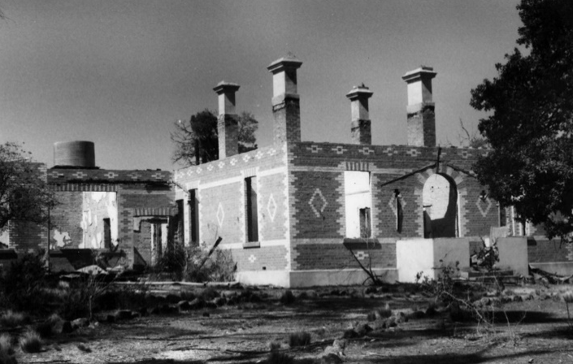
Deanside Homestead Complex
Ruin
Park
School
Historic ford of
creek
Historic buildings
Notes:
The PSP includes a concept plan and design principles relating to development surrounding the Deanside homestead complex heritage site.
The PSP also seeks to make the complex more visible to the public, to help the growing community understand the significance of this place to the European history of the area, while maintaining sense of space around it through locating school and local parks adjacent.

Slide 17
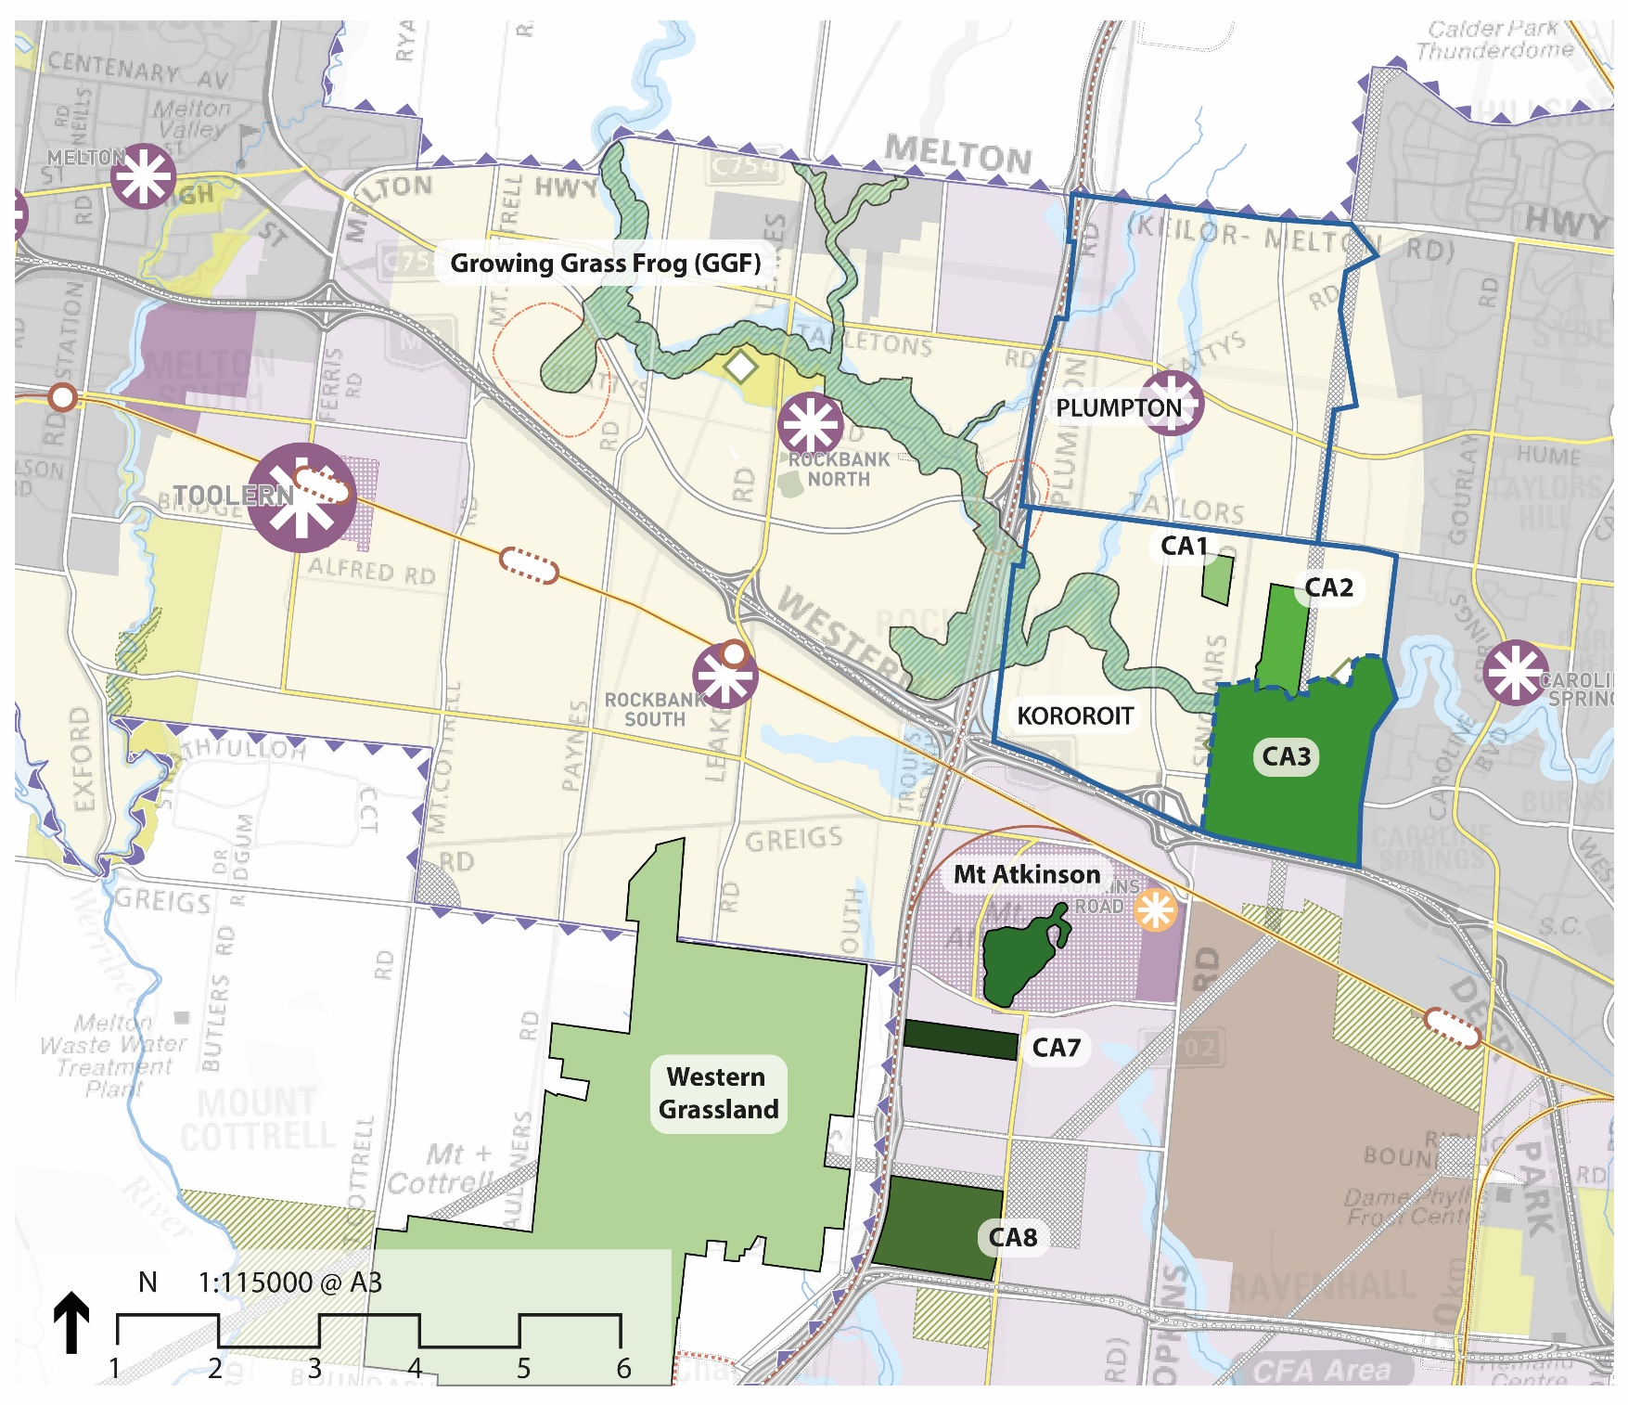
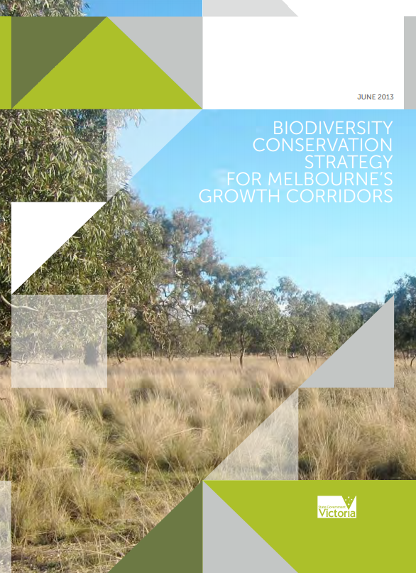
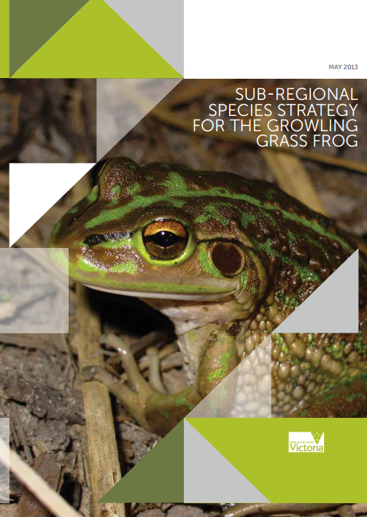
West GCP - Nature Conservation Areas
BCS, 2013
Sub Regional Species Strategy, 2013
Notes:
As mentioned earlier, the West Growth Corridor Plan (2012) set high level planning in biodiversity conservation, transport, and land use.
(This plan is an excerpt of the West GCP)
In terms of biodiversity conservation, the Biodiversity Conservation Strategy for Melbourne’s Growth Corridors undertook ‘time stamping’ of native vegetation to identify areas of highest quality for conservation – while the rest of the developable part of the PSP area can remove native vegetation and pay habitat offset fees.
Fees go towards purchase of nature conservation areas, such as Conservation Areas 1 and 2 in Kororoit PSP – and part of the proposed Kororoit Regional Park and the Western Grasslands Reserve.

Slide 18
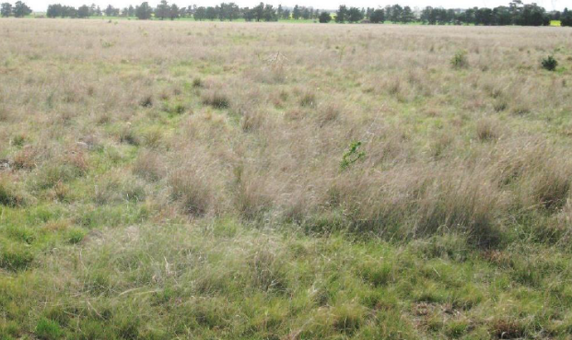
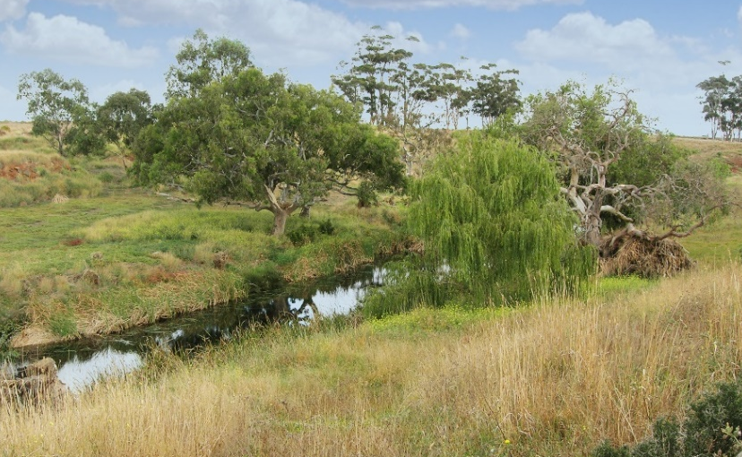
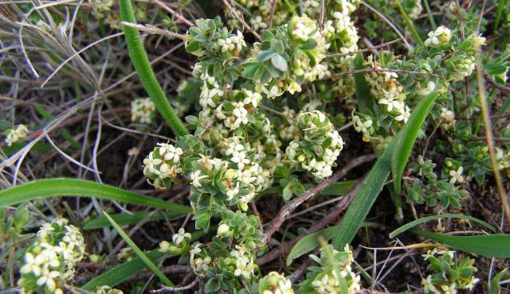
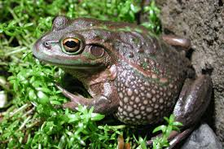
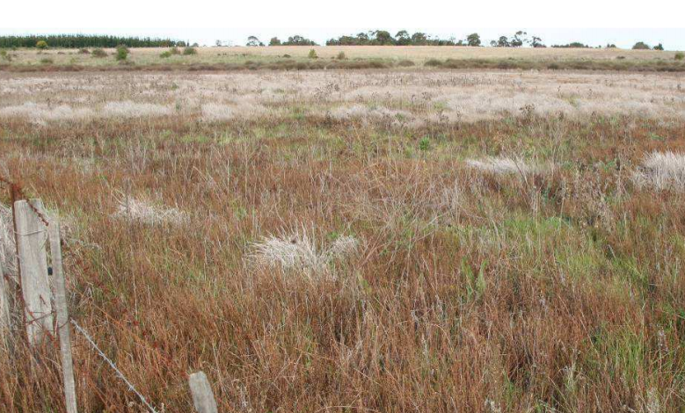
Endangered species + habitat in Kororoit
Herb-rich grassland
Spiny rice-flower
Kororoit creek habitat
Growling grass frog
Seasonal herbaceous wetland
Notes:
These are what we are protecting and enhancing in Kororoit.

Slide 19
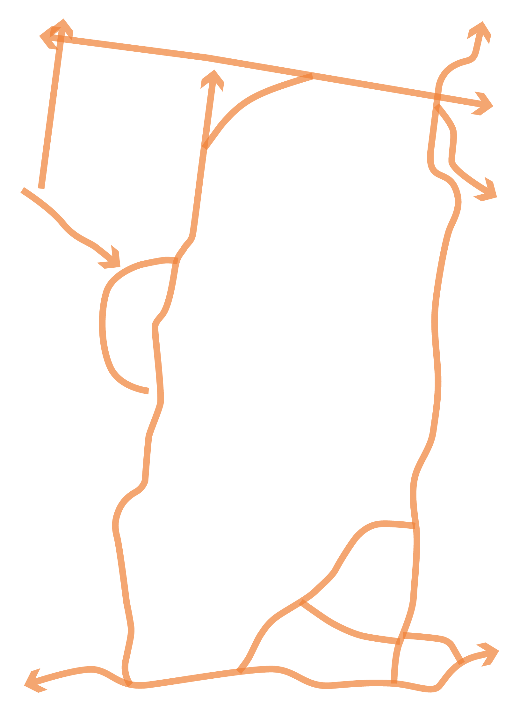
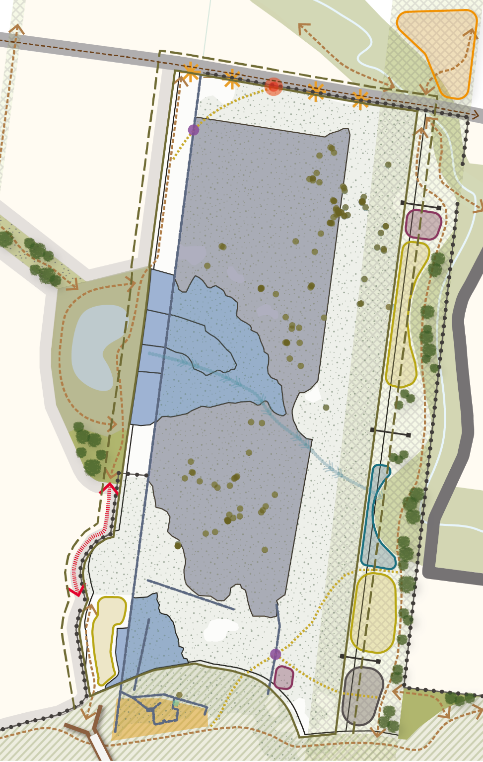
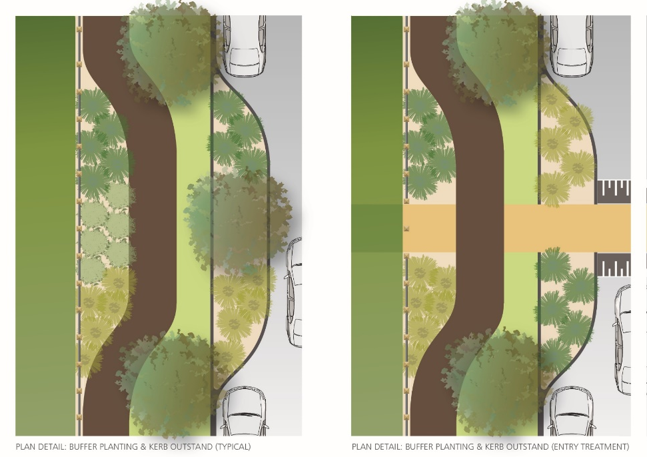
Conservation area concept plan + detail
Rare grassland
Footpaths
Herbaceous wetland
Grassland
Spiny rice flower survey records
Viewing /
Seating area
Notes:
The PSP seeks to ensure that these Conservation Areas become well-loved by the growing residential communities – not seen as fenced off sites which are unattractive and which just collect rubbish.
So we have undertaken a pilot design project to encourage well-directed access into these significant areas, to encourage appreciation of the eco systems, using principles adapted from the Start with the Grasslands – Design guidelines to support native grasslands (A. Marshall 2013)
This involved input from and collaboration with staff from Victorian National Parks Association, Melton council, Parks Vic, DELWP – with the aim being to improve conservation outcomes through encouraging appreciation of these grasslands.

Slide 20
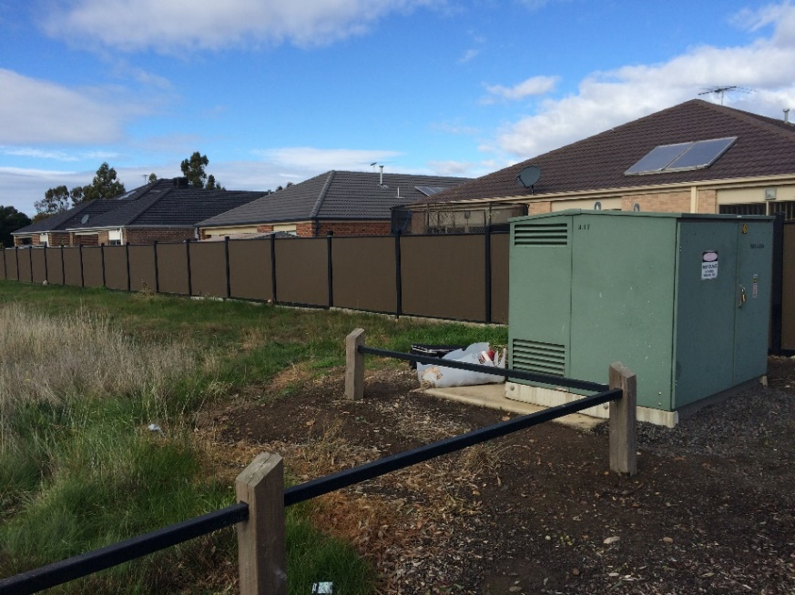
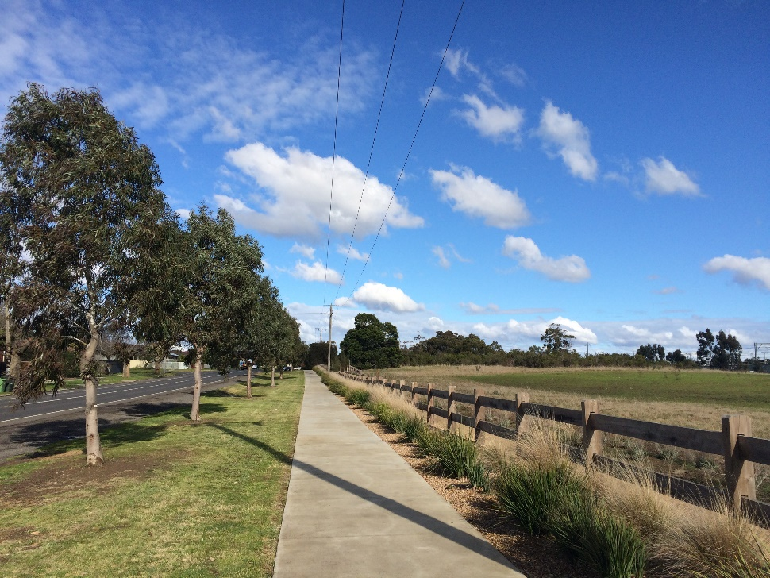
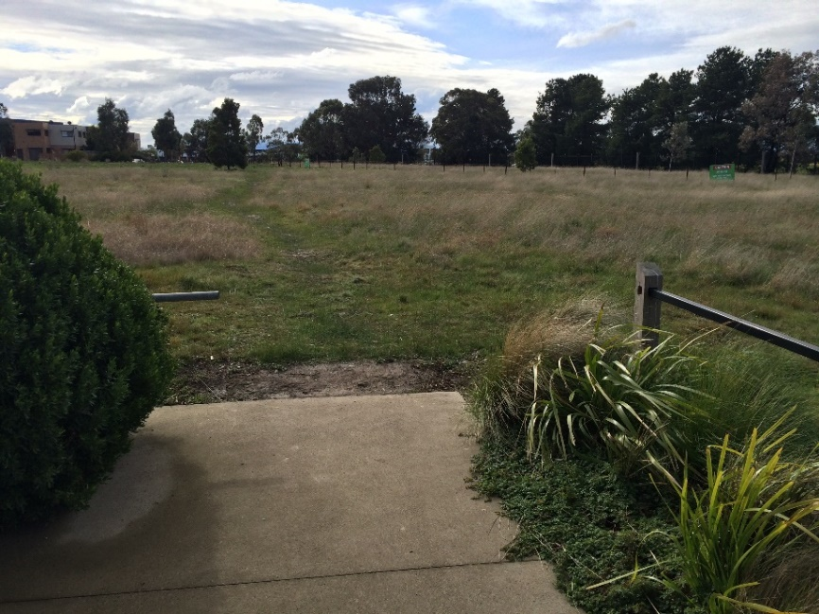
Examples of grassland areas
Poor outcomes
Successful example
Evans St grassland - Sunbury
Notes:
The ‘good example’ has:
a formal path adjacent to the conservation area,
attractively planted edges (stops rubbish entering grassland and makes area look well cared for and attractive),
a low impact path within the conservation area
Signage explaining the features of the grasslands
A Friends group to care for it.
The ‘bad example’ has:
Rear fences adjacent to grassland
No path through grassland conservation area, so goat tracks have developed informally along pedestrian ‘desire lines’, leading to more paths and hence potentially more damage to area

Slide 21
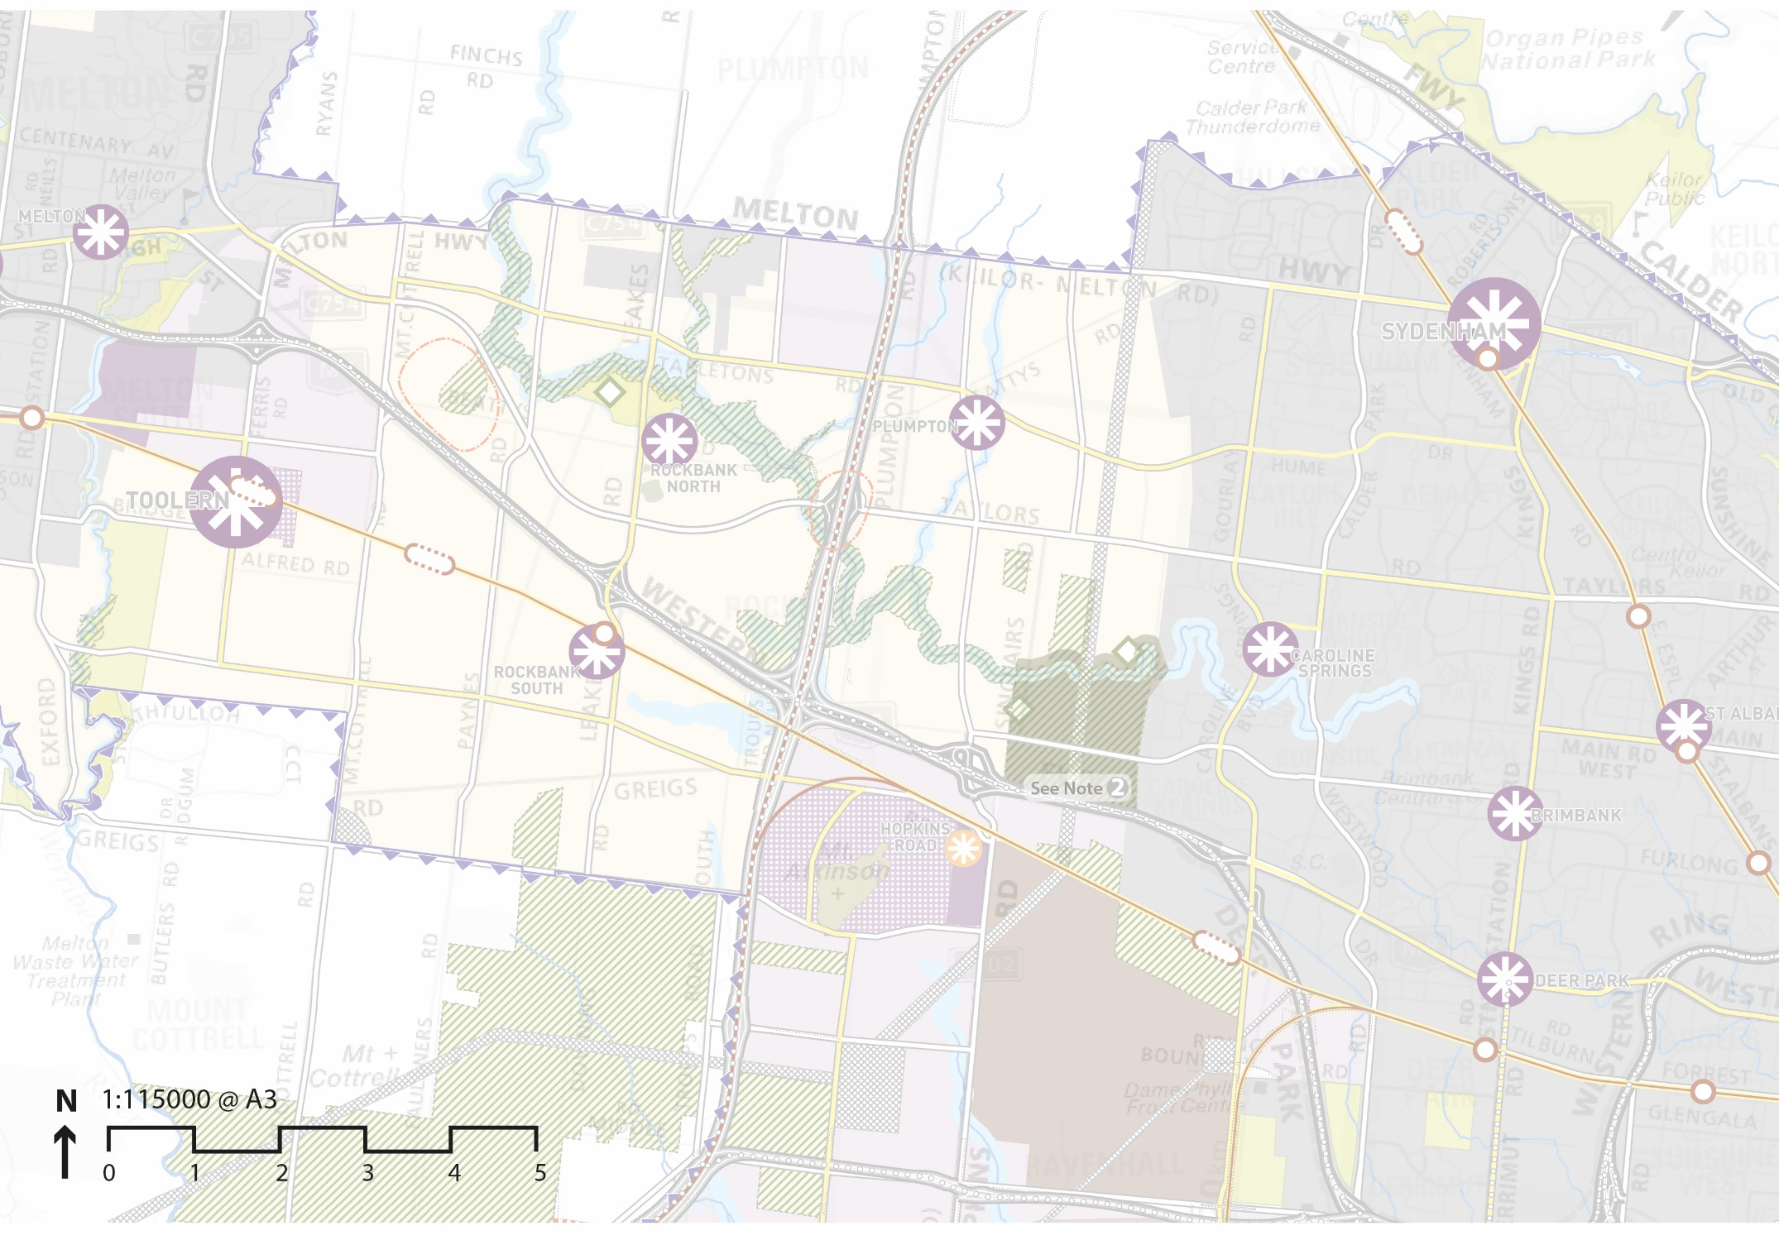
Transport – Growth corridor network
Notes:
The high-level Transport network was also largely developed through the WGCP.
Rail network – duplication then electrification is single biggest priority for this growth corridor (funded through recent State Budget).
New Caroline Springs station opening soon;
partial upgrade to existing Rockbank station planned;
future station location identified at Mt Atkinson.
Arterial network:
Melton Highway and Western Freeway existing
Arterial roads will carry bus network
Future OMR (road and rail)
This area will eventually be extremely well serviced by transport.

Slide 22

Transport – Growth corridor network
Rail lines and Stations
Notes:
The high-level Transport network was also largely developed through the WGCP.
Rail network – duplication then electrification is single biggest priority for this growth corridor (funded through recent State Budget).
New Caroline Springs station opening soon;
partial upgrade to existing Rockbank station planned;
future station location identified at Mt Atkinson.
Arterial network:
Melton Highway and Western Freeway existing
Arterial roads will carry bus network
Future OMR (road and rail)
This area will eventually be extremely well serviced by transport.

Slide 23

Transport – Growth corridor network
Western Freeway and Melton Highway
Notes:
The high-level Transport network was also largely developed through the WGCP.
Rail network – duplication then electrification is single biggest priority for this growth corridor (funded through recent State Budget).
New Caroline Springs station opening soon;
partial upgrade to existing Rockbank station planned;
future station location identified at Mt Atkinson.
Arterial network:
Melton Highway and Western Freeway existing
Arterial roads will carry bus network
Future OMR (road and rail)
This area will eventually be extremely well serviced by transport.

Slide 24

Transport – Growth corridor network
Principal Public Transport Network and Key Bus Routes
Notes:
The high-level Transport network was also largely developed through the WGCP.
Rail network – duplication then electrification is single biggest priority for this growth corridor (funded through recent State Budget).
New Caroline Springs station opening soon;
partial upgrade to existing Rockbank station planned;
future station location identified at Mt Atkinson.
Arterial network:
Melton Highway and Western Freeway existing
Arterial roads will carry bus network
Future OMR (road and rail)
This area will eventually be extremely well serviced by transport.

Slide 25

Transport – Growth corridor network
Outer Metro Ring (Road and Rail)
Notes:
The high-level Transport network was also largely developed through the WGCP.
Rail network – duplication then electrification is single biggest priority for this growth corridor (funded through recent State Budget).
New Caroline Springs station opening soon;
partial upgrade to existing Rockbank station planned;
future station location identified at Mt Atkinson.
Arterial network:
Melton Highway and Western Freeway existing
Arterial roads will carry bus network
Future OMR (road and rail)
This area will eventually be extremely well serviced by transport.

Slide 26

Transport – local public transport network
Notes:
PSP then went further into detail below the WGCP –
Developed a road network suitable to support future bus networks.
‘connector roads’ and ‘arterial roads’ are designed of suitable width and capacity to take buses.
Network is rolled out later, as development occurs and patronage grows
Possible routes shown on this plan

Slide 27



Transport – Plumpton local network
Notes:
The bicycle network and pedestrian paths are planned to be an integrated network, illustrated on the Shared Path Plan in the PSP (included on this slide)
Off road bike paths are delivered through the PSP:
on both sides of arterials (as per cross section on slide)
On one side of connector roads (as per cross section on slide)
along waterways and easements
Other local streets (not shown in the PSP as they are designed as part of the subdivision process) have reduced speeds and therefore safely support bikes on road.
Pedestrian network is delivered through the PSP requiring footpaths along all streets and providing pedestrian and full traffic signals at key locations along the network (refer Shared Path Plan in the PSP).

Slide 28
Town Centres
Town Centres play a critical community building role in new communities
They need to be attractive for businesses to invest in and for people to visit, work, learn play and live in as well
The MPA has undertaken research on the evolution of Town Centres across Metropolitan Melbourne and reviewed recently built centres
We’ve applied this to our Town Centre Principles and Design Guidelines

Slide 29

Local Town Centres – the goal
To create well designed, viable and vibrant mixed use major and local town centres as the community and business focal point, social heart and economic core of the suburbs they serve.
Notes:
Important to have all land uses shown in diagram connecting in to LTCs, and with sufficient residential development close to and adjacent LTC to deliver a walking catchment to the shops/ services in the LTC for a successful and vibrant LTC.

Slide 30
10 Key Principles
Through the planning and design process the MPA developed 10 key principles for the location, design and development of Local Town Centres which are:
Local Town Centre as a focus of the community (~1 per sq mile on the established grid system)
Connector street intersection
Walkable catchment (80-90% within 1 km)
Full range of local services
Public space as the heart
Local employment and service opportunities
Range of housing options
Pedestrian friendly and accessible
Sense of place
Localisation, sustainability and adaptability

Slide 31

PSPs in smaller neighbourhood units
Notes:
Where will people shop, access private and community services, and schools?
In terms of the design of the Future Urban Structure for Plumpton and Kororoit, we thought of the places as a series of smaller neighbourhoods, illustrated in this slide, each focussed on a community hub.
Each n’hood 7,000 – 10,000 people.
Total = 19,000 dwellings; 52,000 people.
Focused around a school; also typically a Council community facility (typically including maternal and child health, meeting rooms, early learning, but with flexibility to adapt to future council needs); sometimes with higher order library, planned activity groups for older people; youth services.
Also sports reserve (Melton prefers a 6 and 10 Ha model to suit rectangular and ovals respectively) -
And local shops/ businesses (either LTC or smaller ‘local convenience centre’)

Slide 32

Plumpton neighbourhood at increased scale
Notes:
Looking at a single ‘neighbourhood’:
walking distance for main catchment is 5 – 10 mins to the LTC and community hub

Slide 33
Plumpton local town centre
Notes:
PSP developed concept plans (indicative, not prescriptive to developers) which adopt the LTC principles and respond to the characteristics of the location - in this case, responding to the future waterway and existing road adjacent. Features:
Main street;
Small local enterprises
Existing street
School, council community facilities.
(refer PSP for more detail)

Slide 34

Future Urban Structure Plan - Plumpton
10,600 dwellings
29,800 residents
Notes:
The neighbourhoods are then all brought together in the Future Urban Structure plan which responds to the conditions of the particular place.
Plumpton’s FUS plan (Plan 3 in PSP) is structured around:
the Beattys Road erstwhile goldfields route as the major ordering device,
topography and waterways,
linear open space connections including powerlines and gas easements (and associated land use restrictions),
designing to create neighbourhoods.

Slide 35

Future Urban Structure Plan - Kororoit
9,200 dwellings
25,800 residents
Notes:
In Kororoit the plan is structured around:
Kororoit Creek
existing roads/ Freeway
Deanside homestead complex
Nature conservation areas
Then all brought together in the Future urban structure plan, structure round linear open space connections, topography and waterways., and neighbourhood principles

Slide 36



Where will people work?
Land Use
Town Centres (community services, retail, other)
Industry/business
Business/mixed use/small enterprises
Home-based businesses
Total
Jobs
8,100
13,100
10,800
1,300
33,300
Alamanda Adelphi street view
Source: Becon Constructions 2016
Caroline Springs town centre
Town centres and local convenience
Notes:
West GCP identified key employment and activity centre locations well serviced by public transport.
PSP refined these locations.
Plan on this slide includes Mt Atkinson and Tarneit Plains PSP, currently being prepared
Over 33,000 jobs across the three PSPs - ie more than 1 job/ dwelling.
These will also provide opportunities for existing Caroline Springs residents.
Jobs will be in a range of locations across the PSPs, and range in type of job as shown in this series of slides –
Town centres and local convenience centres

Slide 37



Where will people work?
Land Use
Town Centres (community services, retail, other)
Industry/business
Business/mixed use/small enterprises
Home-based businesses
Total
Jobs
8,100
13,100
10,800
1,300
33,300
Meridian business park compact warehouse
street front, Thomastown
Logis Eco Industrial Park, Dandenong
Industrial areas
Notes:
Jobs in industrial locations shown on this slide.
Larger format likely in south adjacent growing western industrial precinct.
Smaller / local format likely in smaller areas around rail and in Plumpton.
Photos illustrate:
Warehouse to residential interface – eg the Meridien business park in Thomastown – small offices, compact warehouse, and slightly larger warehouses behind –
factoryettes 122 – 175 sqm ; front street aceess, rear loading; offices 150 sqm.

Slide 38




Where will people work?
Land Use
Town Centres (community services, retail, other)
Industry/business
Business/mixed use/small enterprises
Home-based businesses
Total
Jobs
8,100
13,100
10,800
1,300
33,300
Uni Hill café and office, Bundoora
Meridian Heyington Avenue, Thomastown
Meridian Heyington Avenue, Thomastown
Business and Small Enterprises
Notes:
Small local enterprises adjacent local town centres – which may struggle to find space in LTCs – we are zoning to encourage lower rents.
Uses can include:
Gyms, martial arts studios
Equipment repairs and service for items such as lawnmowers, tools etc
Private play centres;
Squash and other courts
Printers
Crafts centres
Storage
Automotive repairs and service/garages
Studio/workshops
Veterinary Clinics

Slide 39

Where will people work?
Land Use
Town Centres (community services, retail, other)
Industry/business
Business/mixed use/small enterprises
Home-based businesses
Total
Jobs
8,100
13,100
10,800
1,300
33,300
Working from home
Notes:
… or working from home opportunities.
Based on existing trends we assume an average of around 5% of homes will have someone working from home.

Slide 40

Where will people work?
Land Use
Town Centres (community services, retail, other)
Industry/business
Business/mixed use/small enterprises
Home-based businesses
Total
Jobs
8,100
13,100
10,800
1,300
33,300
Mixed Use
Notes:
… or working from home opportunities.
Based on existing trends we assume an average of around 5% of homes will have someone working from home.

Slide 41

Plumpton housing density plan
Housing types
LOCALITY | TYPICAL LOT SIZE (estimate)
Doncaster East | 804m²
Glen Waverley | 668m²
Hawthorn | 608m²
Thornbury | 545m²
Northcote | 495m²
Plumpton + Kororoit | 425m²
Notes:
The PSP proposes a range of housing densities according to location:
Locations with high amenity and access to services, and public transport are encouraged for medium density
16.5 dph (dwellings per hectare) is conventional density in PSPs
25 dph medium
25+ dph higher
This is higher density than many existing middle ring suburbs of Melbourne.

Slide 42

Access to open space
Notes:
Access to open space a critical issue which PSP addresses.

Slide 43

Access to open space
Sports reserves and 1km catchment
Notes:
Sports reserves (ie with ovals or rectangular playing fields, hard courts) are designed to ensure 95% houses within 1km catchment.

Slide 44

Access to open space
Local parks / sports reserve 400m walking catchment
Notes:
Local park network designed to ensure 95% houses within 400m (short walk) of a local park (around 1 ha in size).

Slide 45


Access to open space
Potential walking trails
Notes:
Design of the open space network then allows us to build in opportunities for future walking trails to take in local features and link with pedestrian and traffic signals, bridges and culverts.

Slide 46



Access to open space
Taylors Hill West
Powerline easement concept plan and examples
Notes:
PSP makes the most of existing easements for power and gas (which are mostly undevelopable in residential areas)
Can be used for active recreation, stormwater management, landscaping.

Slide 47


Beattys Road concept plans + sections
Powerlines + shared path + active recreation + connector
Notes:
Beattys Road, one of the key ordering devices through Plumpton PSP
provides opportunities for a linear open space link punctuated by different activities along the way
This plan indicates future opportunity for a BMX track, a shared path along its length, and a connector street

Slide 48


Beattys Road concept plans + sections
Sports reserve + shared path + connector
Notes:
Beattys road in other locations within the PSP:
Partially used as land for a sports reserve and connector or local streets – elsewhere water management.
Houses will face Beattys Road throughout.

Slide 49


Existing infrastructure
Existing Roads
Cadastre
Kororoit Creek
Notes:
How will the vision for this place be delivered?
There are varying funding streams, and infrastructure/ services delivered over time.
This series of slides builds up the layers of infrastructure required for development of the area, and illustrates the funding source of each.
1. Existing infrastructure.

Slide 50


Management agreement/land transfer
Growling grass frog conservation area
Notes:
2. Management agreements secure land for GGF corridor, or transfer of land to the State.

Slide 51









Indicative infrastructure contributions plan works (subject to confirmation)
Arterials
Bridges
Culverts
Sport reserves
Local parks (land only)
Community centres
Library
Indoor recreation (land only)
Notes:
3. Infrastructure Contributions Plan works (paid by developers to local council as part of subdivision permit process).
This list is approximate as ICP guidance is still being developed (based on previous Development Contributions Plan system).

Slide 52





Developer Works
Connector roads
Local roads
Local parks
Easement landscaping
Notes:
3. Infrastructure Contributions Plan works (paid by developers to local council as part of subdivision permit process).
This list is approximate as ICP guidance is still being developed (based on previous Development Contributions Plan system).

Slide 53


Melbourne Water developer services
Storm water management
Notes:
3. Infrastructure Contributions Plan works (paid by developers to local council as part of subdivision permit process).
This list is approximate as ICP guidance is still being developed (based on previous Development Contributions Plan system).

Slide 54





State funds
Melton Highway upgrade
Hopkins Road interchange
Schools
Outer Metro Ring (OMR)
Bus services
Notes:
3. Infrastructure Contributions Plan works (paid by developers to local council as part of subdivision permit process).
This list is approximate as ICP guidance is still being developed (based on previous Development Contributions Plan system).

Slide 55



Other Council funds (+ possible government grants)
Aquatic centre (land + construction)
Indoor recreation (construction)
Notes:
3. Infrastructure Contributions Plan works (paid by developers to local council as part of subdivision permit process).
This list is approximate as ICP guidance is still being developed (based on previous Development Contributions Plan system).

Slide 56



Habitat compensation fees
Nature conservation area 1
Nature conservation area 2
Notes:
3. Infrastructure Contributions Plan works (paid by developers to local council as part of subdivision permit process).
This list is approximate as ICP guidance is still being developed (based on previous Development Contributions Plan system).

Slide 57


Other non-government funds
Non – government schools
Notes:
3. Infrastructure Contributions Plan works (paid by developers to local council as part of subdivision permit process).
This list is approximate as ICP guidance is still being developed (based on previous Development Contributions Plan system).

Slide 58
Total Infrastructure Costs: Plumpton + Kororoit PSPs
Total infrastructure costs
(indicative estimates)
Local (ICP fully covers) $385m
(incl. local park land, sports reserves, library, 1st stage arterial roads)
Council (non ICP-funded) $50m
(incl. aquatic centre land + construction, indoor rec construction)
State (GAIC partly covers) $345m
(incl. schools, final stage arterial roads, rail upgrade, nature conservation)
Developer construction $1,015 m
(incl. subdivision works, sewer, water, drainage)
Non-government $50m
(schools)
Total $1,845m
Total investment $10,150m
(Land + works incl. holding, financing and profit but excl. taxes and charges)

Slide 59


PSP development: a collaborative process over 2 ½ years
Aboriginal Victoria
Ambulance Victoria
Anglican Diocesan Schools Commission
APA GasNet Australia Group PTY LTD
APA Group
Ausnet Services
Australian Council for Islamic Education in Schools
Australian Council of Jewish Schools
Australian Energy Market Operator AEMO
Bicycle Network Victoria
Catholic Archdiocese of Melbourne
Catholic Education Office Melbourne
Christian Schools Australia
CitiPower and Powercor
City West Water
Country Fire Authority
Court Services Victoria
Department of Economic Development, Jobs, Transport and Resources
Department of Education and Training
Department of Environment, Land, Water and Planning
Department of Health and Human Services
Department of Justice and Regulation
Energy Safe Victoria Environmental Protection Authority (EPA)
Heart Foundation
Heritage Victoria
Independent Schools Victoria
Jemena
Melbourne Water
Metropolitan Fire Brigade
NBNCo Limited
Parks Victoria
Public Transport Victoria PTV
SP Ausnet
Sport and Recreation Victoria
State Emergency Service SES
Uniting Church of Australia
VicHealth
VicRoads
Victoria Police
Victorian Ecumenical System of Schools
VicTrack
Western Water
Notes:
The MPA’s closest relationship in PSP preparation is usually with the local council as they are the responsible authority for subdivision applications and therefore implement the PSP, together with developers and gov’t authorities.
Consultation afternoons/ evenings are held with local landowners;
workshops with developers regarding their specific site opportunities and constraints
Consultation as needed with state gov’t agencies, and more formally at ‘pre-exhibition’ stage.

Slide 60


Thank you
Thank you

