Slide 1

Post PSP Approvals Streamlining
Dean Rochfort
Post PSP Approvals Streamlining Manager, Victorian Planning Authority
October 2016

Slide 2
Post PSP Approvals Streamlining - Why?
Source: Improving Planning System productivity in the development of Melbourne’s Growth Areas, Stockland/Urban Enterprise 2015.

Slide 3
Post PSP Approvals Streamlining - Why?

Slide 4
Post PSP Approvals Streamlining - Aims
Maintain a strong pipeline of supply:
Melbourne at 8 million
15 year supply target
Support housing affordability
Tackle Victoria’s competitive disadvantage:
Melbourne’s Greenfields Post PSP approvals times
Benefits of faster approvals:
Direct savings to the developer per month, per lot of $3,359
20% reduction, 4.6 months, economic benefit of $798m

Slide 5
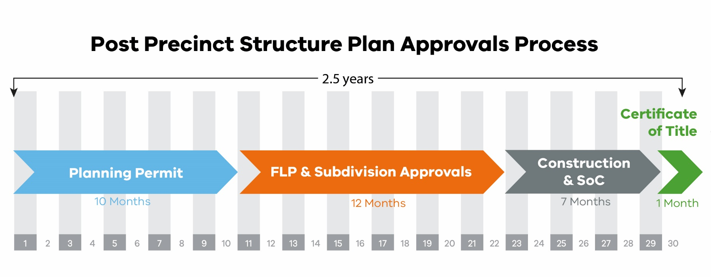
Post PSP Approvals Streamlining - What?
Primary Focus

Slide 6
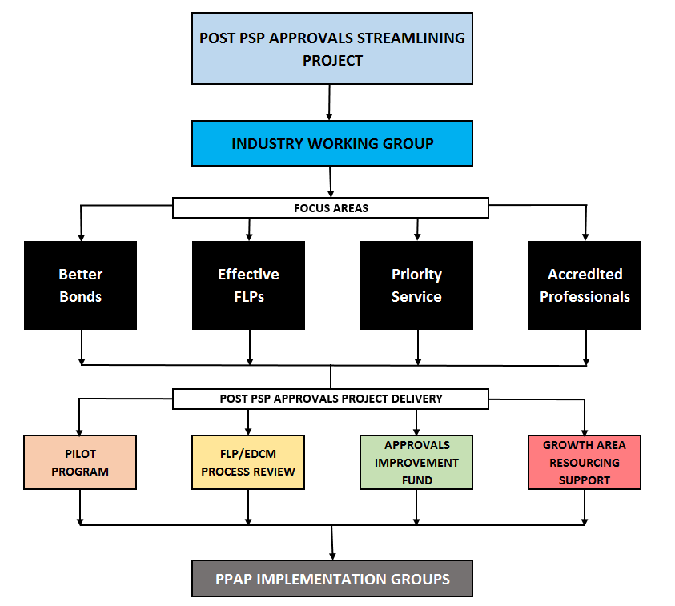
Post PSP Approvals Streamlining - How?
Collaboration

Slide 7
Post PSP Approvals Streamlining - How?
Short Term
Black log clearing support
Effective function layout plans
Medium Term
Process streamlining and improvement
Greater use of accredited consultants
Longer Term
Legislative
Regulatory
Bonding practice consistency
Council funding program
System integration between approvals participants
Technology
Priority resourcing models

Slide 8
Post PSP Approvals Streamlining
Questions?
Contact:
Dean Rochfort Post PSP Approvals Streamlining Manager Victorian Planning Authority T: 03 9651 9689 E: dean.rochfort@vpa.vic.gov.au

