Slide 1

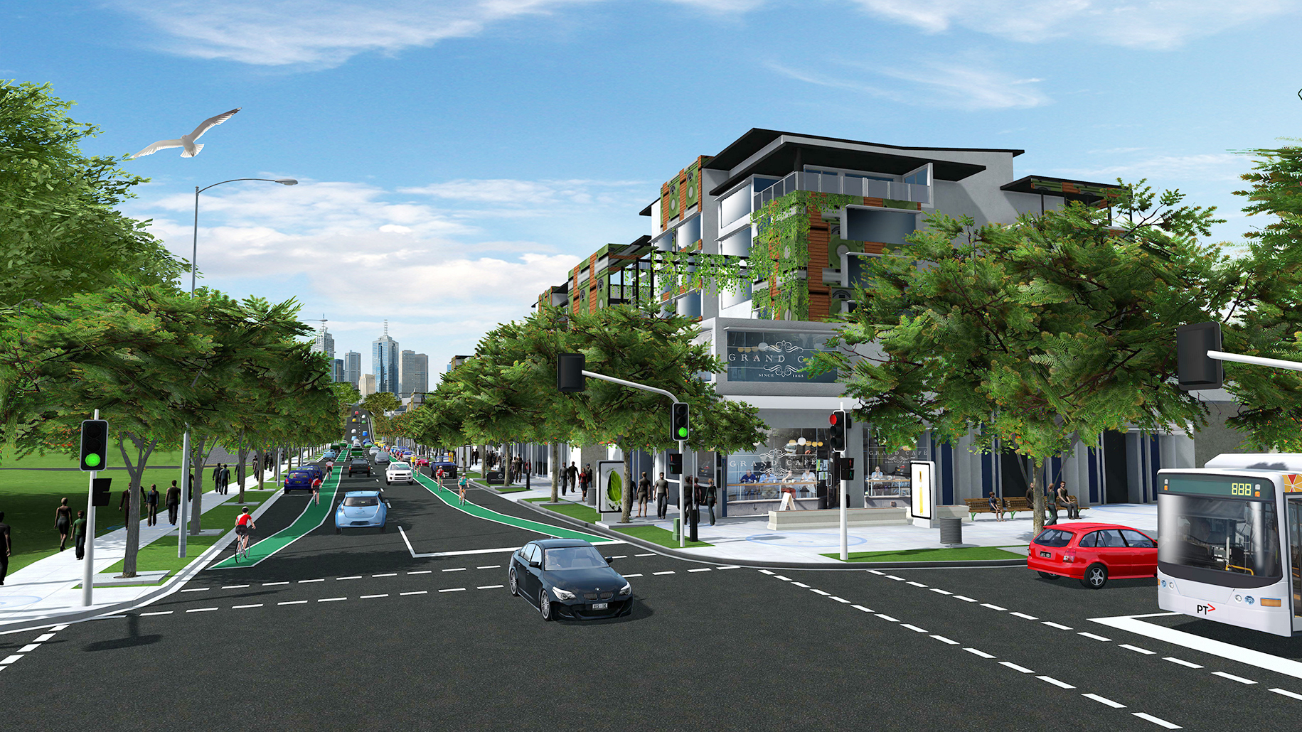
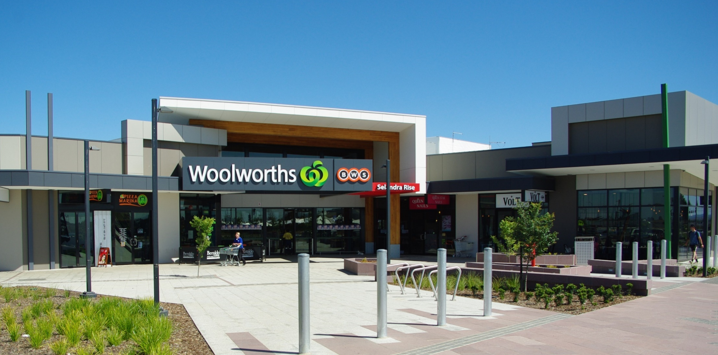
Planning ➔ Reality ➔ Cranbourne East
Paul Cassidy
Director Greenfields, Victorian Planning Authority
October 2016

Slide 2
The Cranbourne East PSP Assessment Project
“The best laid plans of mice and men often go awry”.
Robert Burns
So How Did We go…
Notes:
We know planning is vexed…

Slide 3
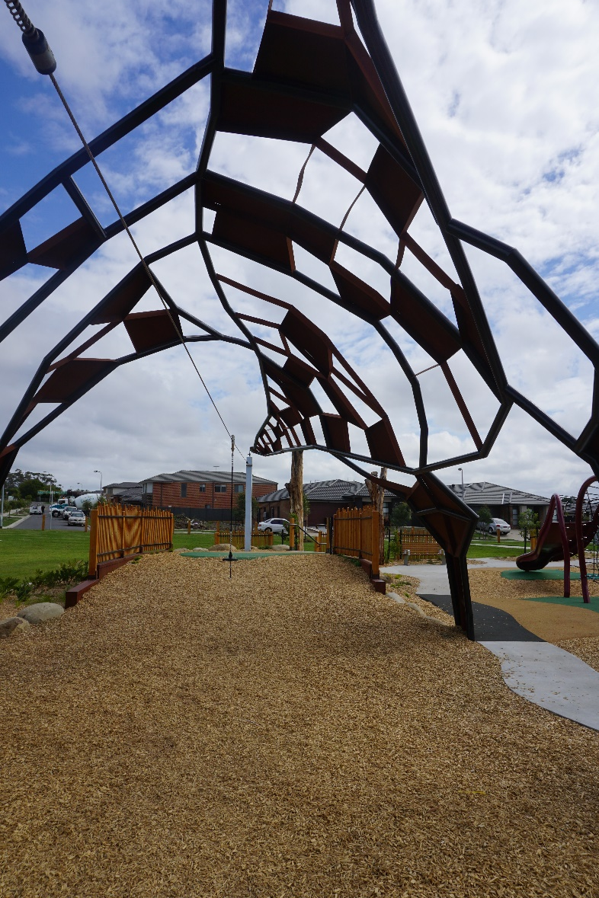
A Little Bit of Background
Approved May 2010.
Around 6,500 Projected Dwellings.
1st with GAA as Planning Authority.
PSP guidelines Principles applied.
Number of S96 (A) parallel subdivision permits.
Mandated recycled water.
Catalyst Developers.
  Stockland
  Peet
  Villawood
  GEO
  Devine
  Blue Hills Retirement

Slide 4
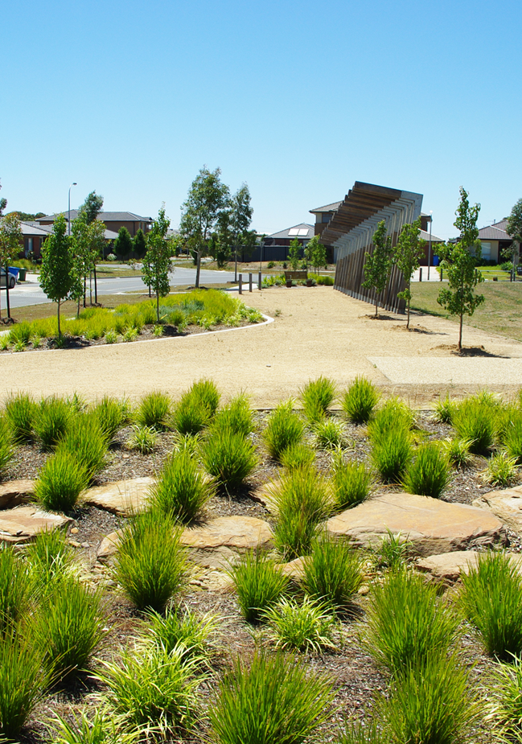
All About Learnings
What has worked.
What has not worked.
What planning Improvements would make a difference.
What Implementation Improvements could be made.

Slide 5
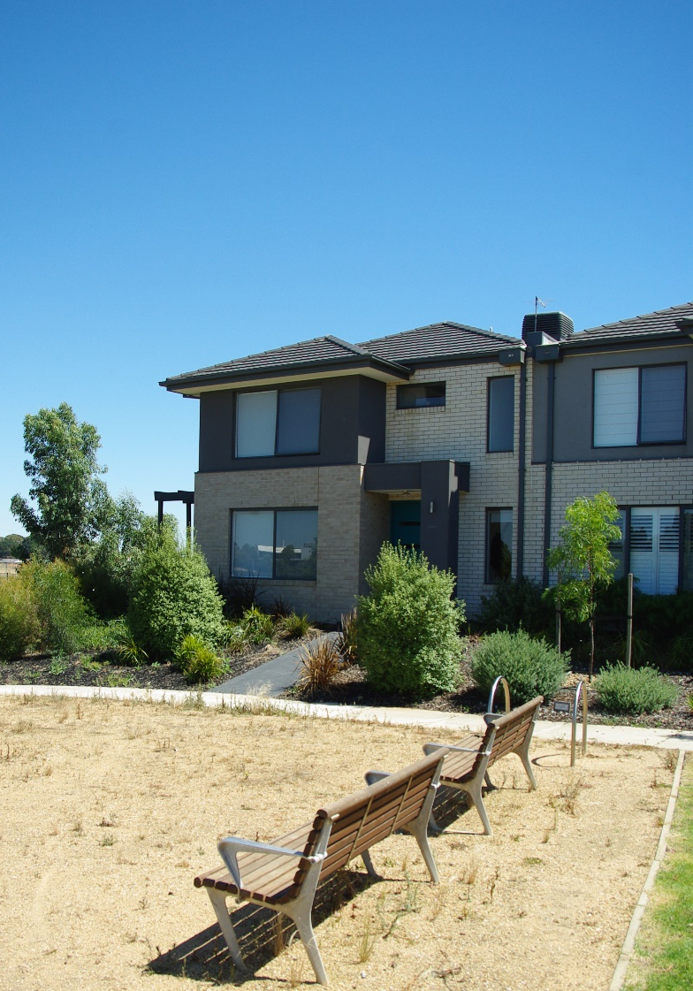
3 Key Work-Streams
Data and Mapping & Site Observations.
  Urban structure.
  Lot and housing types.
  Socio-economics.
Survey of views and observations of ‘Institutional Stakeholders’.
  Developers.
  State agencies (inclusive of VPA).
  Council.
Survey of Community.
  Demographics / socio-economics.
  Education.
  Transport.
  Housing Community.
  Retail / shopping habits.
Notes:
Hard to get ABS data for such small developing areas
Trialled use of VBA data for 1st time.

Slide 6
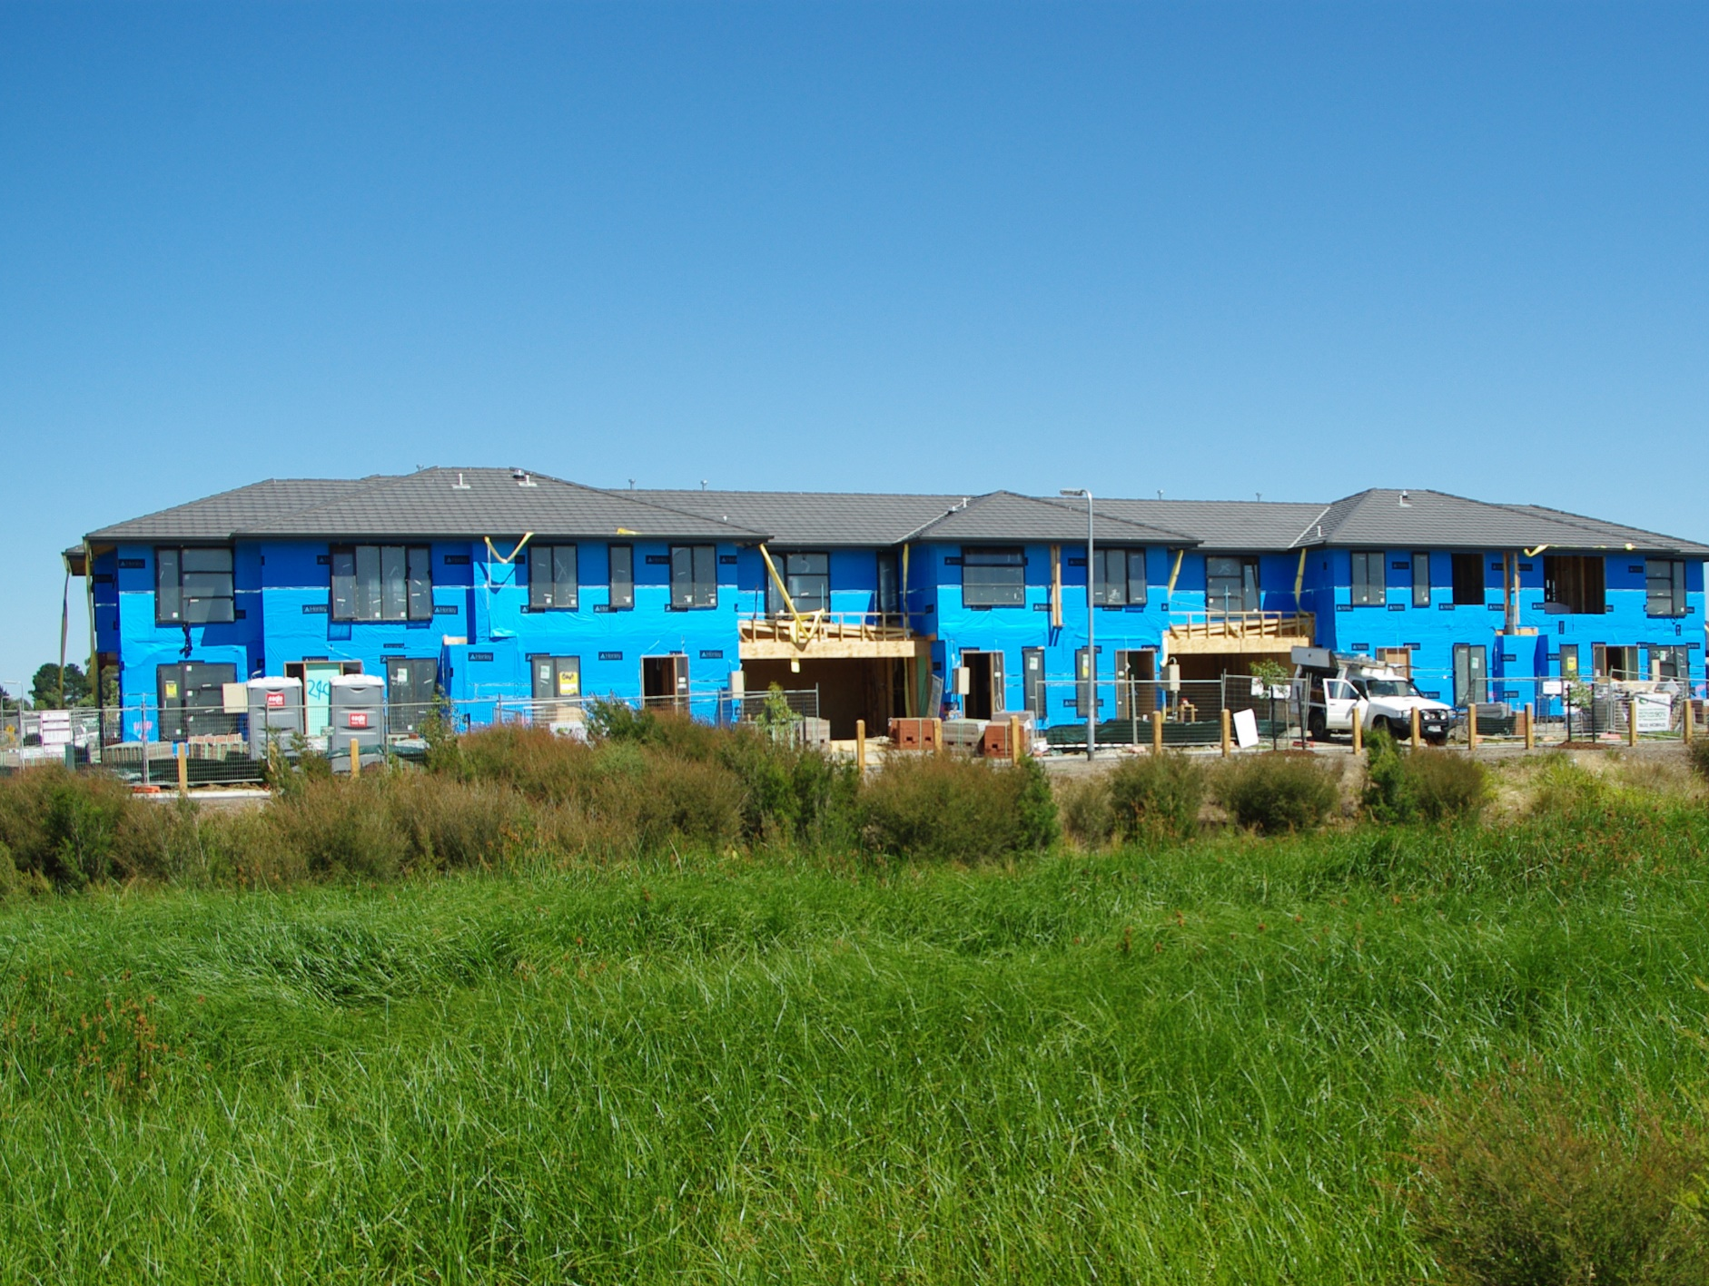
Urban Structure & Housing

Slide 7
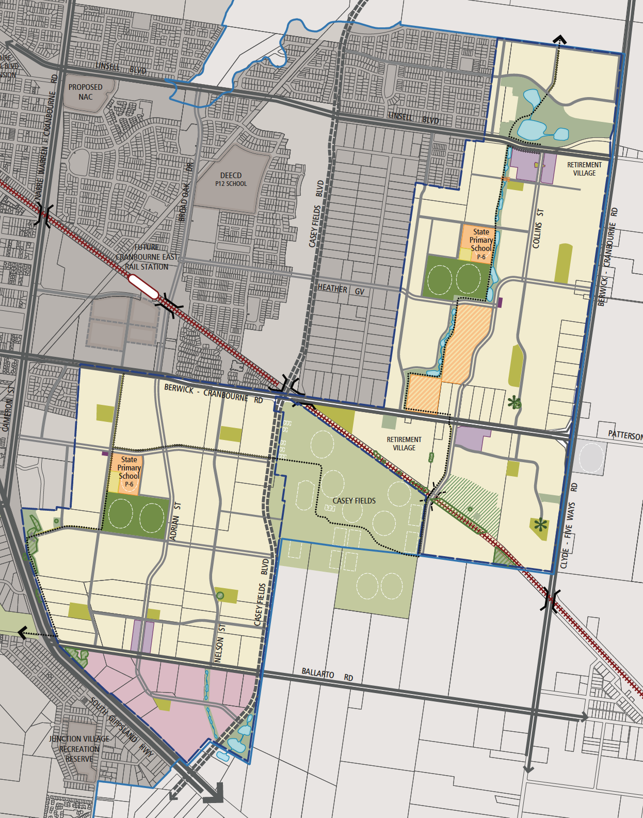
The Plan is coming Together…
Notes:
The structural outcomes are remarkably faithful to the PSP (assisted by some 96 (A)s
Where changes have been made, Council has used its ‘generally in accordance with’ discretion well.

Slide 8
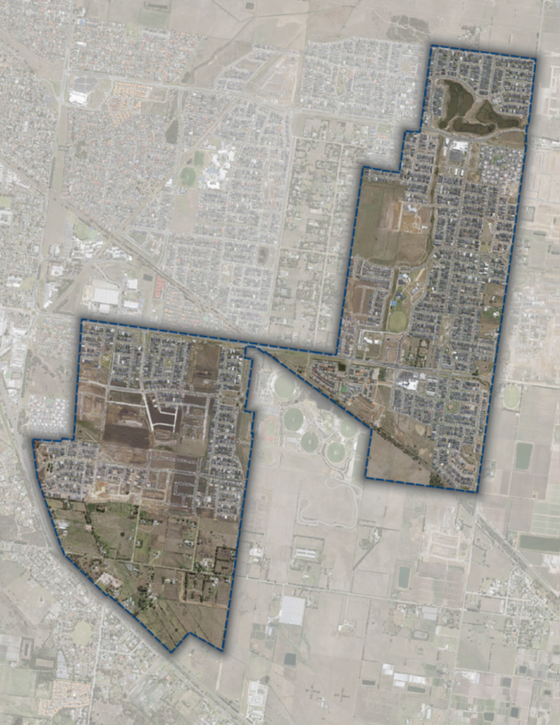
The Plan is coming Together…
Notes:
The structural outcomes are remarkably faithful to the PSP (assisted by some 96 (A)s
Where changes have been made, Council has used its ‘generally in accordance with’ discretion well.

Slide 9
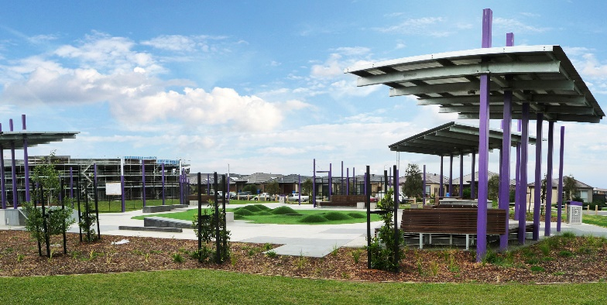
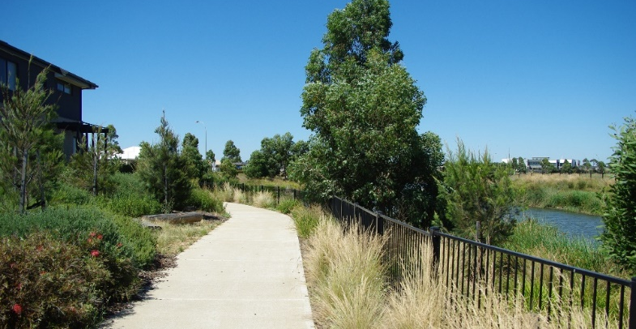
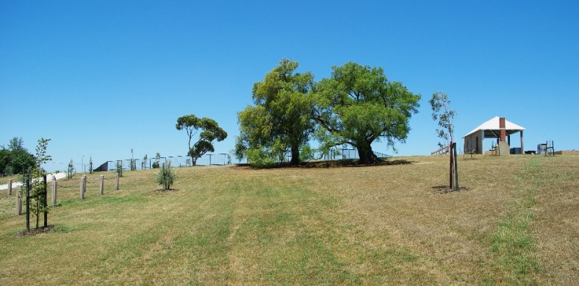
…Open Space
Notes:
Speak about learnings from heritage in hilltop park

Slide 10
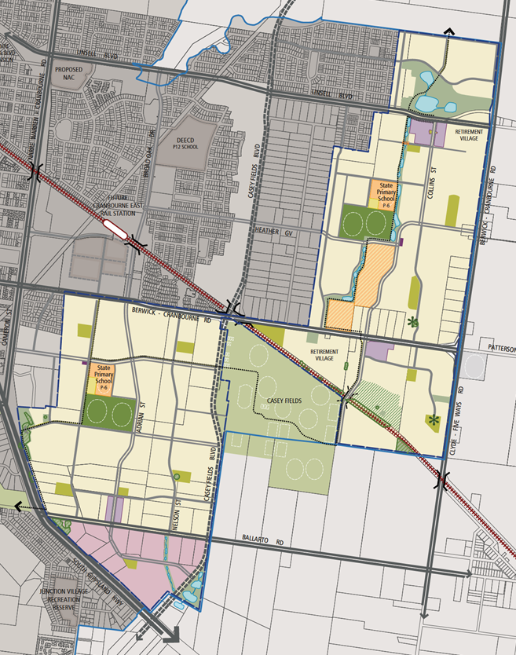

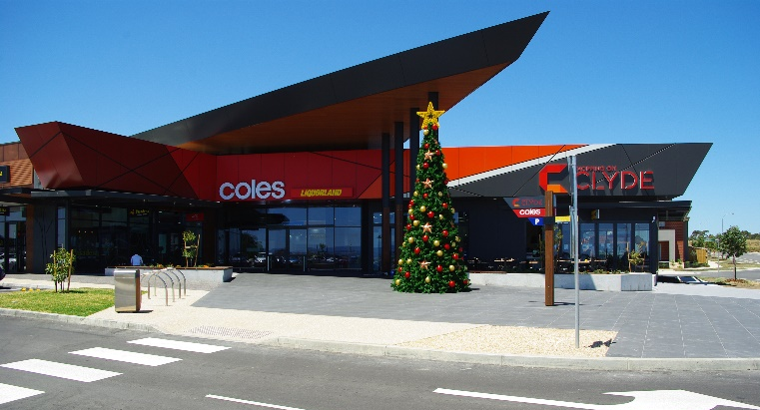
…Town Centres
Not Yet
Notes:
Overall success – 3 where once there may have been only one

Slide 11
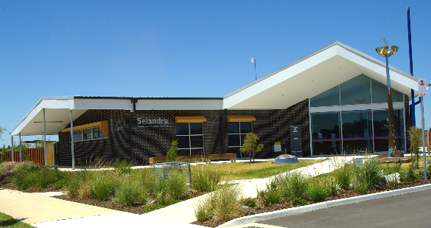
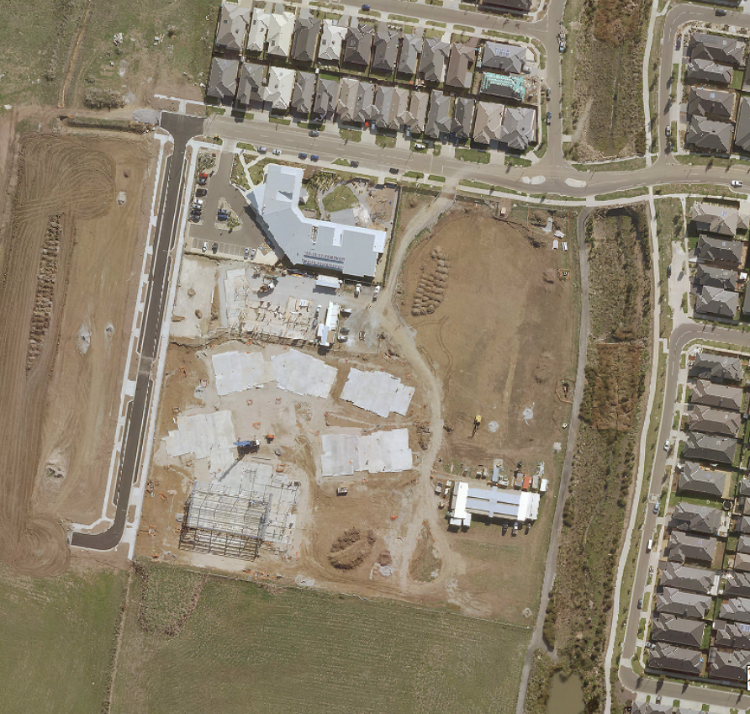
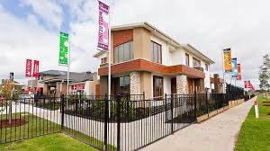
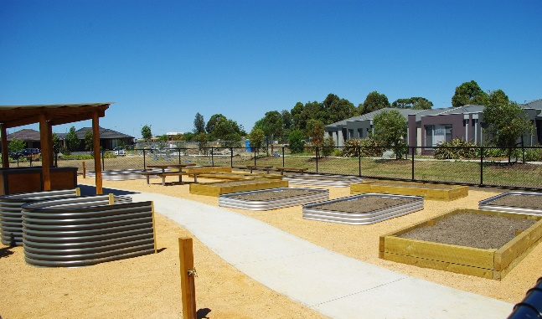
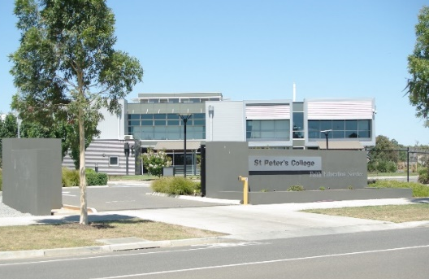
…Community
Notes:
Success – mention Selandra Rise Community Place and strong Stockland / Council commitment
Mention adjusted DCPs for Clyde which enabled Council to embed similar approaches if it chooses.

Slide 12
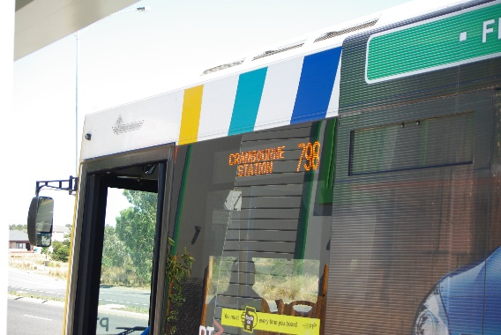
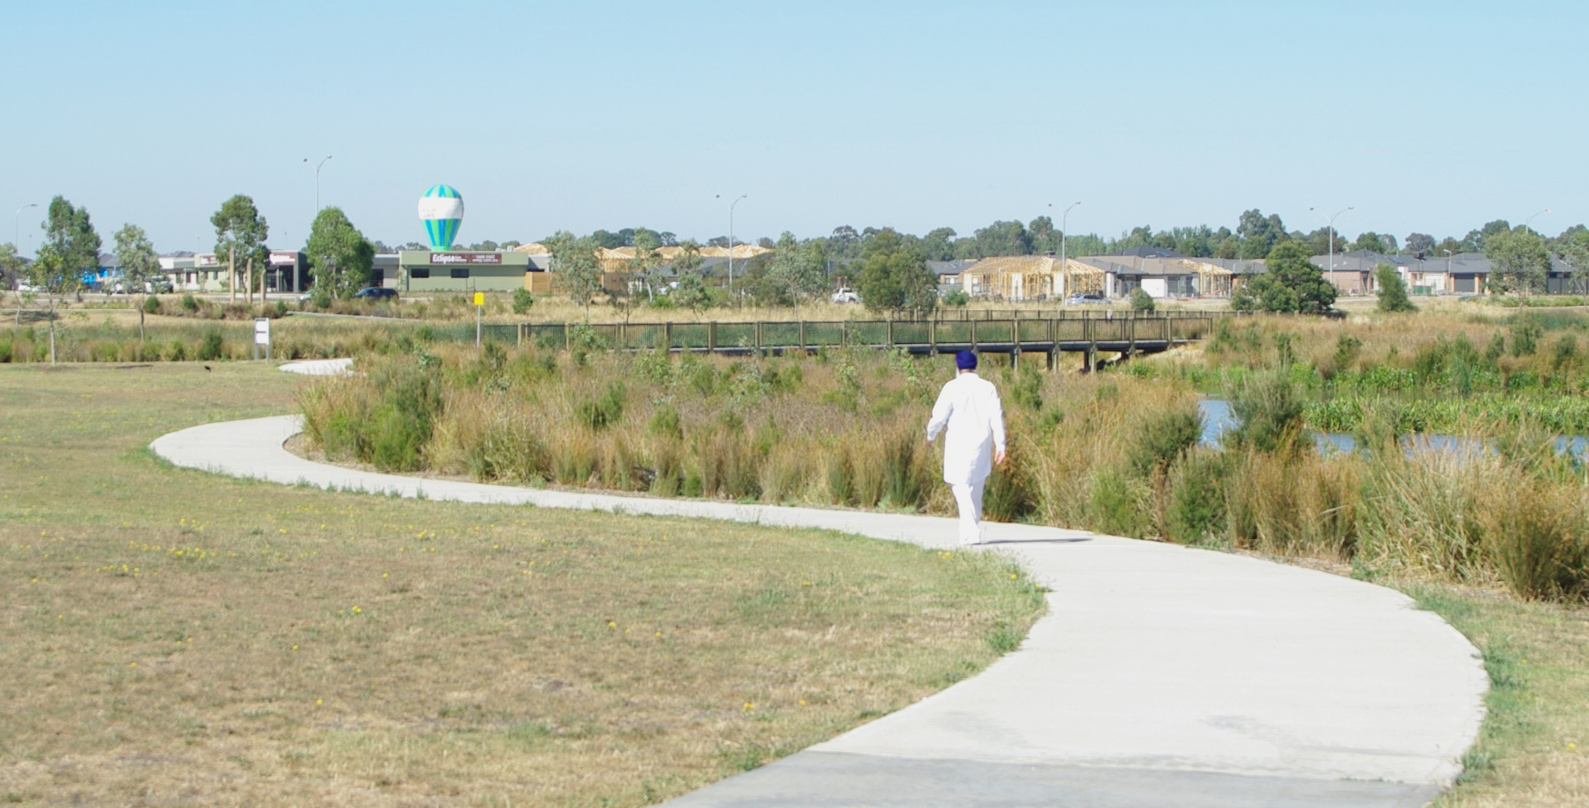
…Transport & Movement
Notes:
Early Bus to Selandra Rise
Good street structure and path network we have come a long way since earlier days –
Interim connectivity and connectivity across some arterial roads a potential issue.

Slide 13
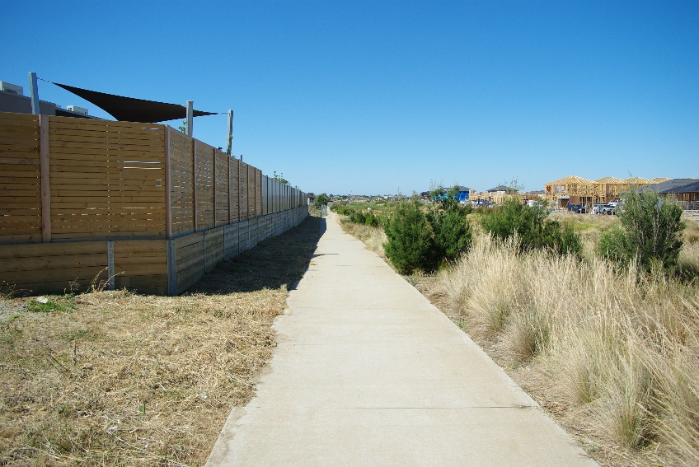
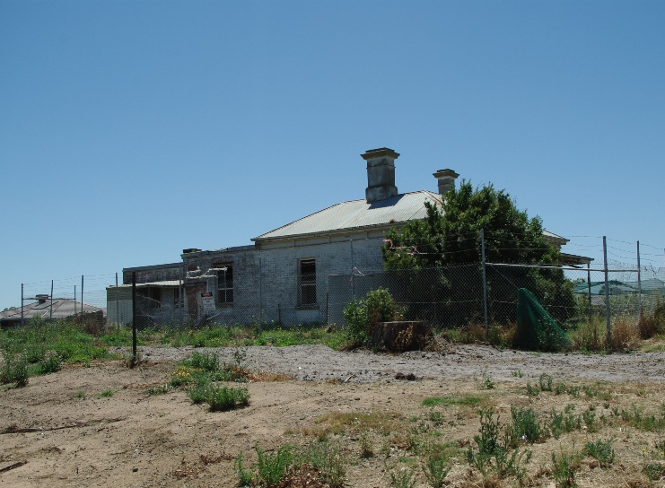
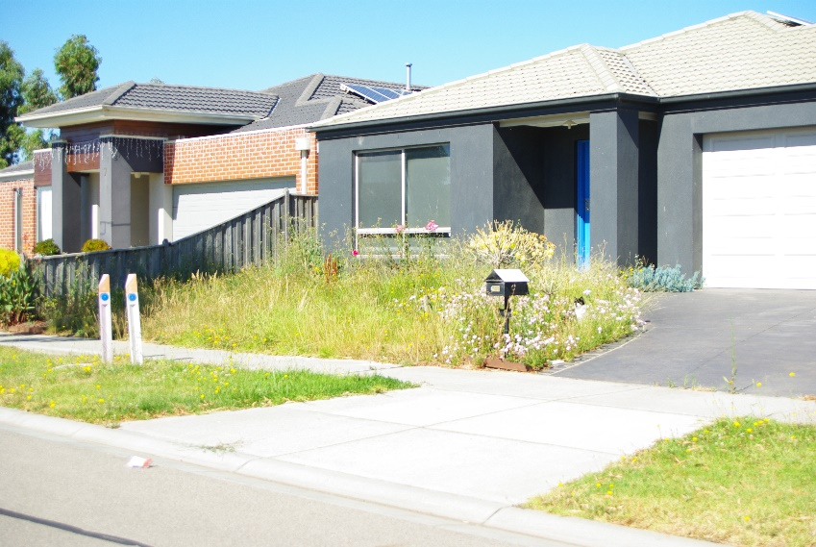
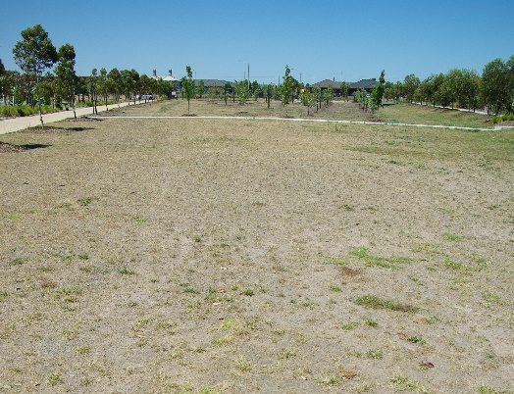
Is it Perfect?
Notes:
In pockets
Front setbacks – fences, maintenance do we need communal mowing schemes????
Narrow nature strips – who will maintain
Trees not yet planted
Unirrigated / dry parks…

Slide 14
…Housing
PSP Projections
Lot Type |  | NDHa (ex LTCs) | Dwell / NDHa | Projected Dwellings | Avg Lot Size |  | Percentage of Total
Residential - High Density |  | 5 | 35 | 192 | 200 |  | 3%
Residential - Medium Density (inc. retirement) |  | 109 | 23 | 2,515 | 304 |  | 39%
Residential - Conventional Density Residential |  | 290 | 13 | 3,774 | 538 |  | 58%
Totals |  | 405 | 16 | 6,481 | 438
Actuals October 2016
Total Lots | Consolidated Lot Size range | Proportion of Total
2331 | <400 | 49.6%
1483 | 401-500 | 31.5%
890 | >500 | 18.9%
4704
401m2 avg. lot size
17.5 Dwell. per NDHa
Over 70% of projected lots delivered

Slide 15
…Housing
Lot Size Range |  | Total Lots | Proportion of Total
<=200 |  | 14 | 0.3%
200 - 250 |  | 224 | 4.8%
250 - 300 |  | 541 | 11.5%
300 - 400 |  | 1552 | 33.0%
400 - 500 |  | 1483 | 31.5%
500 - 600 |  | 662 | 14.1%
600 - 700 |  | 104 | 2.2%
700 - 800 |  | 22 | 0.5%
> 800 |  | 102 | 2.2%
 |  | 4704

Slide 16
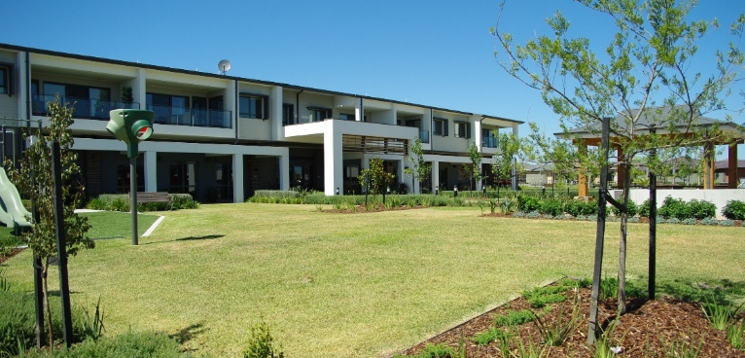
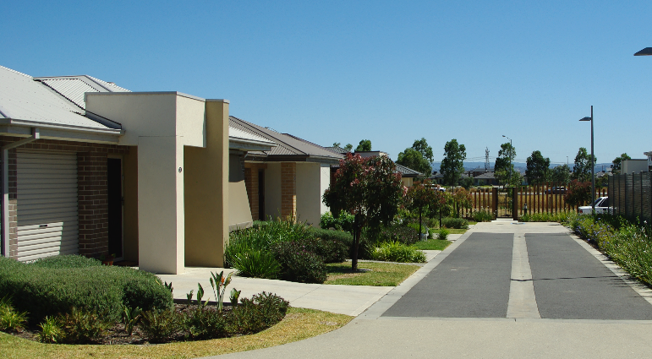
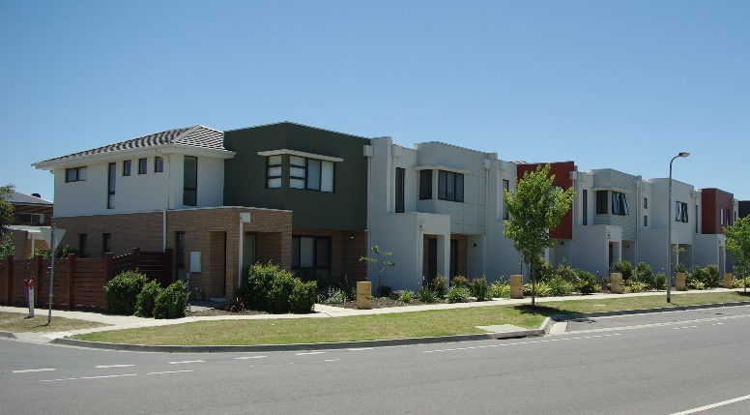
…Housing

Slide 17
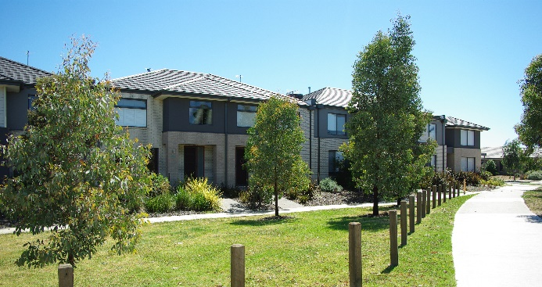
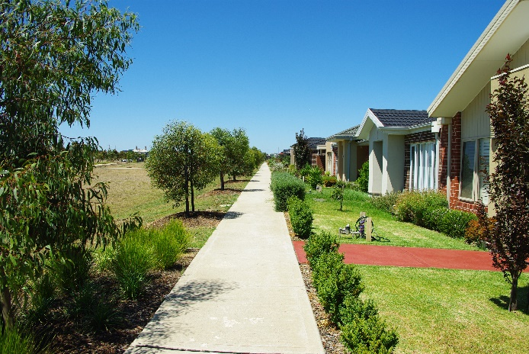
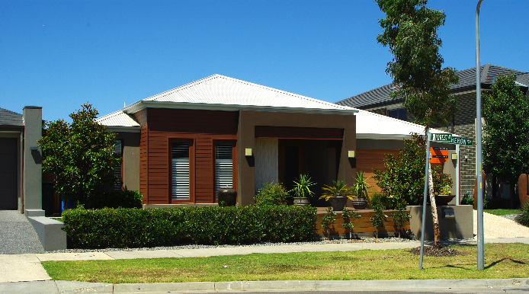
…Housing
88%
12%
Notes:
Front fencing works best with shallow setbacks…
Not much two storey – would like to see more – better scale and streetscape interface outcomes

Slide 18
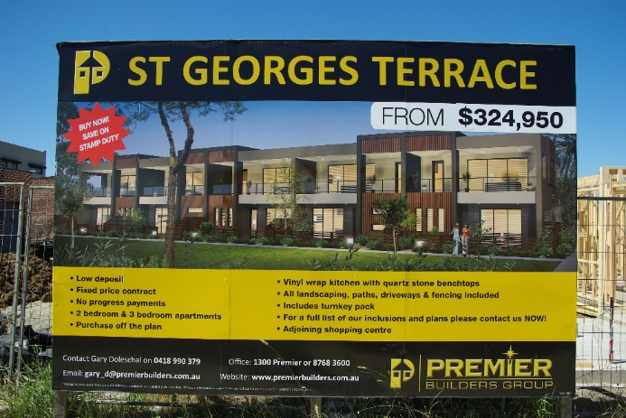
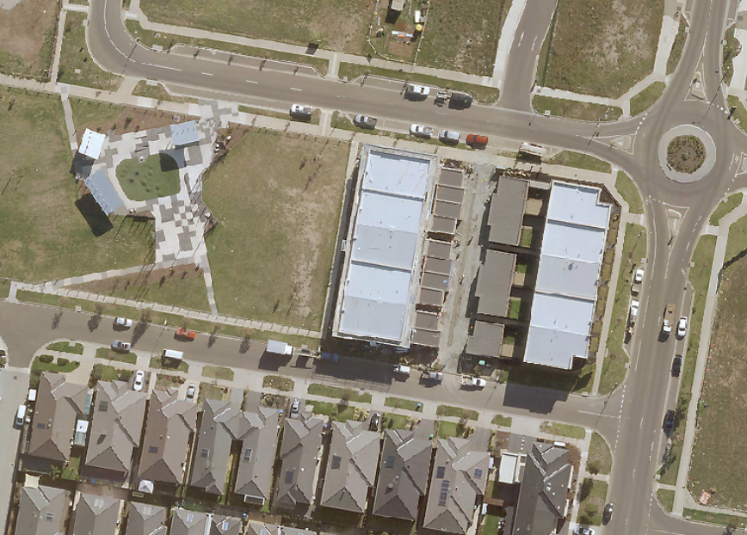
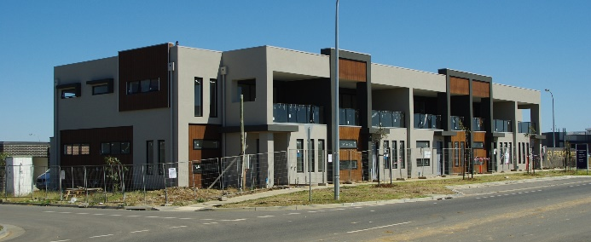
Affordability
$230,000 median lot price June 15-June 16
Recent Sales:
  $132,000 for 268m2
  $193,000 for 336m2
  $245,000 for 448m2
Notes:
Over life of project median is around $220,000
Will vary depending on lots coming to market – still a range expected.

Slide 19
Affordability - Dwellings
$205,000 median dwelling cost @ average 201m2
Overall around $435,000 as median house and land with a range of ‘price points’.
Notes:
Compares to about $740,000 for metro Melbourne as a whole

Slide 20
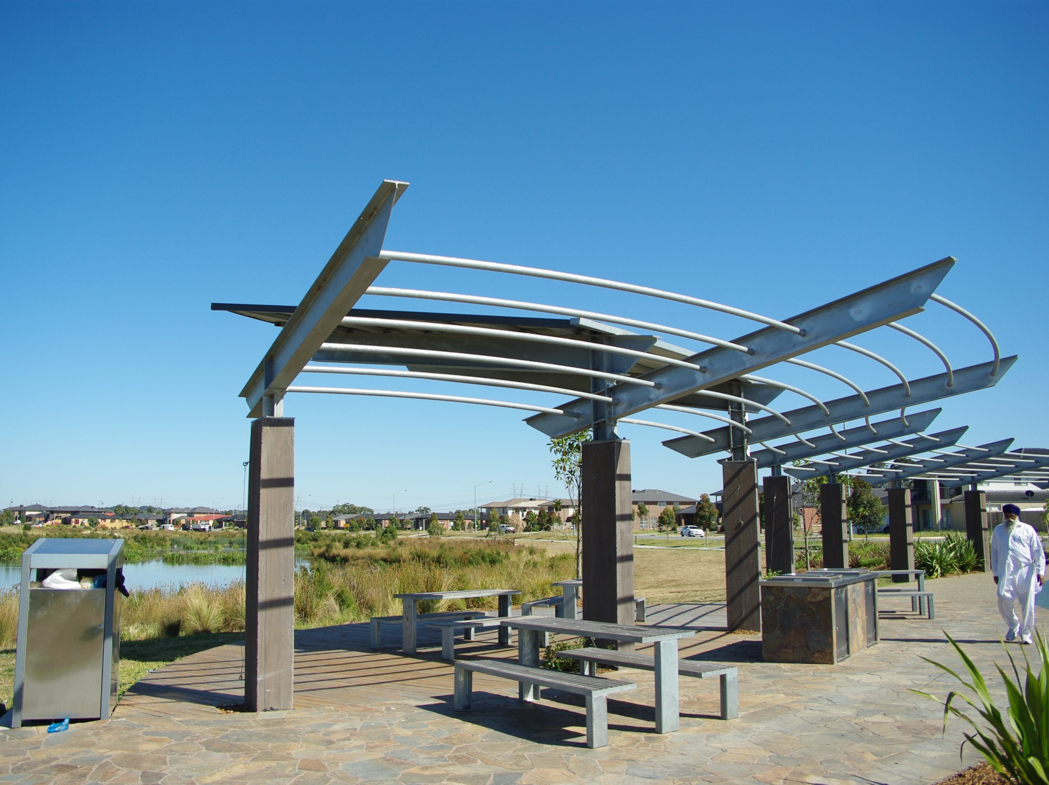
‘Institutional’ Stakeholder Survey

Slide 21
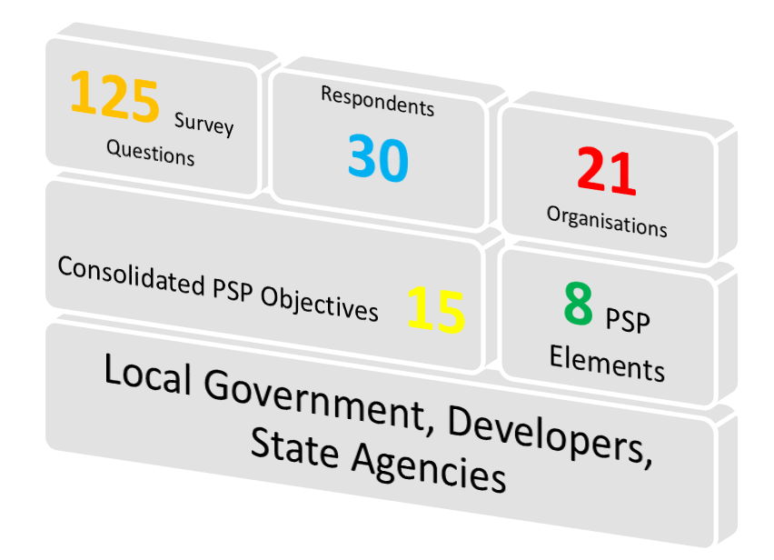
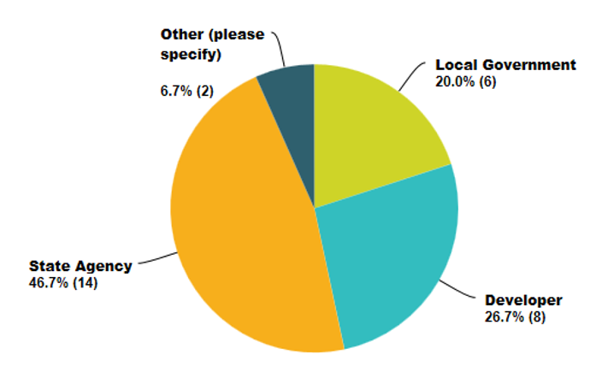
Stakeholder Survey

Slide 22
Themes of Questions
Notes:
Based on PSP elements
65 Objectives in PSP distilled down to 15 overaching ones to enable surveying – maybe shows we need to stay vigillent and economise on PSP wording / complexity (was before shorter format PSPs developed)

Slide 23
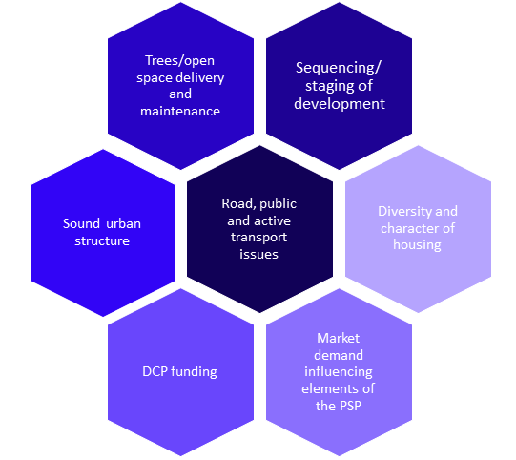
Key Themes of Outcomes
Notes:
Trees/ Open space delivery and maintenance:
- No large canopy trees, mostly due to planning scheme and council requirements.
- Costly maintenance of landscapes (Casey).
- Good integration of open space and commercial and residential areas (Casey).
- Open space generally delivered on time and of a decent quality.
Sequencing/ staging of development:
- Restrictive transport and movement sequencing (paths, roads etc) caused delays to development.
- Sequencing of housing was quite troublesome (Several developers).
Sound urban structure:
- Community and open spaces facilities established.
- Road network shown in PSP is on the way to completion (VPA).
- Generally a consistent built form.
- All utilities delivered.
Road, public transport and active transport issues:
- Need to improve PT delivery, funding and agency involvement play a significant part (PTV, several developers).
- Lack of path network connectivity throughout entire PSP, some areas connected well (Casey, developers).
- Bus services have been delivered in some areas.
Diversity and character of housing:
- Some PSP areas have a stronger character than others (depending on the developer aspirations).
- Some housing fronting amenity (positive).
- Mixed opinions regarding the diversity of housing stock, some appears similar in neighbouring PSP areas.
- Lack of active frontages to open space, no diversity of lot sizes (Casey).
Stakeholder collaboration:
- Negotiation time with authorities slows infrastructure delivery (Developer).
- Inconsistency between PSP and council decisions.
- Some developers willing to consult with council in order to achieve better outcomes.
Market demand influencing elements of the PSP:
- No high density development evident (especially around town centres).
- Economic forces driving lot size and prices.

Slide 24
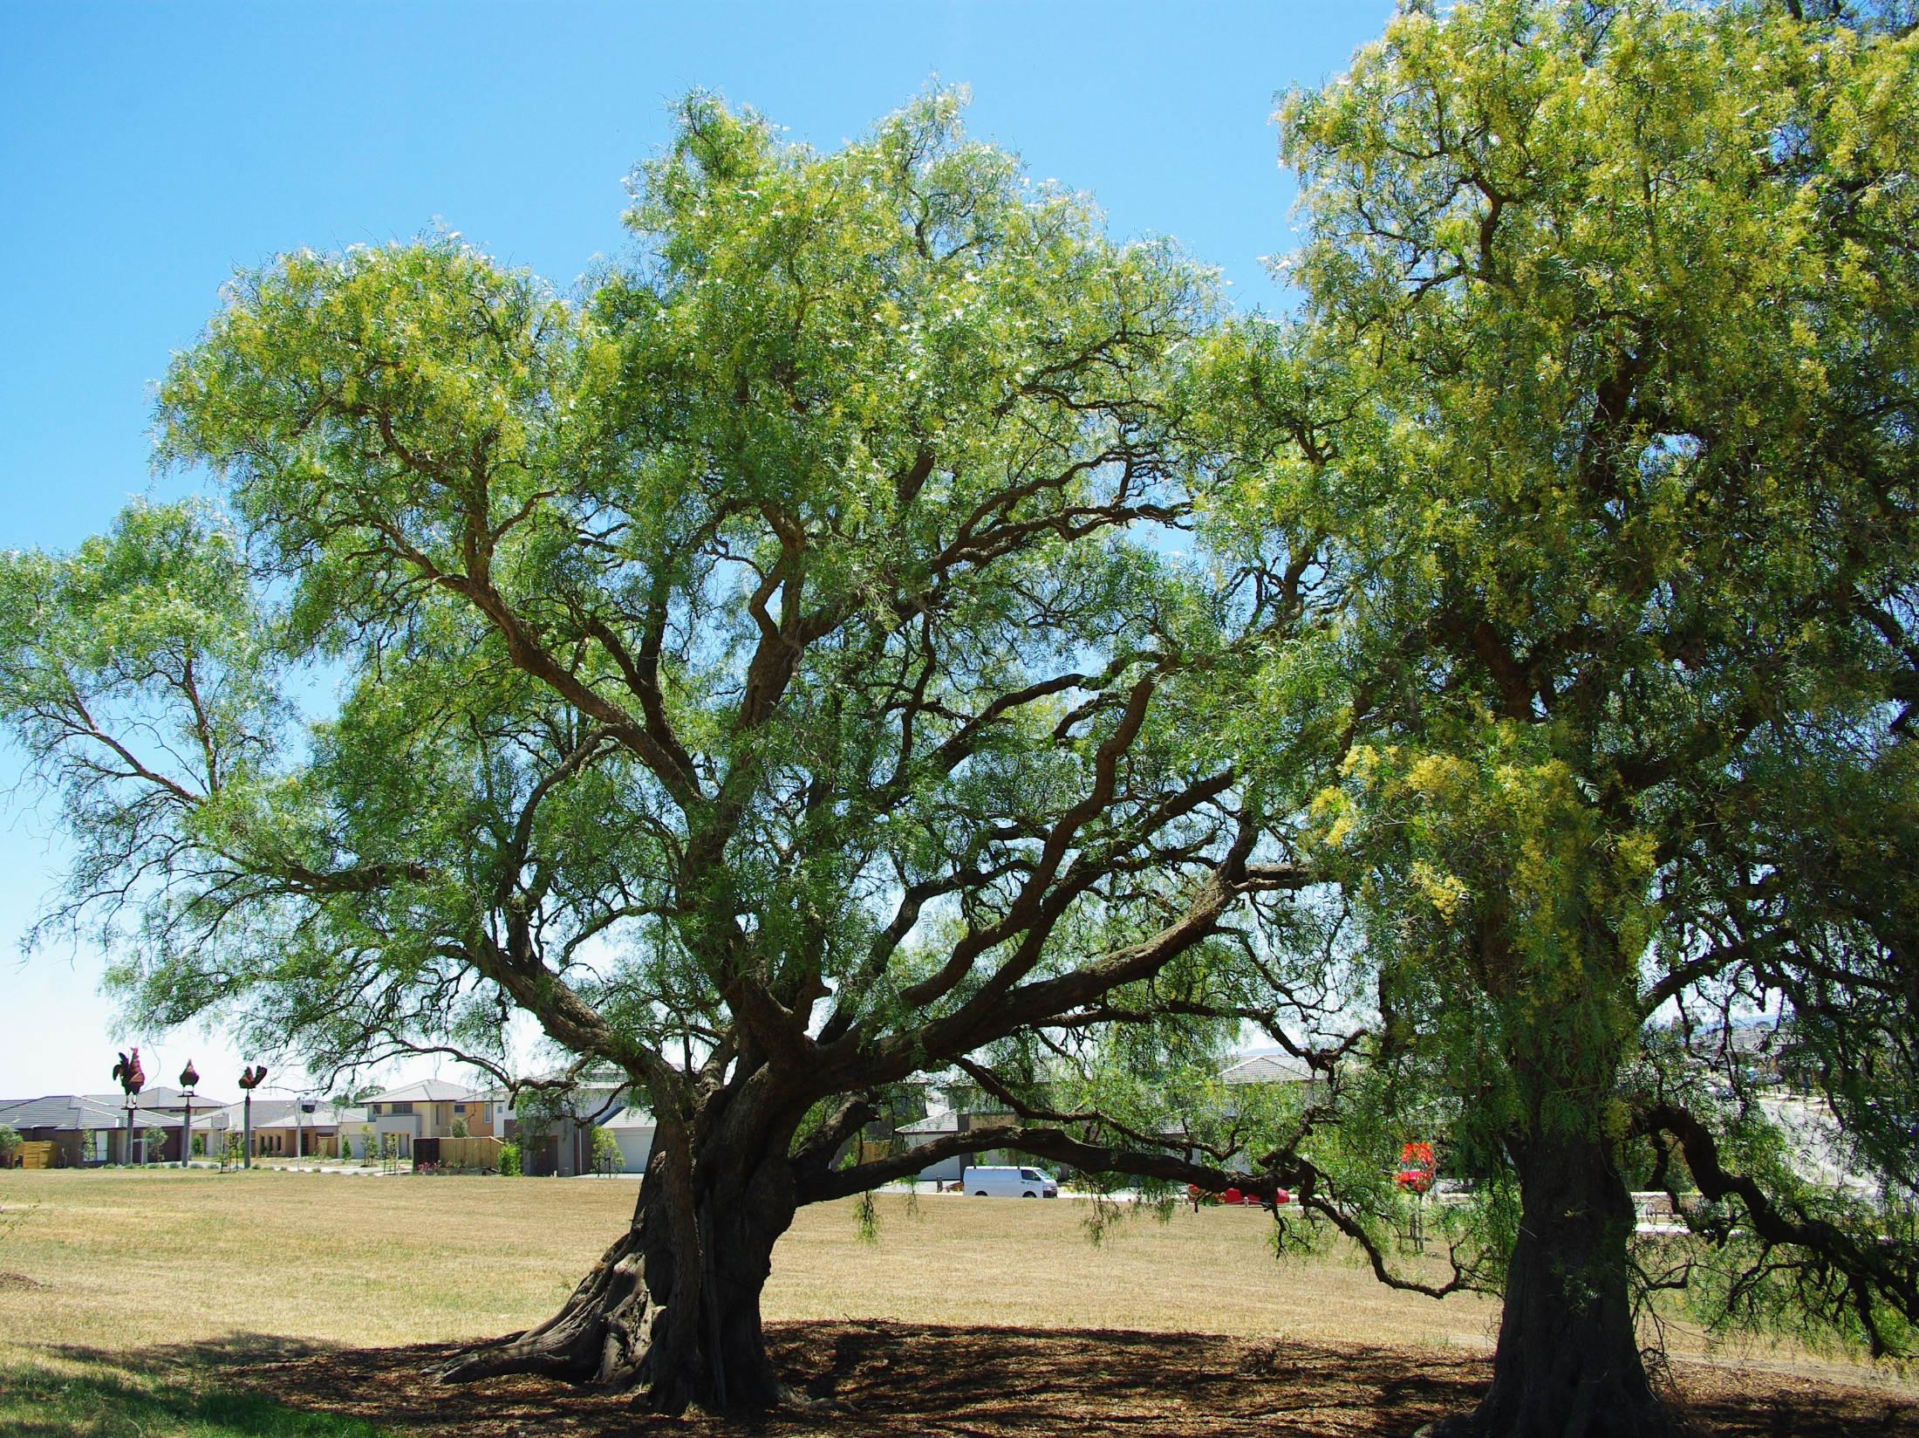
Community Survey

Slide 25
Background
375 Households constituting 1068 Individuals completed surveys.
Drop-off & Pick Up Methodology.
Undertaken over two weeks.
All estates surveyed except Selandra Rise retirement village.

Slide 26
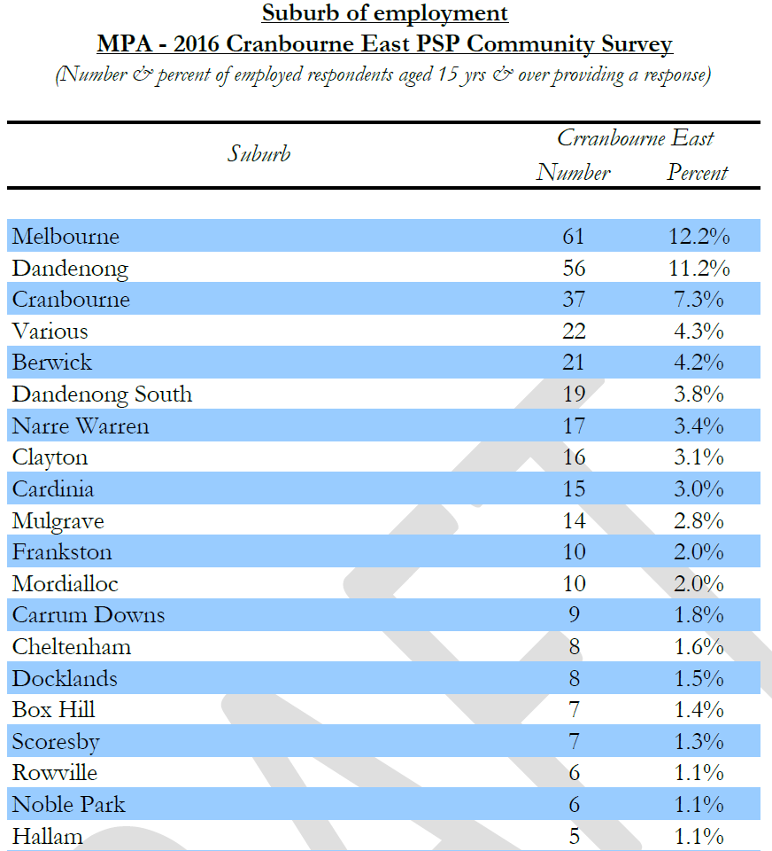
Socio-Economics – Some Interesting Findings
49% Born overseas.
Median age = 32.
25.1% employed respondents (over 15yoa) are professionals.
40.2% work in the south east region of Melbourne.
Median annual income of all respondents = $39,717.
Median Household income $90,288.
83% of respondents said they regularly visited Shopping on Clyde and Selandra Rise Town Centres for everyday household needs
Notes:
Biggest overseas born cohorts = 12.5% India, 6.9% SriLanka, 4.2% Philippines
Casey Median age =33
Casey professionals = 14.2%
Many teachers, registered nurses, emergency services occupations in professional category
39,917 is considerably higher than Casey median of $29,744
2011 census household income for Casey $69,704 – prob now around $77-80k

Slide 27
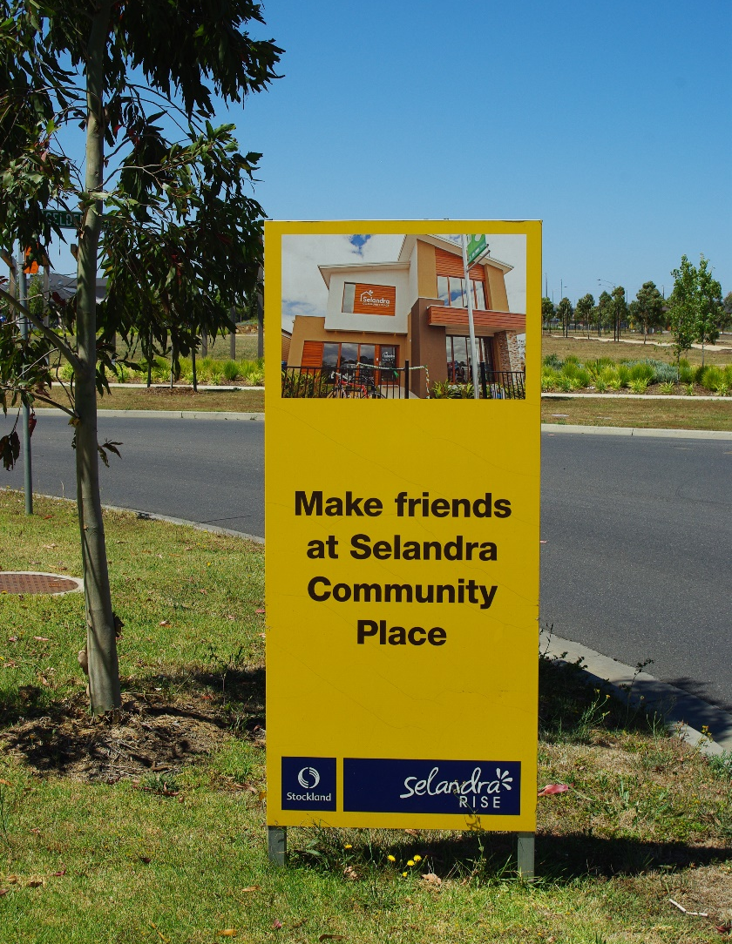
Community Satisfaction - importance
Overall 91.5% of respondents are very satisfied or neutral to somewhat satisfied with how living in the precinct met expectations.
However community had concerns with:
  Public Transport
  Road congestion
  Connectivity
  Public safety
  Jobs
Notes:
59.6% very satisfied, 31.9% neutral to somewhat satisfied and 8.5% dissatisfied

Slide 28
Community Satisfaction - importance

Slide 29
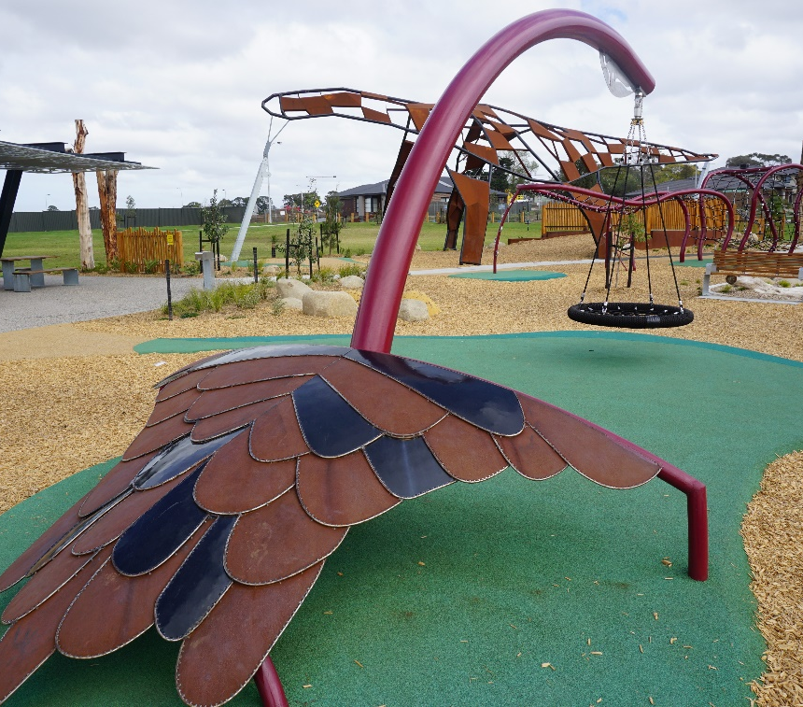
Some Conclusions and Learnings
Transport connectivity an issue as part of development phasing.
Jobs, Jobs, Jobs.
Road congestion, public transport and commuting is a challenge.
More focus on trees and greening needed.
Further investigation of safety issue…
Dwelling / street interface and private landscaping variable.
Need to keep an eye on PSP complexity.

Slide 30
Some Conclusions and Learnings
There is a sense of community and place emerging.
Yield / diversity has exceeded expectations – still plenty to do.
Focus on timely / transitional community facilities makes a difference.
Local Town centres are working, being used and are important.
The Urban structure and principles which underlie it are sound – it works.
Notes:
Last do point – and this provides a strong basis for the suburb to grow and the community place their stamp on it over time.
Intensive exercise – VPA considering how it may manage / undertake future projects as part of continual assessment and learning
Mention PSP Guidelines and Internal PSP Design Reviews.

Slide 31
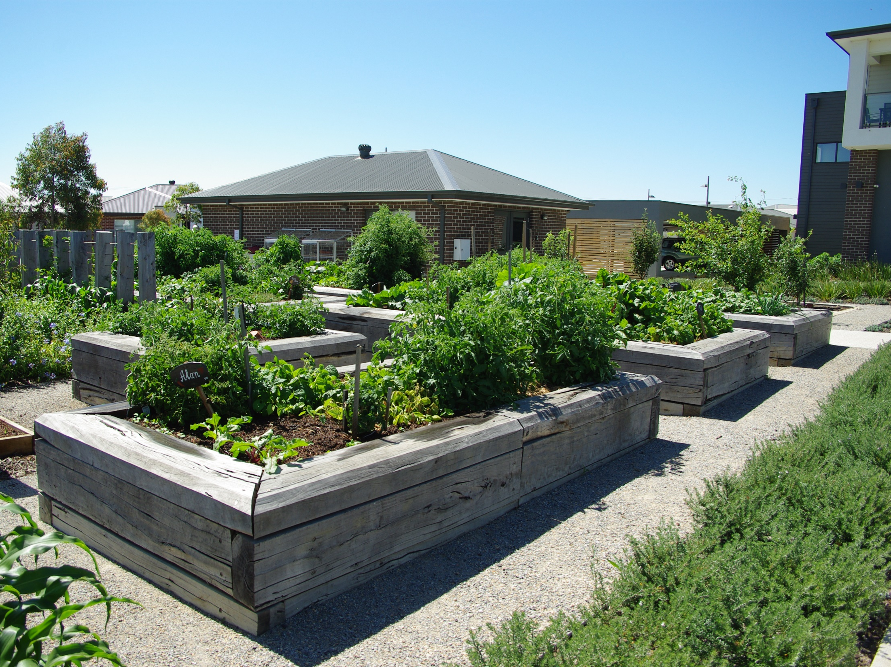
Thank You

