Slide 1

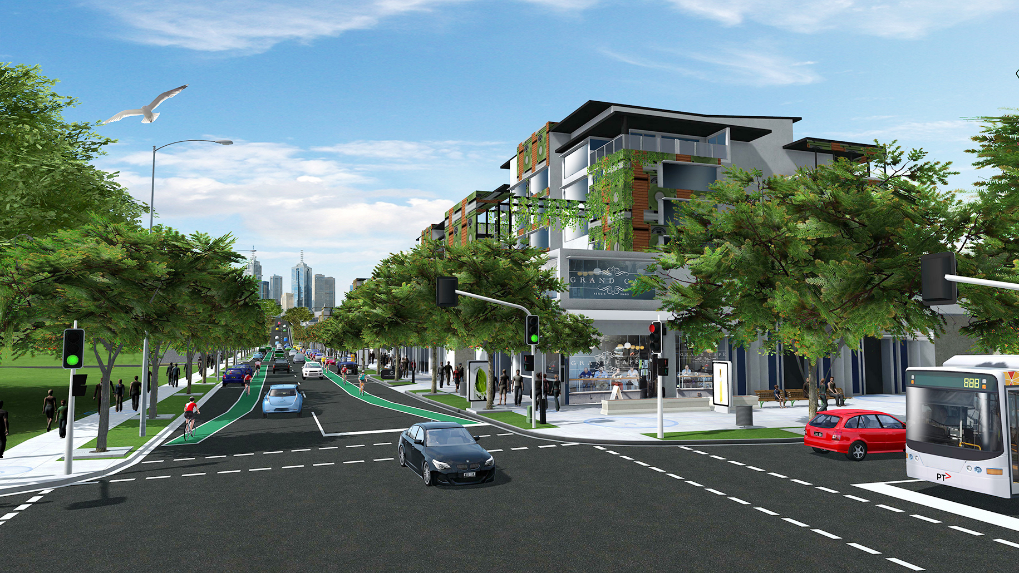
VPA Leading Practice Series: New Designs on Greenfield Planning
Paul Byrne
Lead Director - Greenfields, Victorian Planning Authority
October 2016

Slide 2
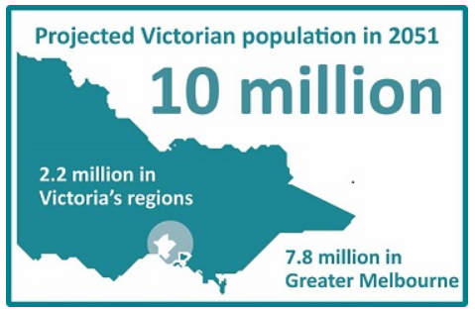
Planning for Victoria’s Booming Population Growth
Melbourne and Victorian population continues to grow strongly
Fastest growth rate in Australia: 1.7 per cent pa
Need an additional 2.2 million dwellings over next 35 years to house the extra 4.1 million population increase – over 110,000 more people every year

Slide 3
What makes up our population growth
Total
Immigration
Natural Increase
Interstate

Slide 4
And where our population growth is occurring
Steady Growth Areas

Slide 5
“Natural Increase” – masks the sheer scale of baby boom
In places like Casey and Wyndham, this equates to over 75 babies per week!
But, growth areas are accommodating only 32% of Melbourne’s babies per year

Slide 6
Victoria’s Population Distribution: What role we play in influencing this
Our planning is based on strong principles to create great communities – no matter where

Slide 7
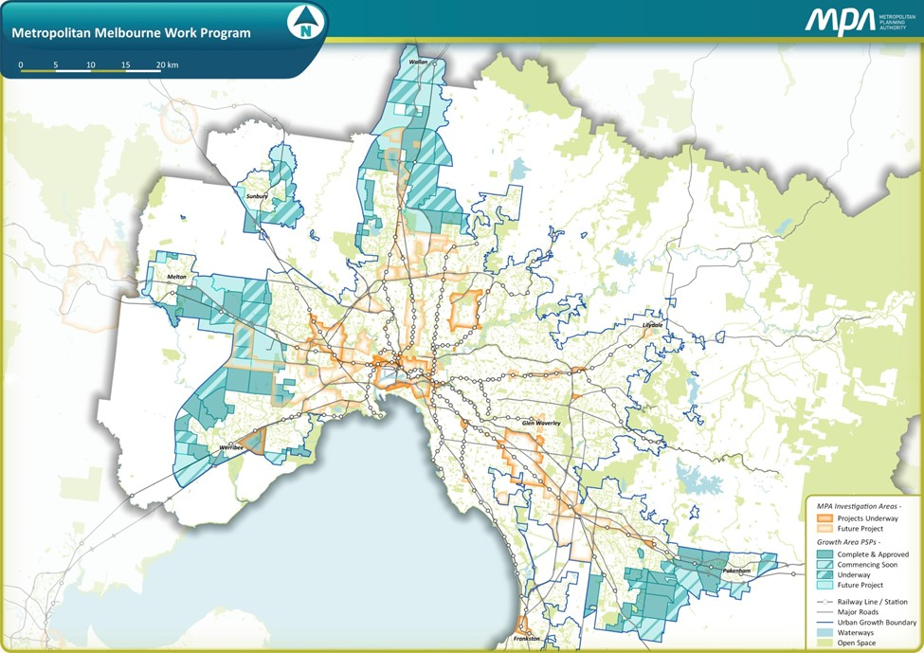
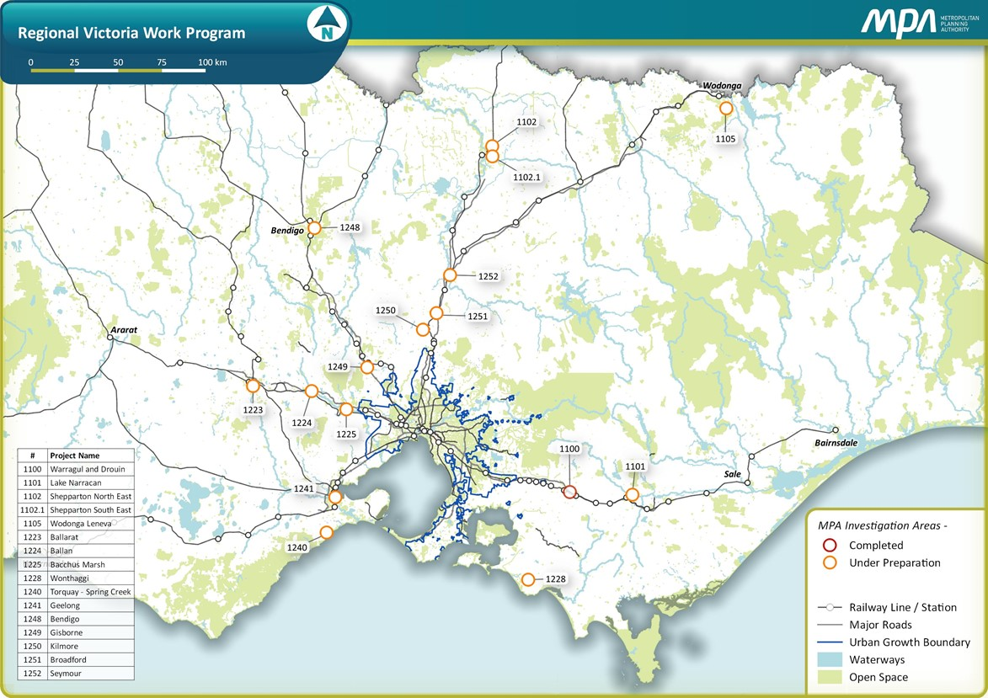
Where we work - Melbourne and the regions Today is about the Greenfields, but the priorities are common to all areas we plan
Our priorities
Mixed use precincts, choices for housing.
More businesses & jobs where people live.
Housing affordability.
High quality public realm.
Intelligent and efficient transport systems.
Infrastructure coordination and funding
Streamlined planning and innovation

Slide 8
Growth Areas – Planning for Long Term Changes in Age Profiles

Slide 9
Something from GAA back in 2008 Sound familiar, it should, and it is what the GAA / MPA / VPA has been dedicated to delivering
We need to
Stop building “dormitory suburbs”
We need jobs close to home (reduced travel distance and time)
Better sustainability outcomes
Internally self sufficient communities
Polycentric city
Higher densities
New transport solutions
High quality, affordable and desirable places for people to live in and businesses to operate in
And growth areas are only part of the solution, we need urban consolidation as well
Since then some things have been added, including greater focus on infrastructure coordination and funding mechanisms (ICPs / DCPs, GAIC), streamlined planning, innovation, design review and guidance, short form PSPs, learning from experience, stakeholder engagement, estimating development timeframes (ie first 5 and 10 years) to name but a few

Slide 10
2010 GAA PSP Status Map Only 43 PSPs or ‘new suburbs’ : but we knew much more was coming !

Slide 11
60 PSPs now Approved – Over 250,000 lots

Slide 12
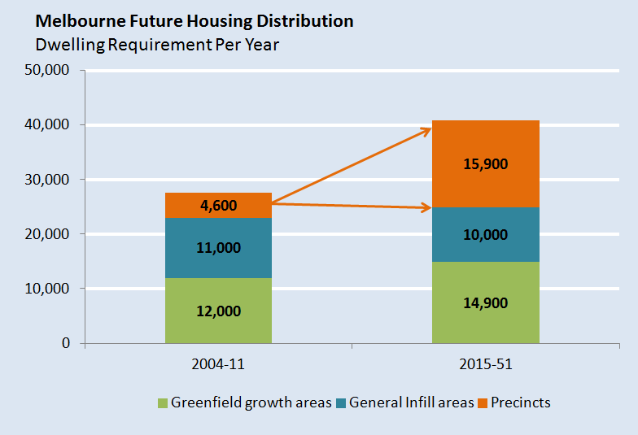
Role of VPA: Unlock and manage Victoria’s growth using the planning system, and infrastructure coordination

Slide 13
Melbourne leads housing supply and greenfields developments across Australia
Melbourne
Sydney

Slide 14
Melbourne’s competitive position - Housing supply and maintaining affordability
Savings to Melburnians in our growth areas:
Assume 20,000 lots sold x $230,000 difference = $4.6 billion per year!

Slide 15
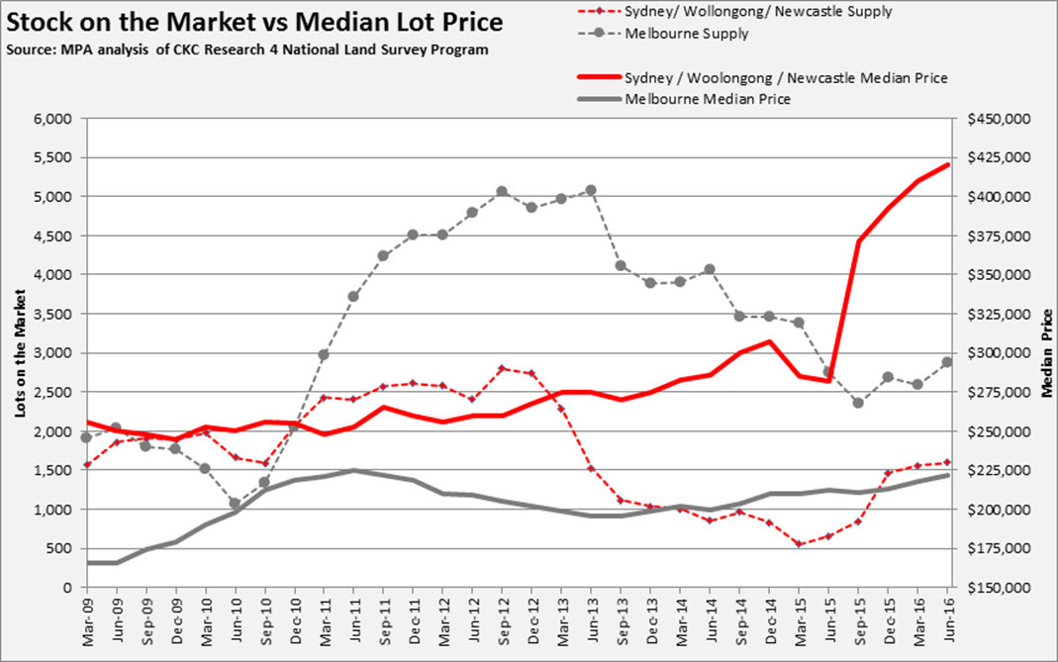
Increasing Supply and maintaining Affordability The economic principles really do apply!
Savings to Melburnians in our growth areas:
= $4.6 billion per year!

Slide 16
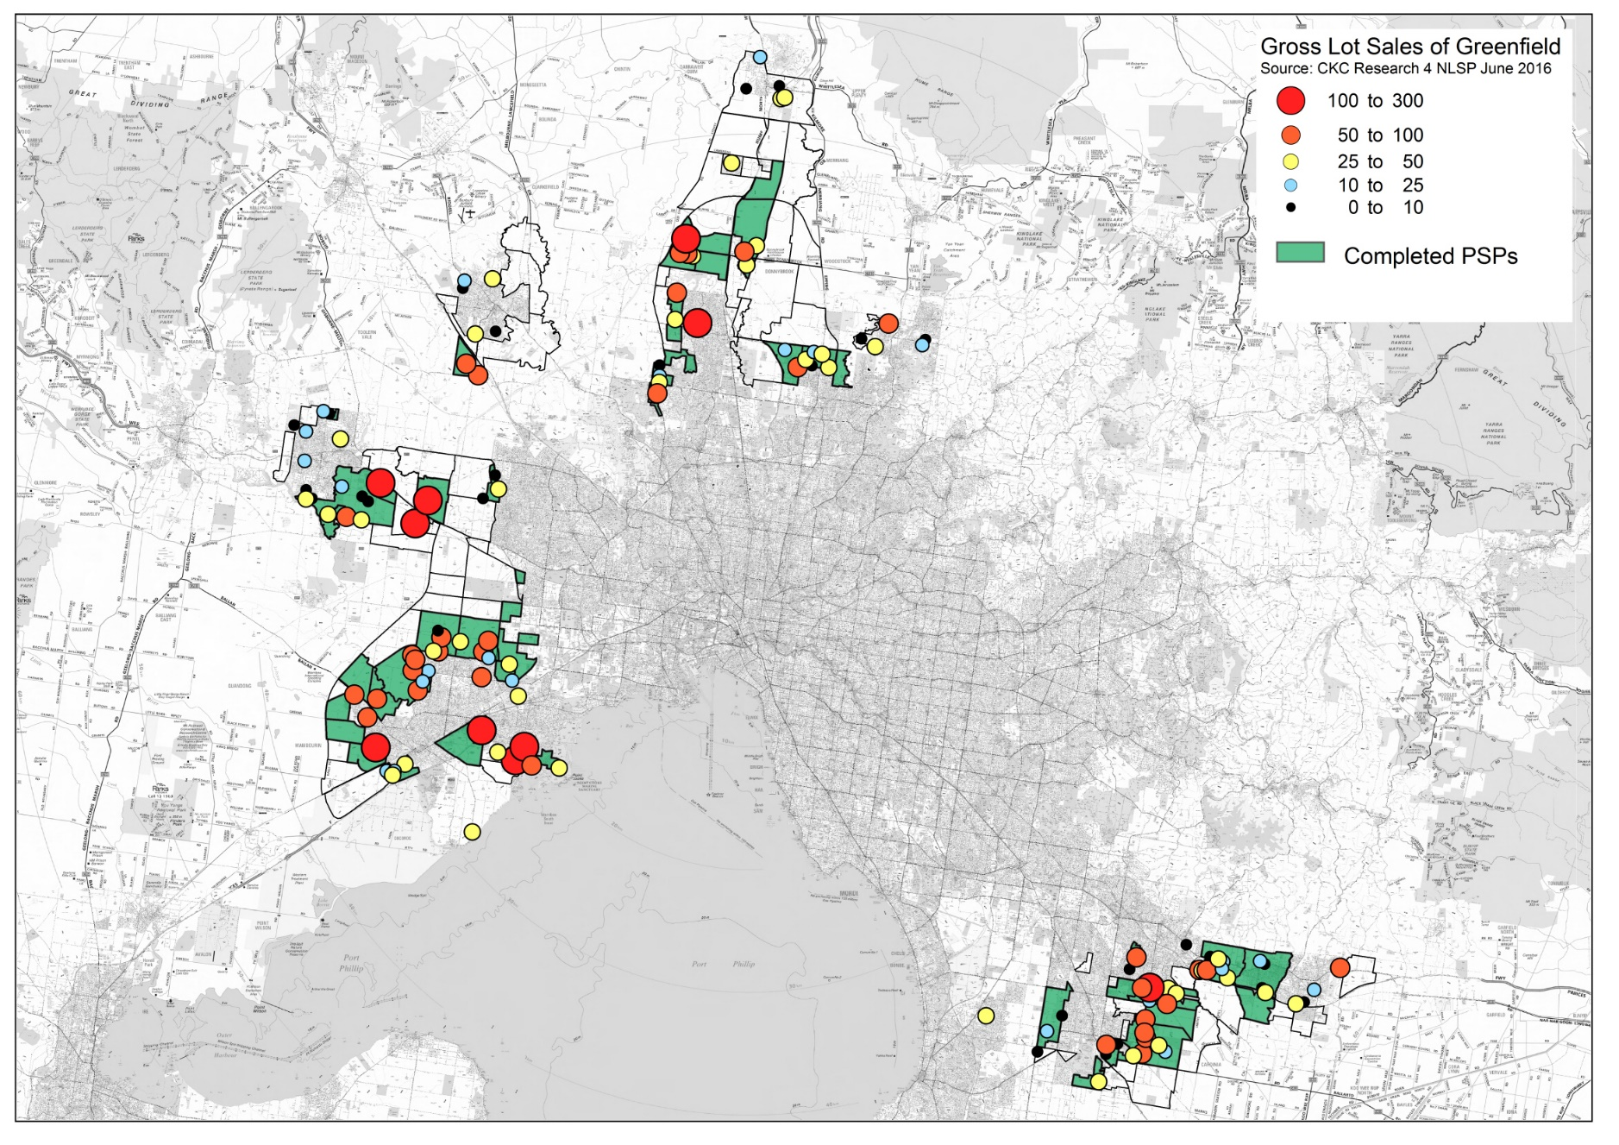
Melbourne’s Active Projects - Over 70% of Melbourne’s 136 Active Projects are now starting to flow into Approved PSP areas

Slide 17
Record year for Melbourne’s Growth Areas
– 22,000 lots sold, competition delivers both quality and affordability
However, delivering this puts Councils’ and Agencies’ Planning Approvals processes under significant pressure – Post PSP Streamlining Program
Wyndham
Casey
Hume
Melton
Whittlesea
Cardinia

Slide 18
Strong demand is putting real pressure on short term supply stock

Slide 19
And the longer term “PSP Approved Supply” must be maintained, and our future PSP Work Program ensures this

Slide 20
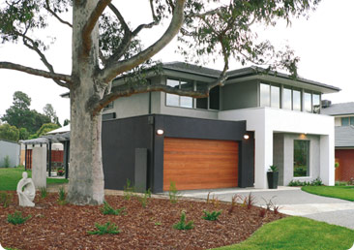
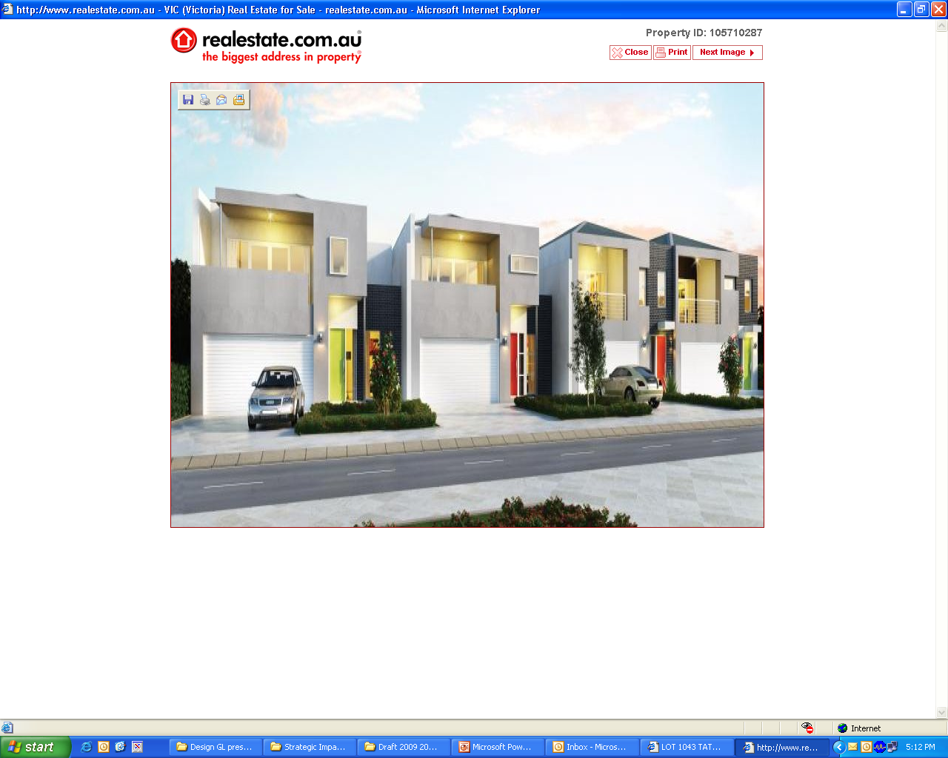
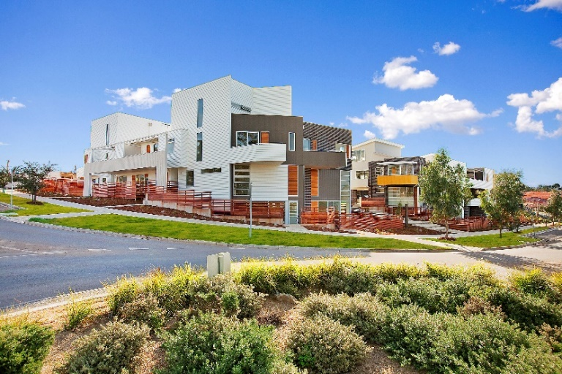
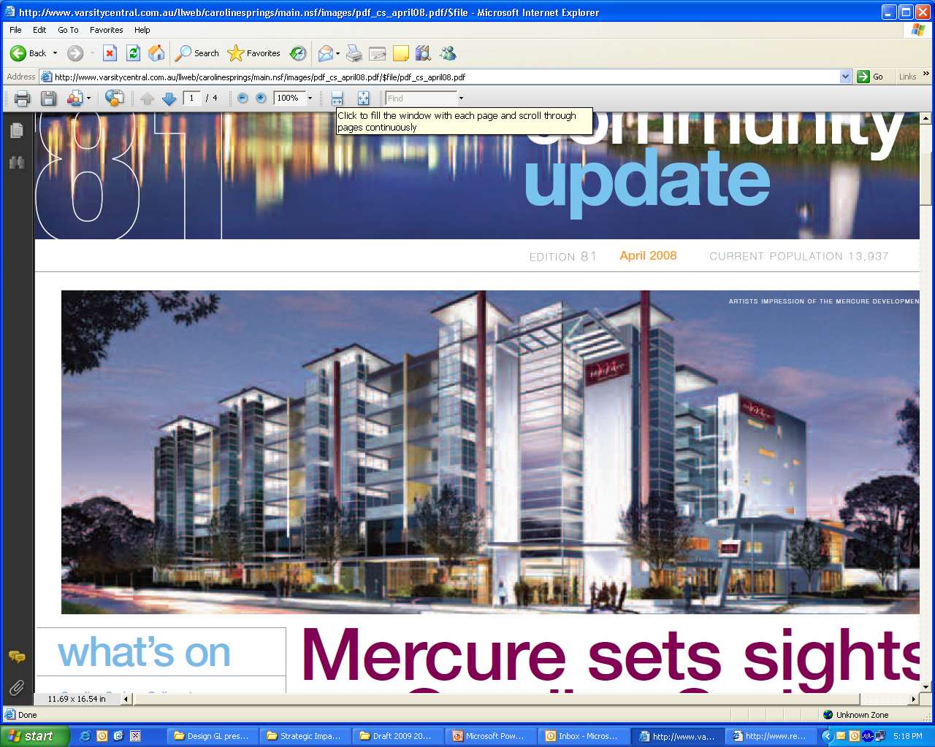
We are meeting the overall housing demand, and progressively increasing Housing diversity in Growth Areas – but needs to be accelerated

Slide 21
Melbourne’s Employment Suburbanisation In 2011, Melbourne had 2.1m jobs – over 1.67m (~80%) are in the suburbs VPA remains committed to the “1:1 Target” for the growth areas

Slide 22
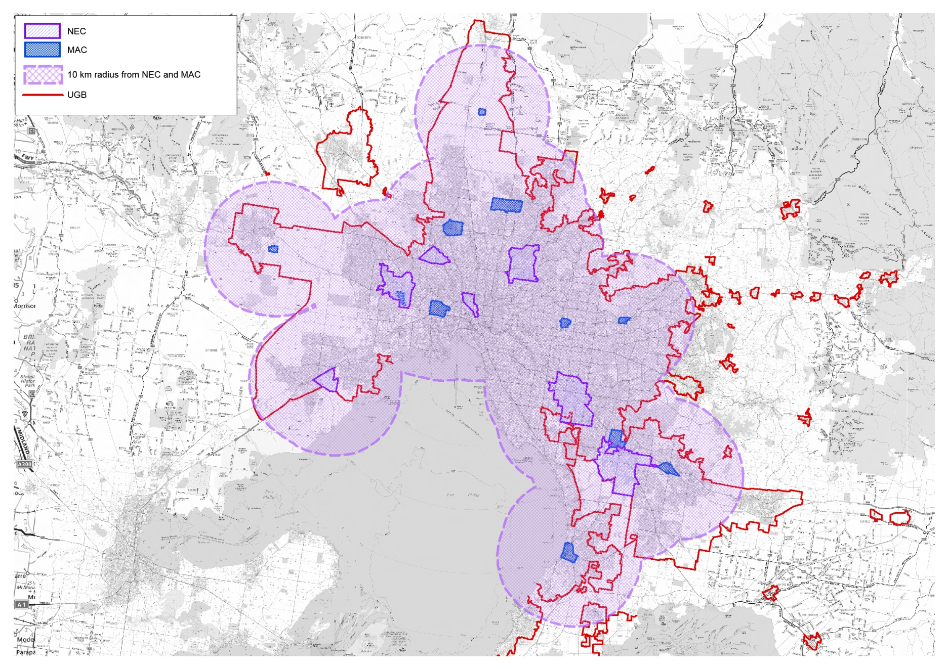
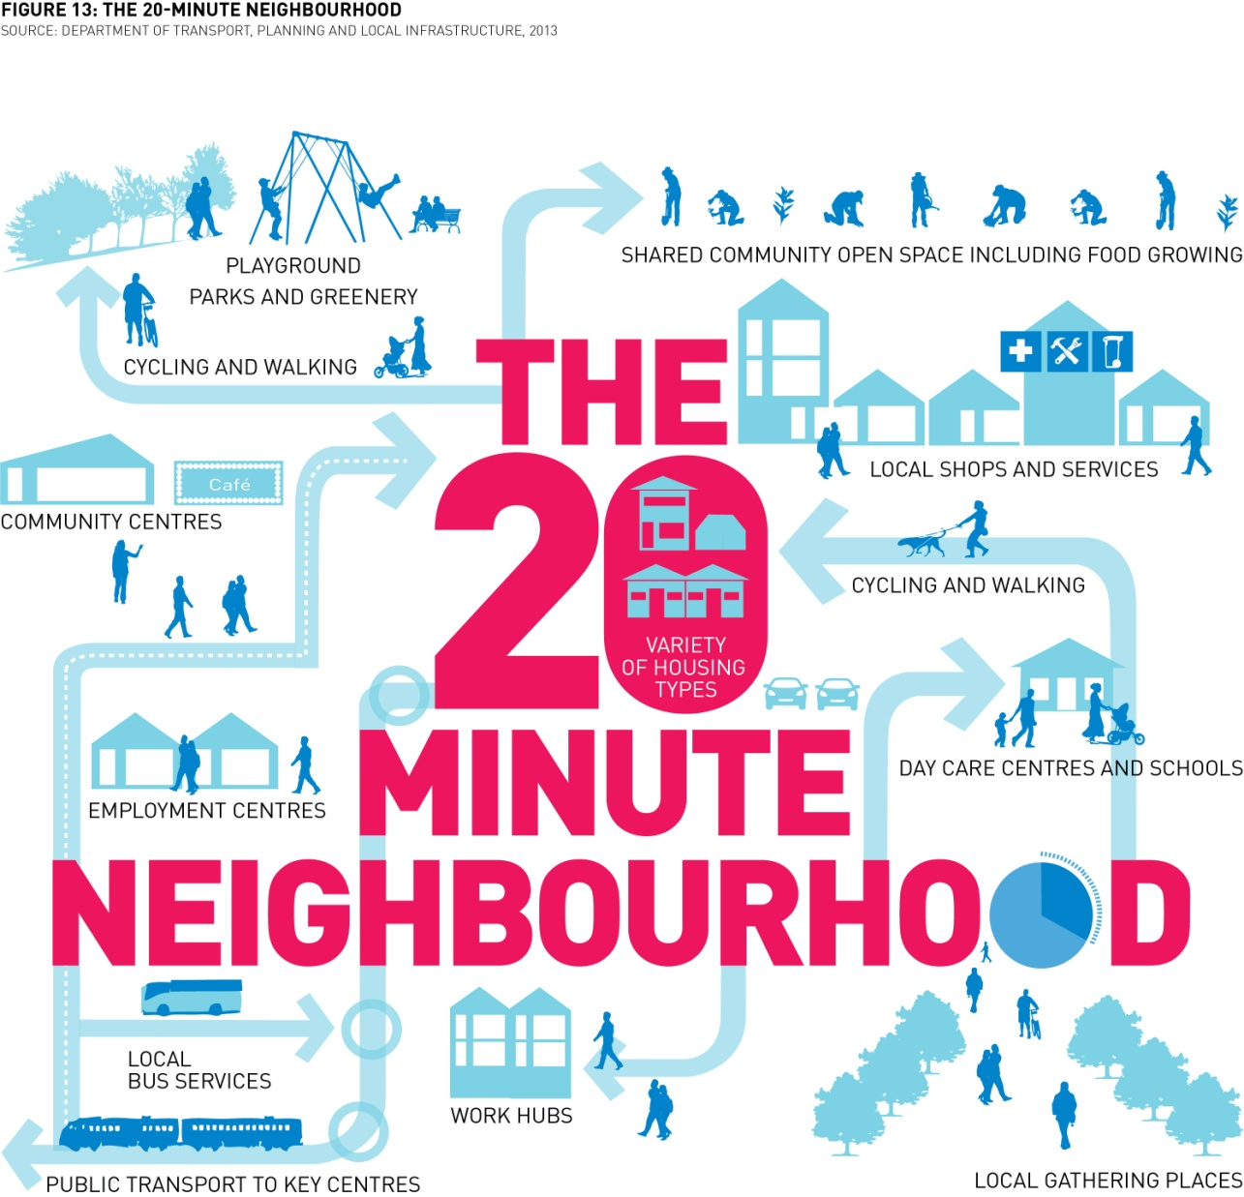
Most of Melbourne within 10km of NEC or MAC – including much of our Growth Areas. Supported by localised job centres in PSPs
Sunshine
La Trobe
Monash
East Werribee
Dandenong South

Slide 23
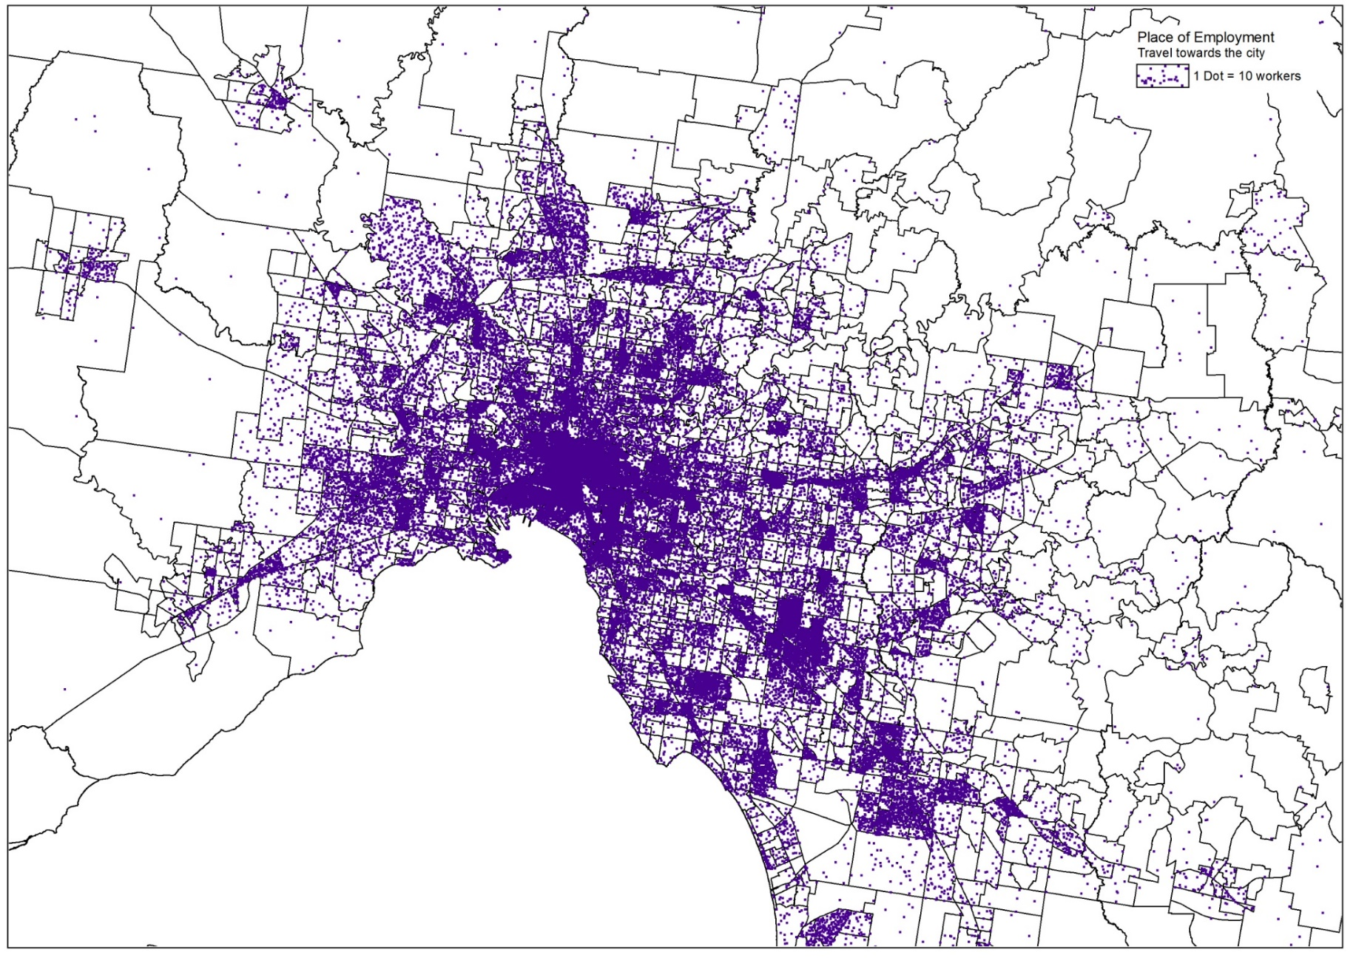
And we need to change metro wide transport movements - This shows ‘Towards’ the city – 58% of all trips … the most expensive … but only half of these go into final 2 km to GPO
 | Number of Jobs | Percent
Towards the City | 925,744 | 58.2%
Within 1 km of Home | 147,402 | 9.3%
Away from the City | 143,574 | 9.0%
Perpendicular to the City | 373,196 | 23.5%

Slide 24
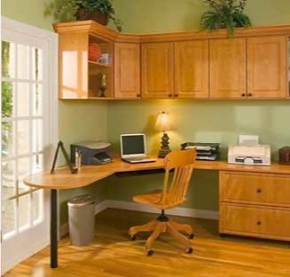
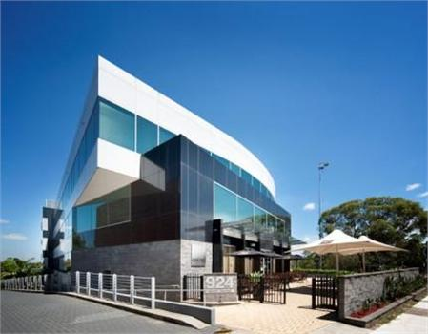
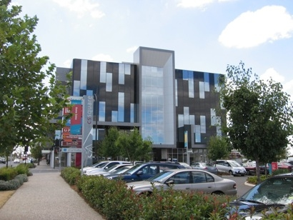
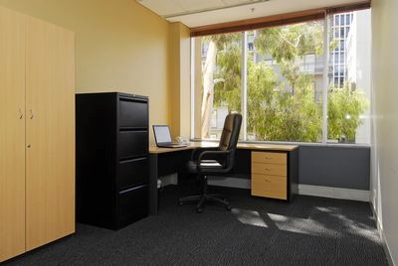
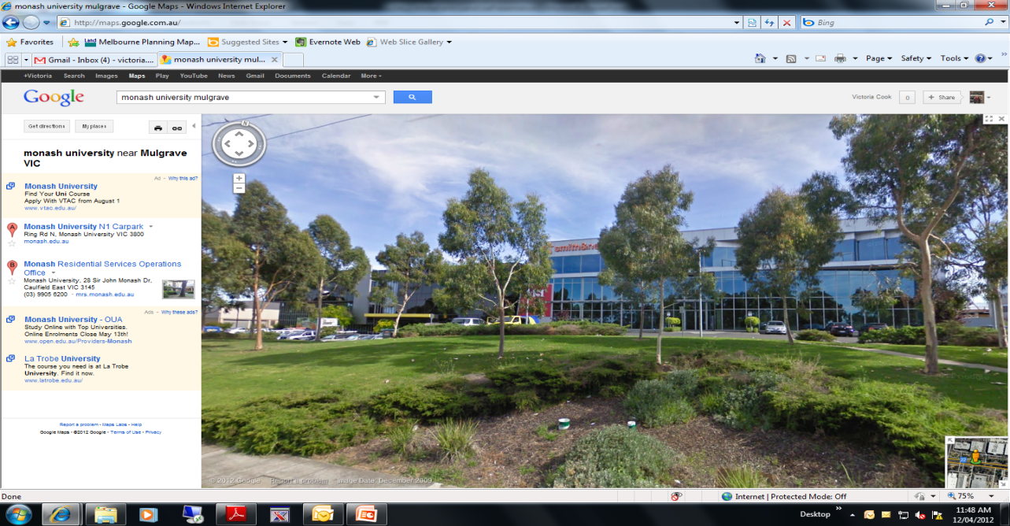
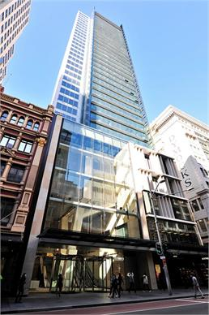
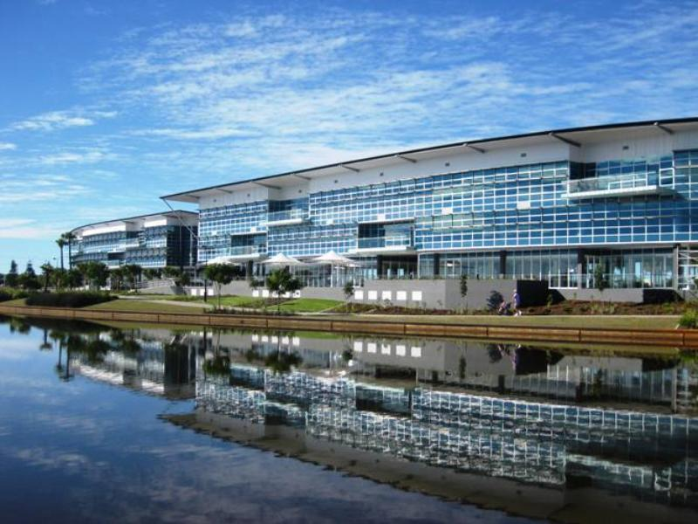
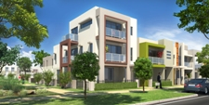
Our new Precincts are planning for a diversity of high quality Town Centres and Employment hubs (around 100 new centres needed) – providing high amenity, and clear business growth options
Home Based Business
9-15sqm
2 storey office building
2,629 sq m office space
6 storey office building
7,000 sq m office space
Serviced Office
10-30sqm
2-3 storey SoHO
Up to 50 sq m office space with residential above
28 storey office building
37,600 sq m office space
3 storey office building
7,000 sq m office space

Slide 25
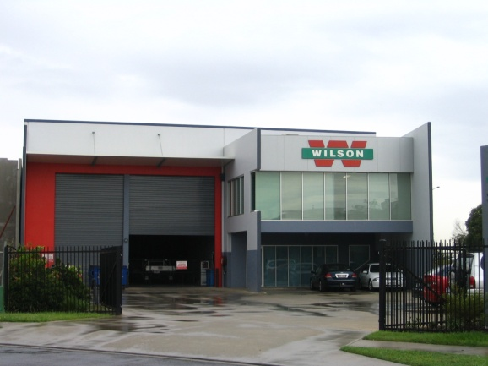
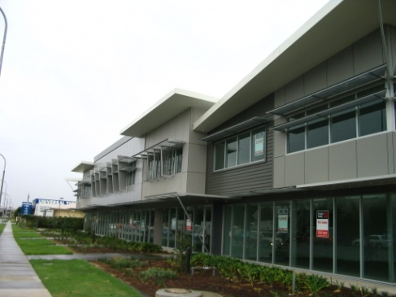
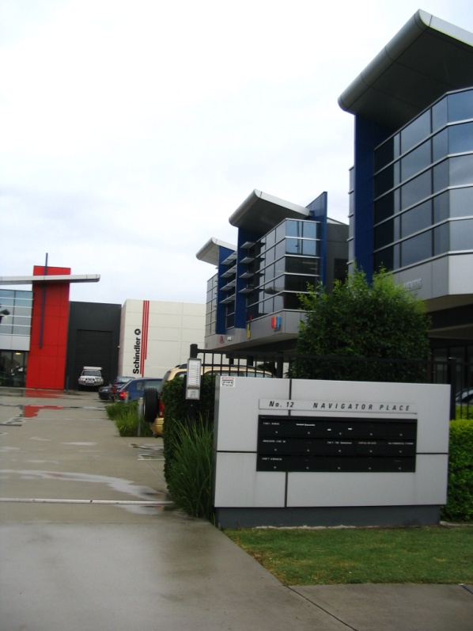
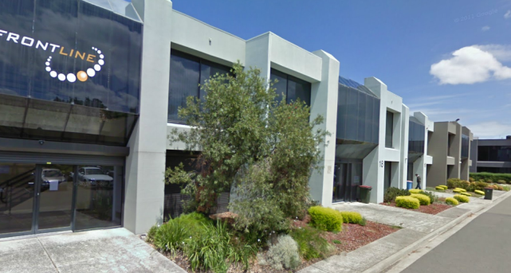
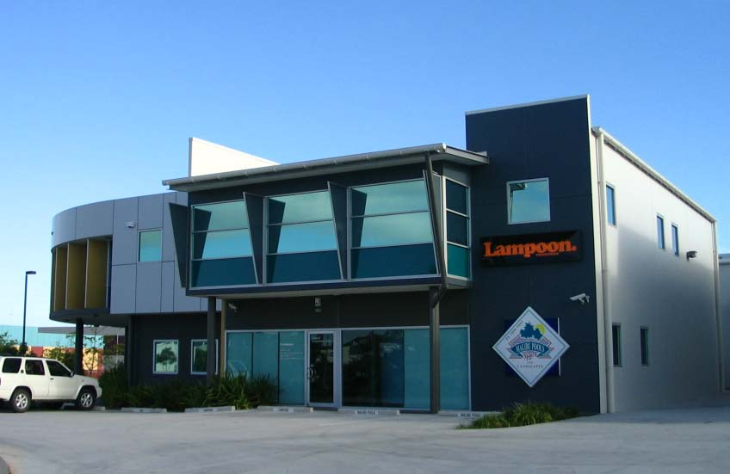
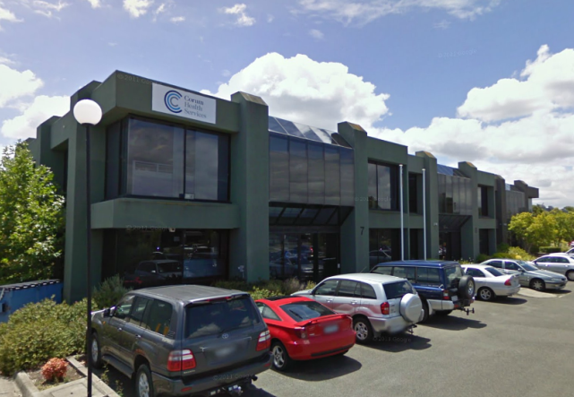
And dedicated areas for: Office / Warehouse, Office / Factory, Office / Showroom - Extremely versatile and adaptable forms of Development
Melbourne
These are our new Small Local Enterprise Precincts (SLEPs)

Slide 26
Putting our PSPs in the Melbourne Context
60 PSPs Completed
Including 7 in 2016 to date (>22,000 lots)
18 Underway (> 100,000 lots)
including several Council Led
5 to commence for 2017/18
~30 to be in future programs

Slide 27
VPA Leading Practice Series: New Designs on Greenfield Planning
Paul Byrne
Lead Director - Greenfields, Victorian Planning Authority
October 2016

