Slide 1


Slide 2
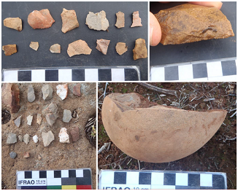
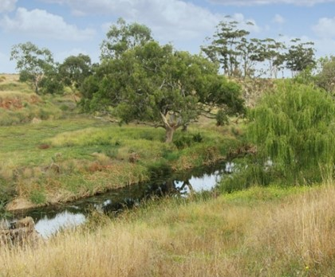
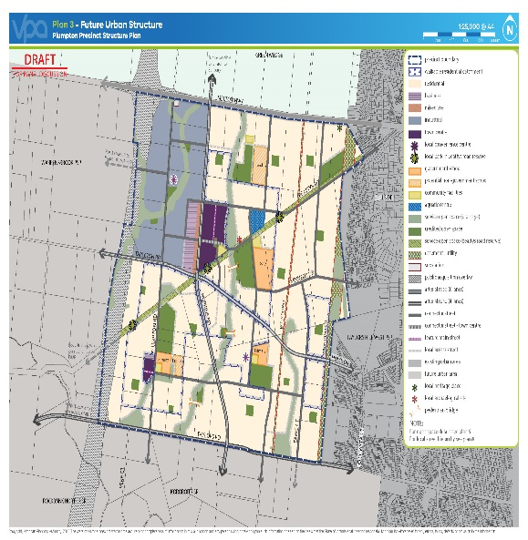
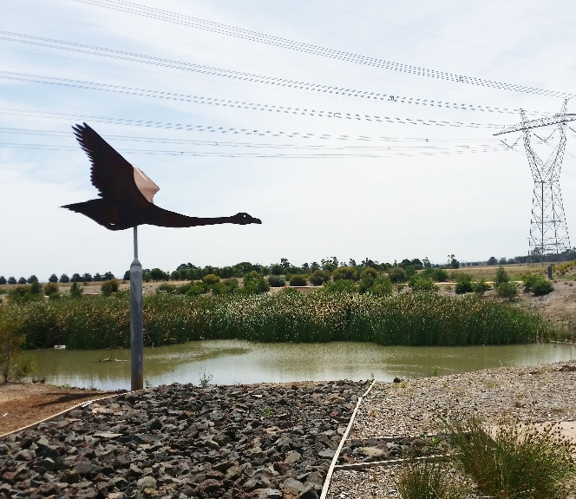
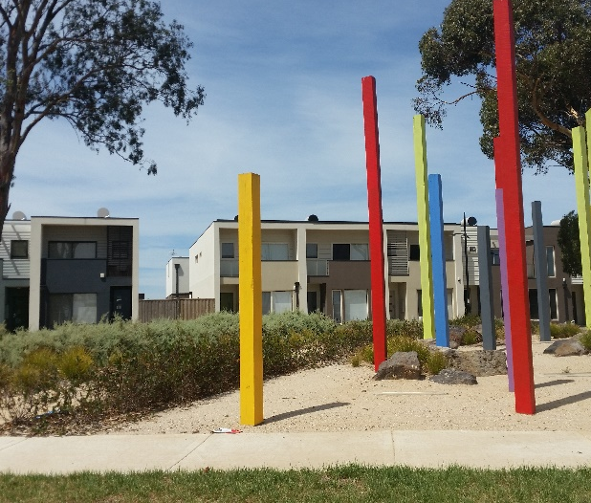
Plumpton & Kororoit PSPs: large, modern new suburbs for the West

Slide 3
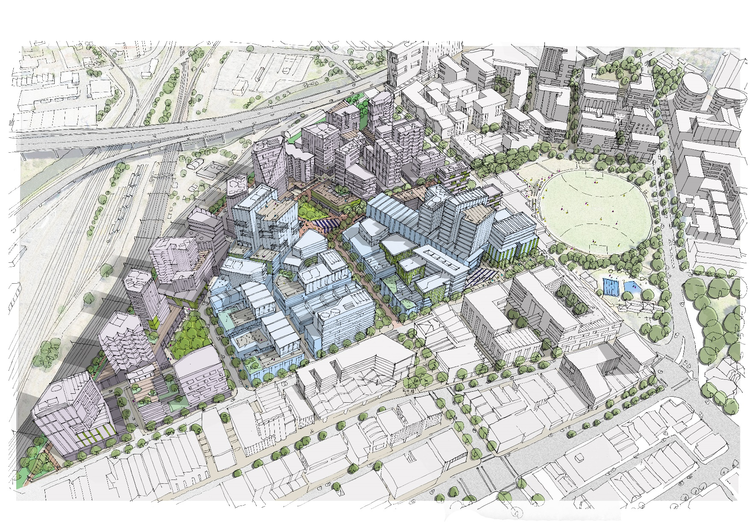
Arden: a new central city destination

Slide 4
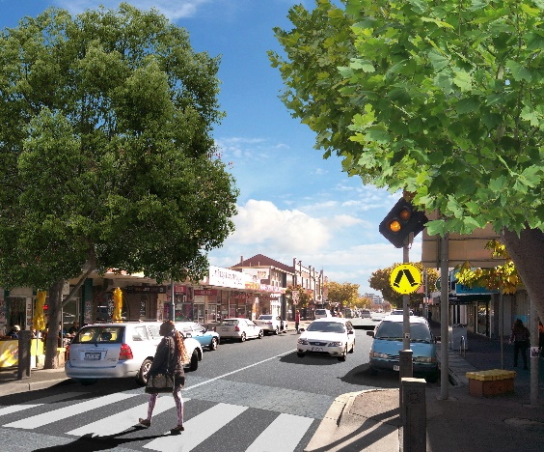
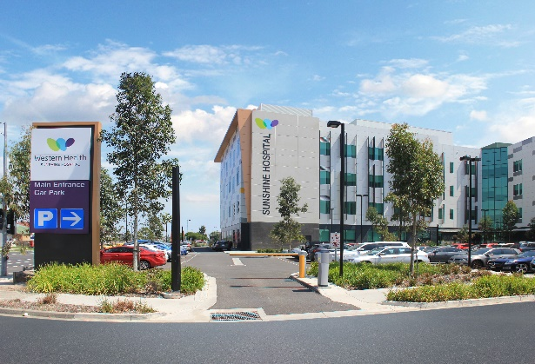
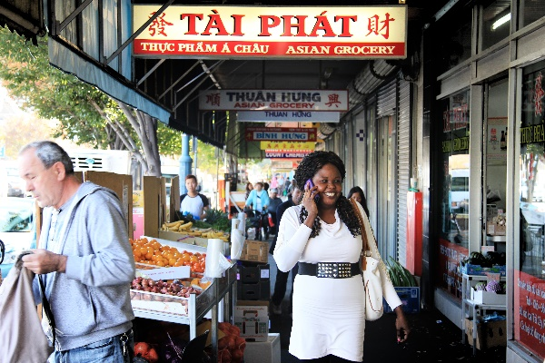
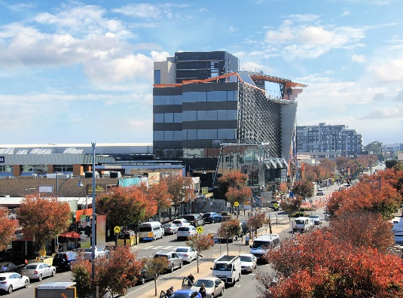
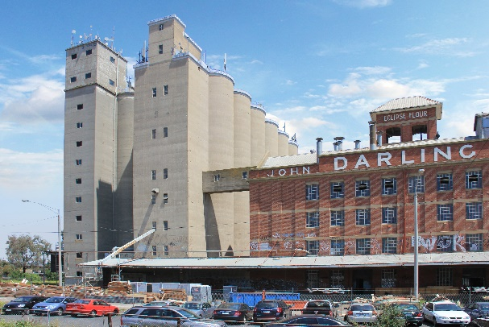
Sunshine cluster: a growing business precinct for the West

Slide 5
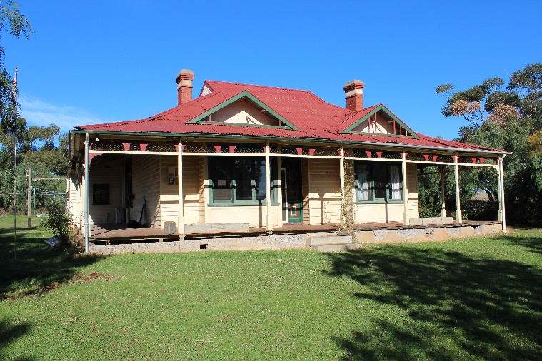
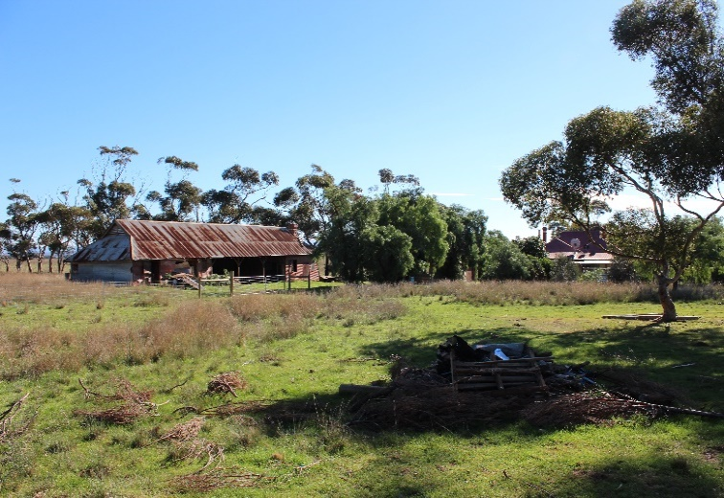
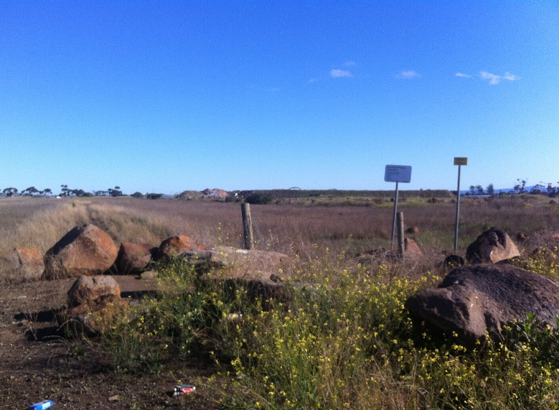
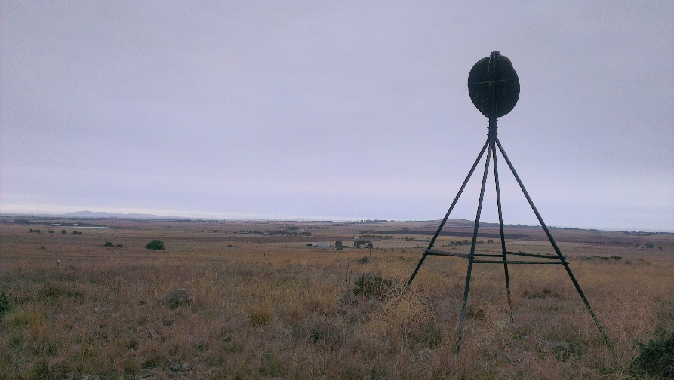
Mt Atkinson & Tarneit Plains: incorporating heritage into the PSPs

Slide 6
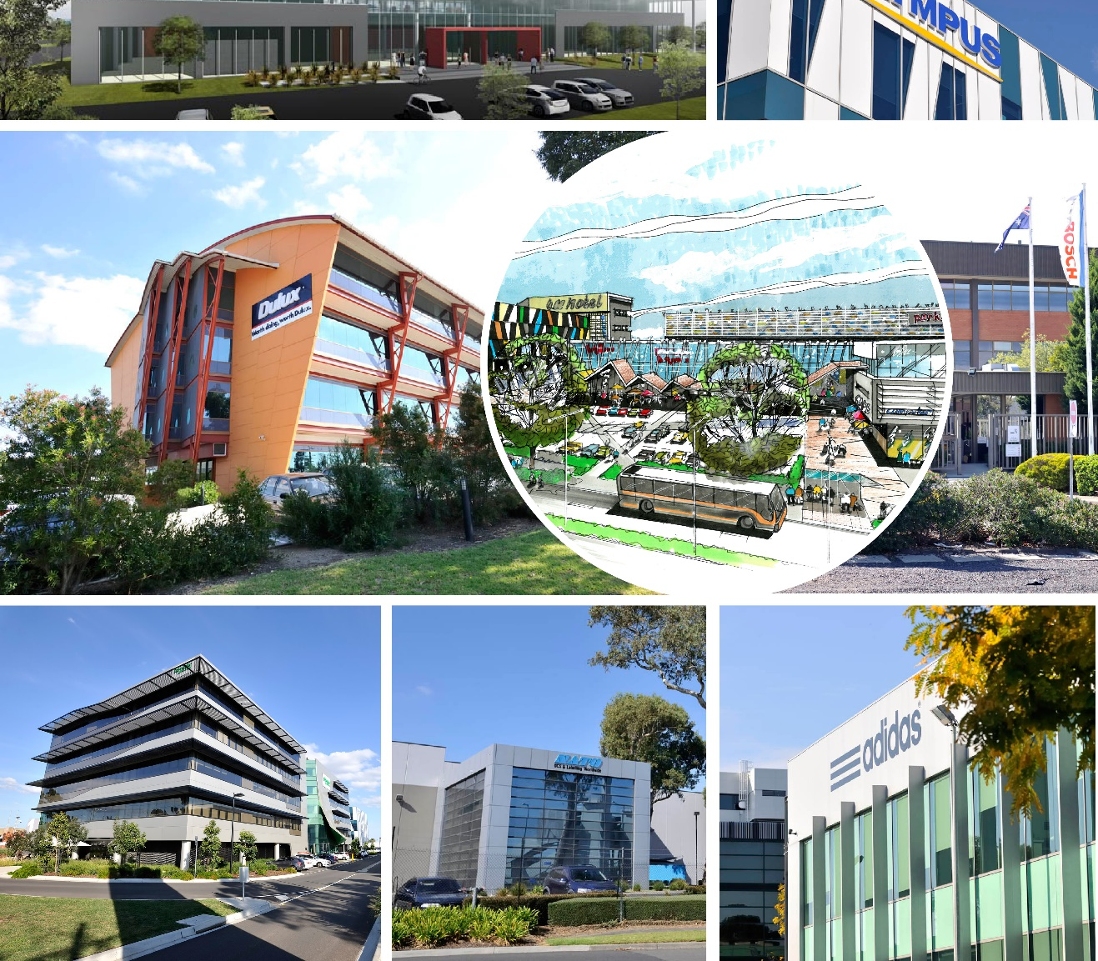
Monash cluster: creating a 21st century business precinct

Slide 7
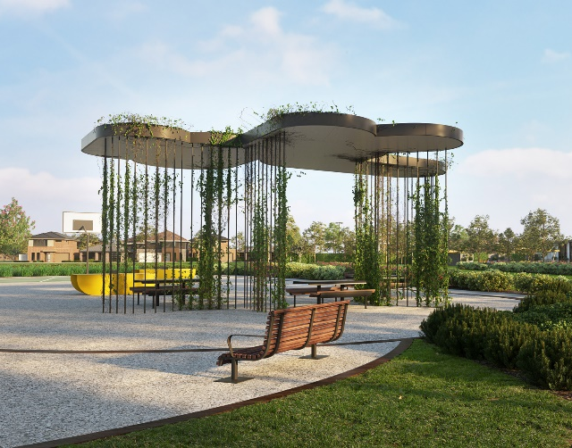
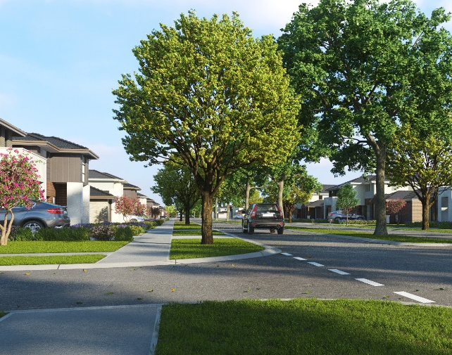
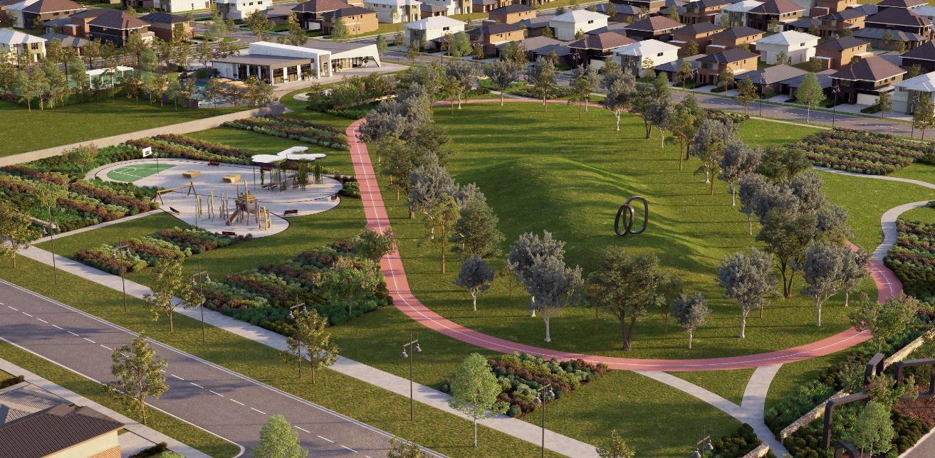
Rockbank PSP: approved

Slide 8
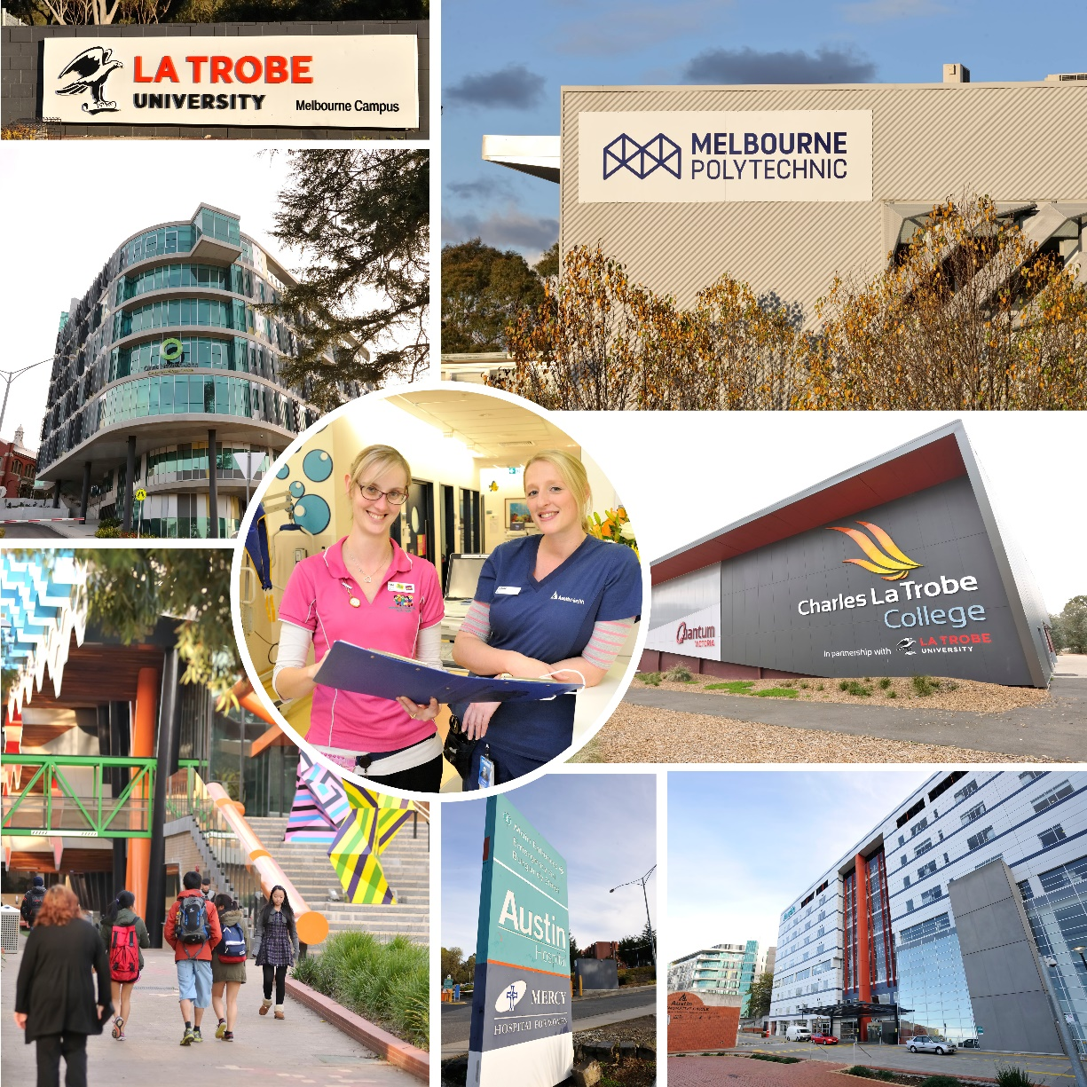
La Trobe cluster: leveraging health & education for research and innovation

Slide 9
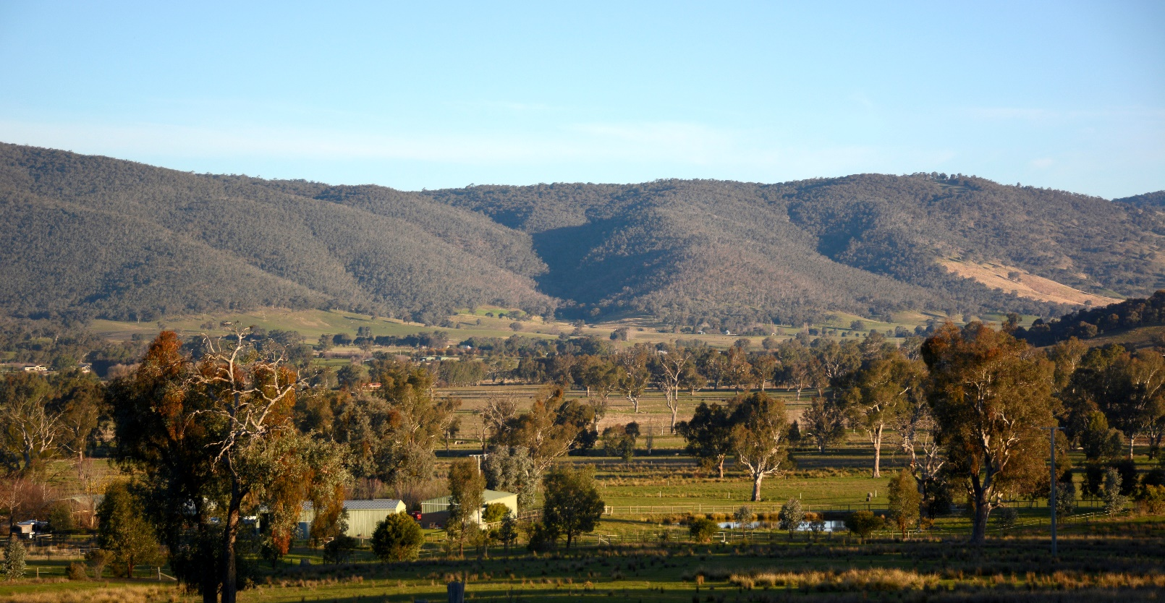
Leneva-Baranduda PSP: Wodonga’s growth area

Slide 10
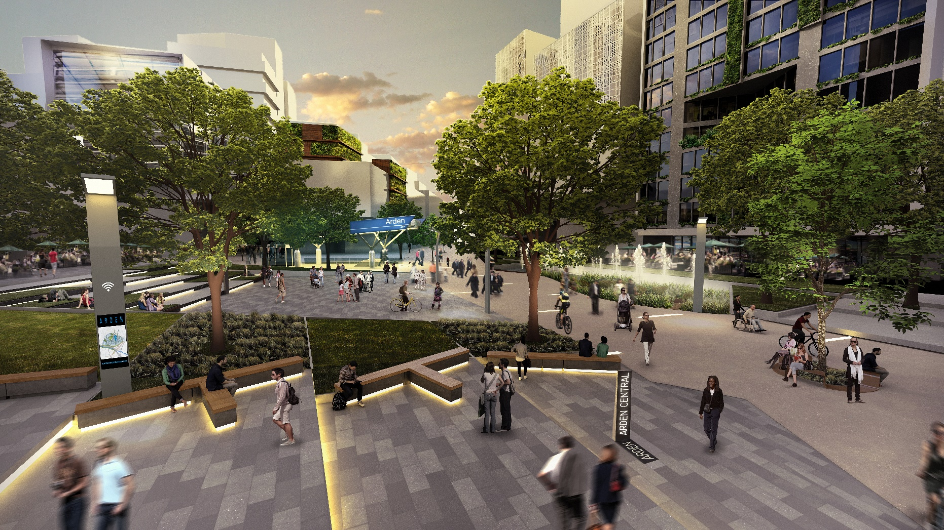
Arden civic heart: artist’s impression

Slide 11
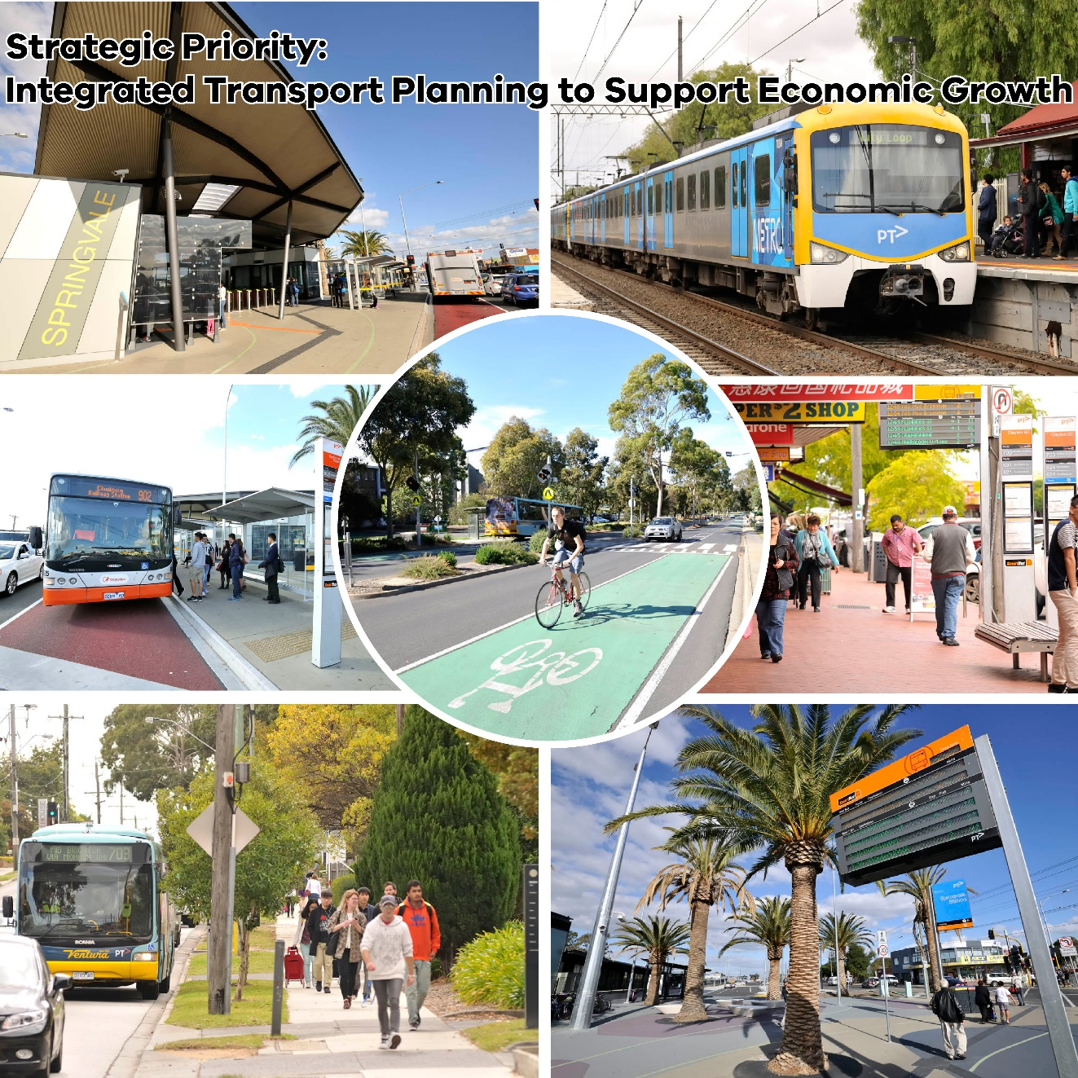
Monash cluster: better connections to support growth

Slide 12
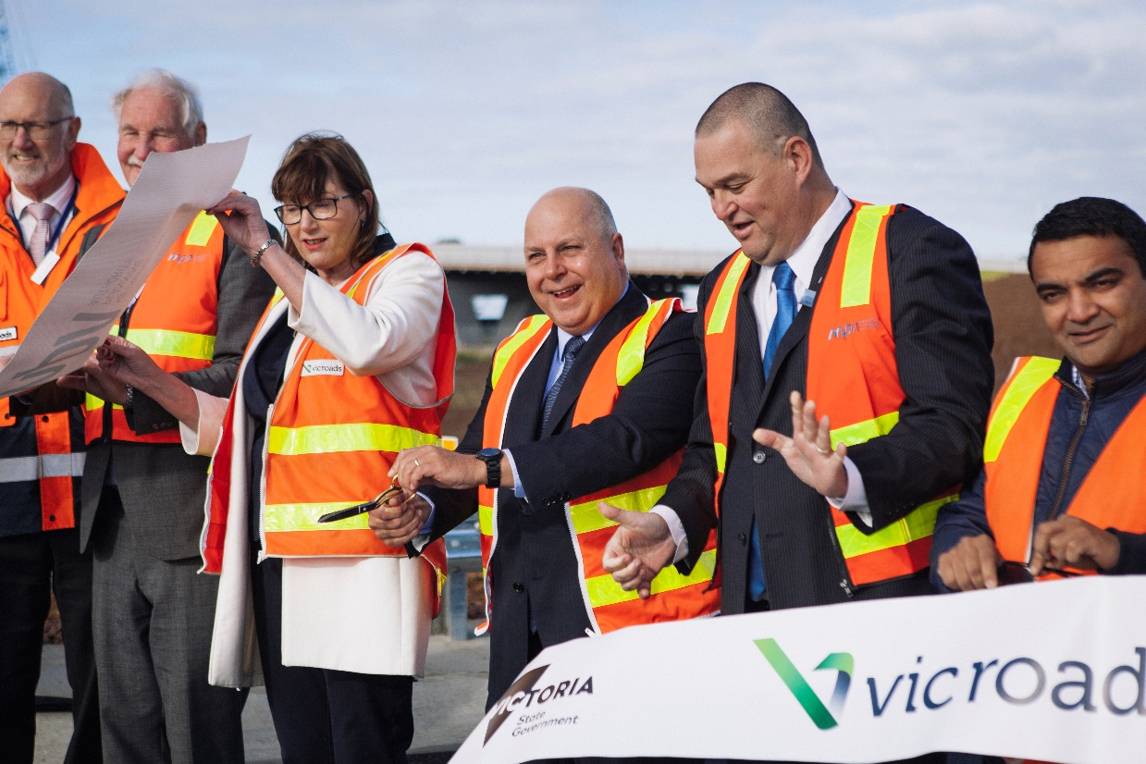
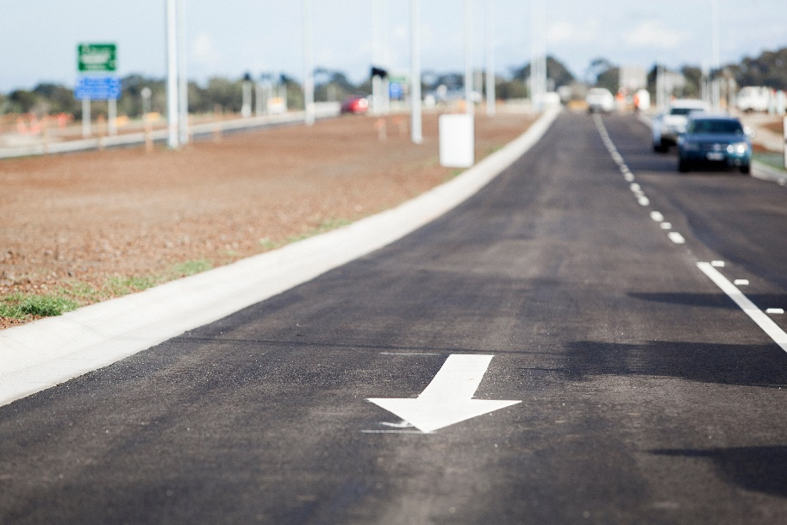
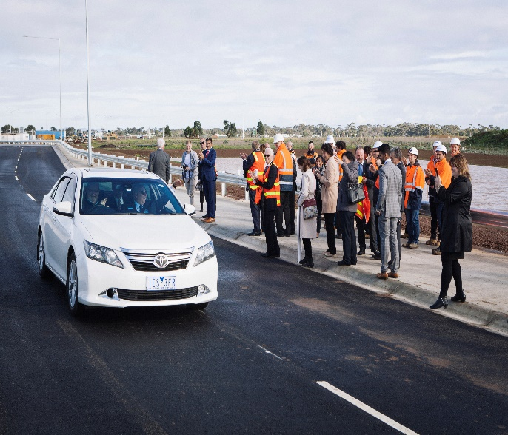
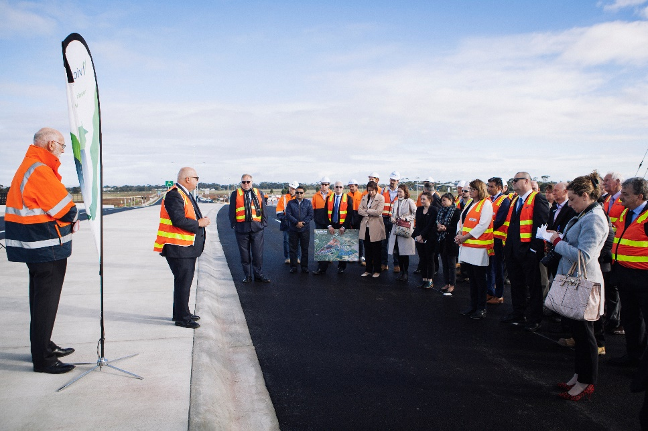
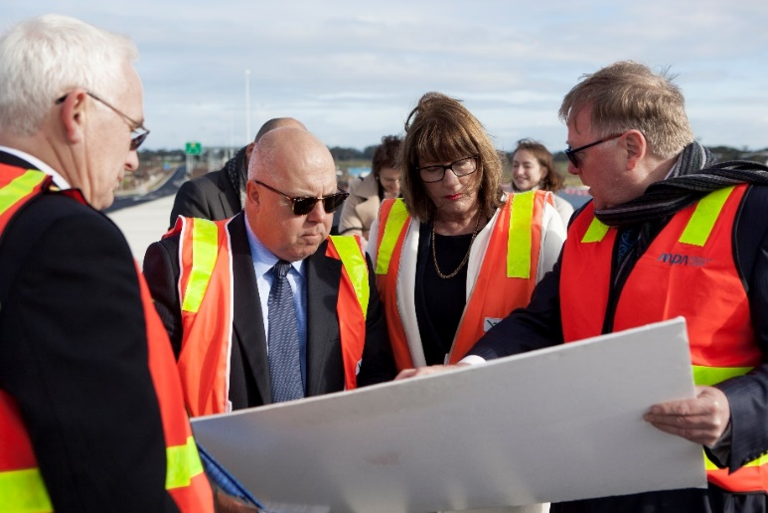
East Werribee: Sneydes Road Interchange completed

Slide 13
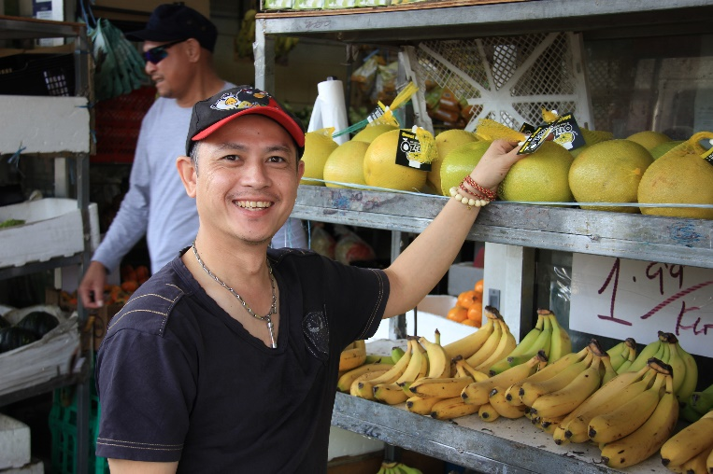
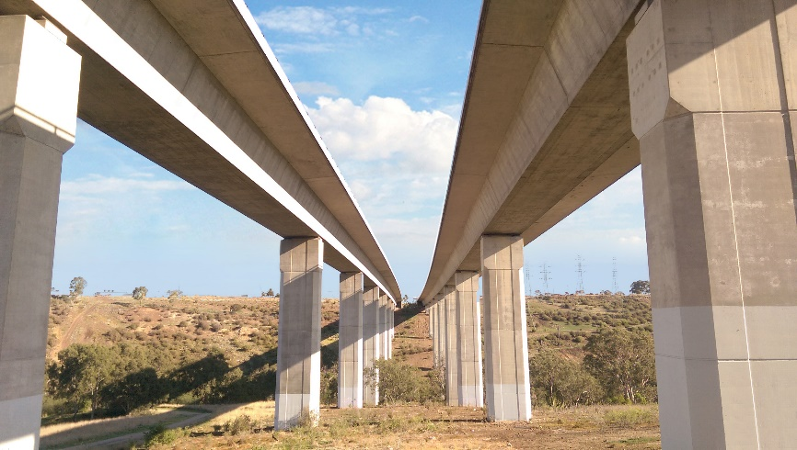
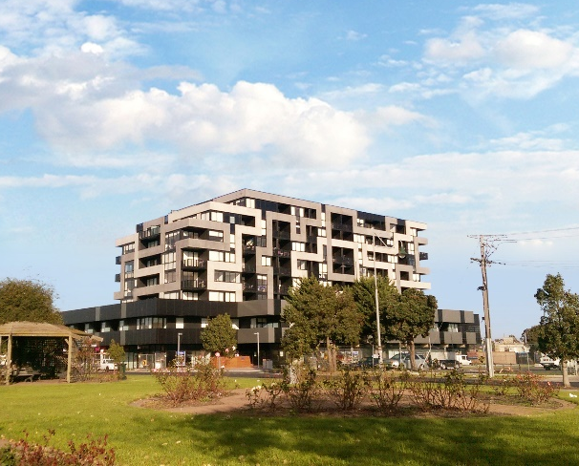
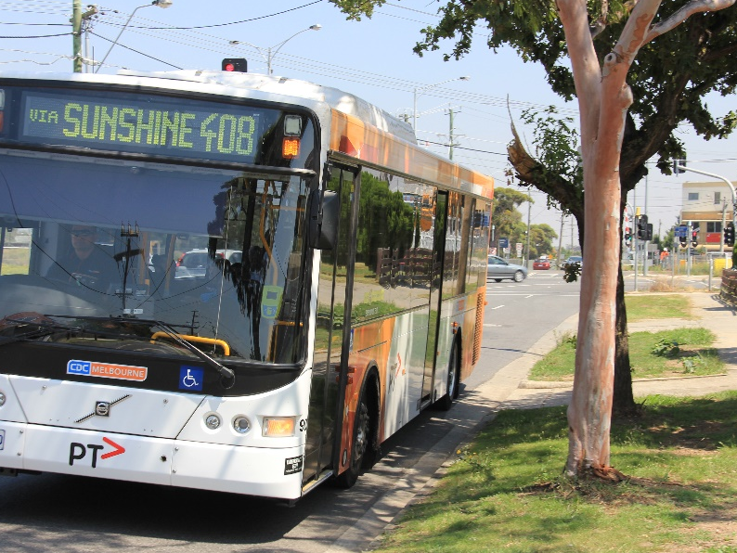
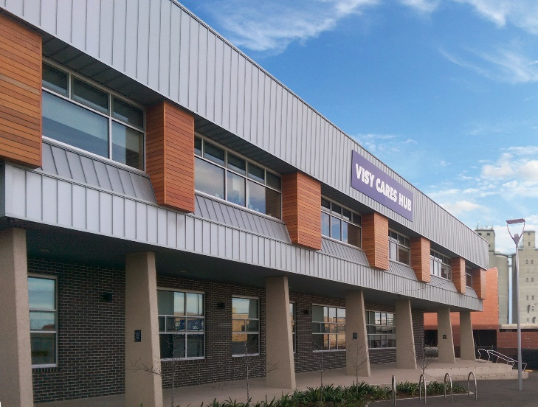
Sunshine Cluster: a framework plan for the future

Slide 14
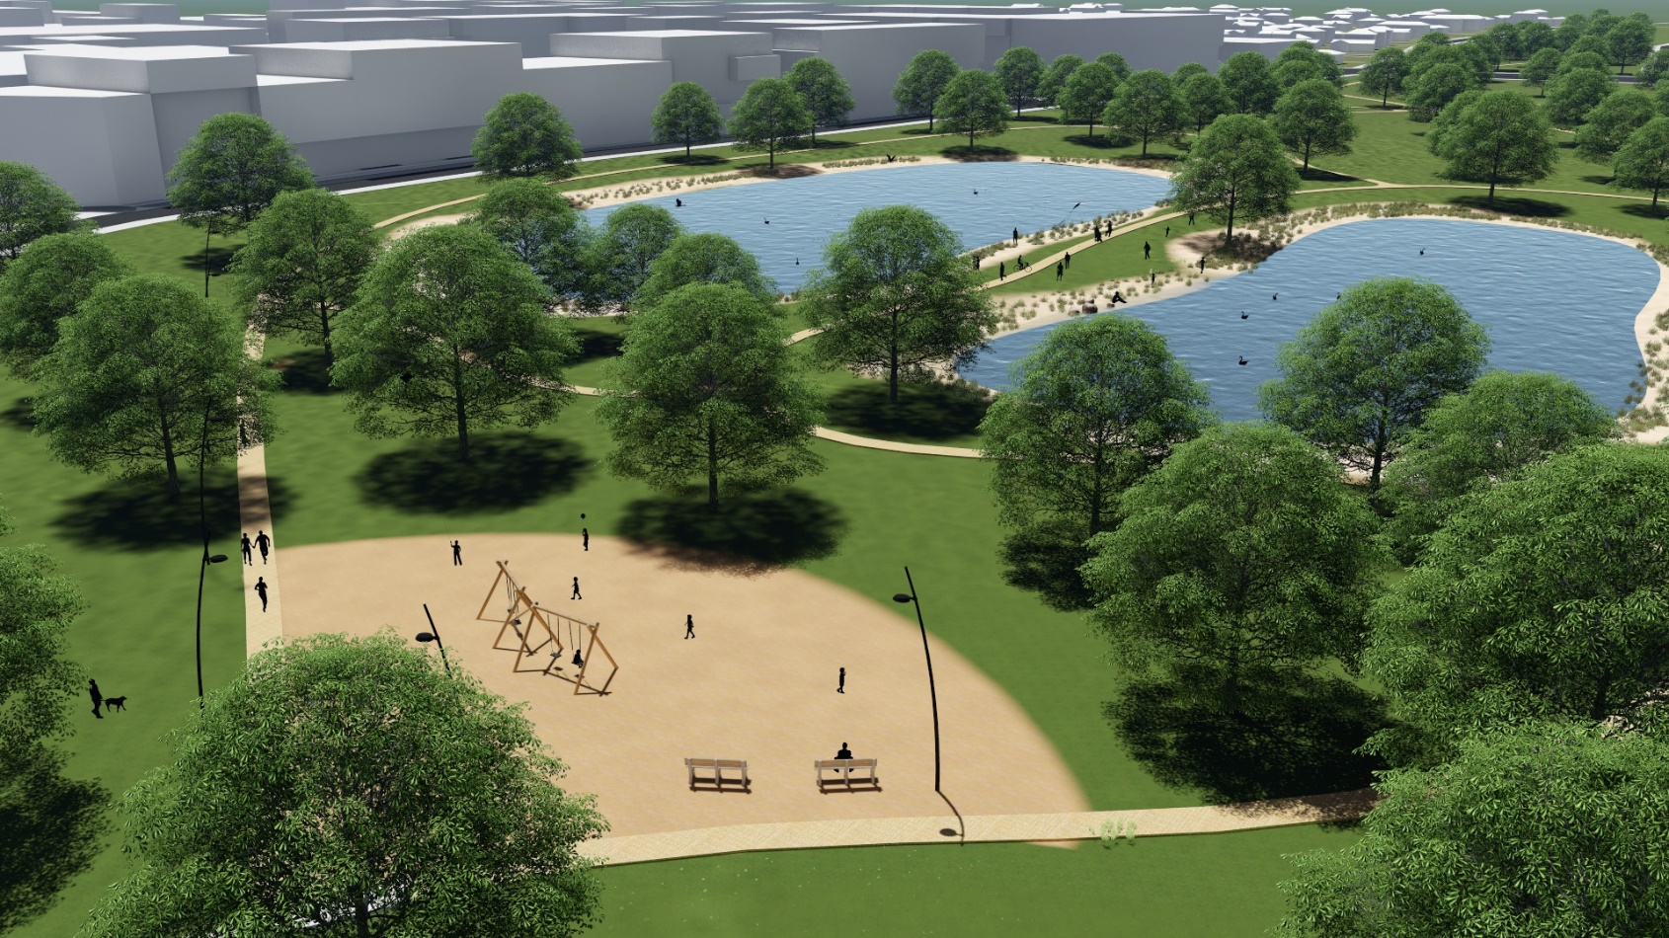
Plumpton (in Melton) PSP: future parks

Slide 15
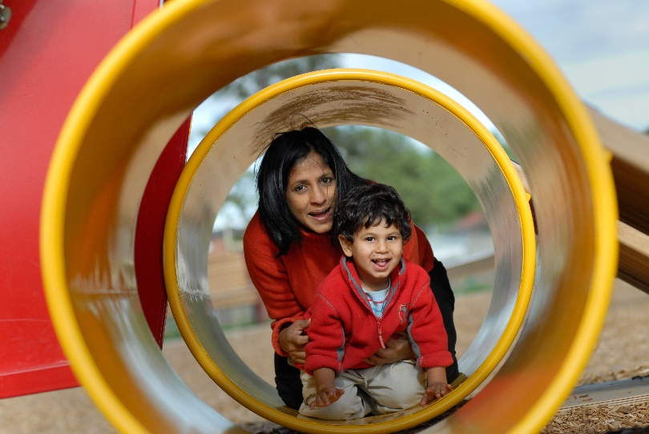
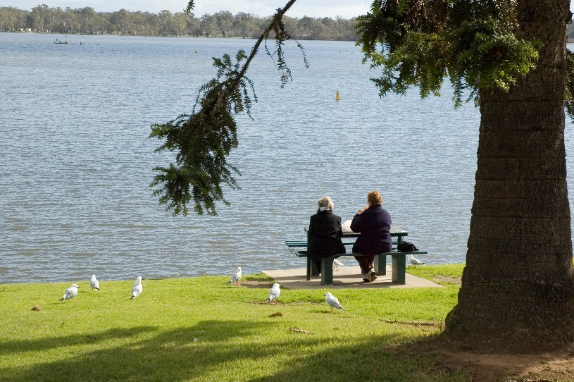
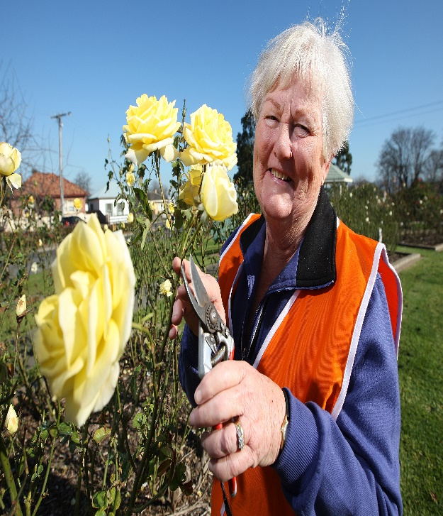
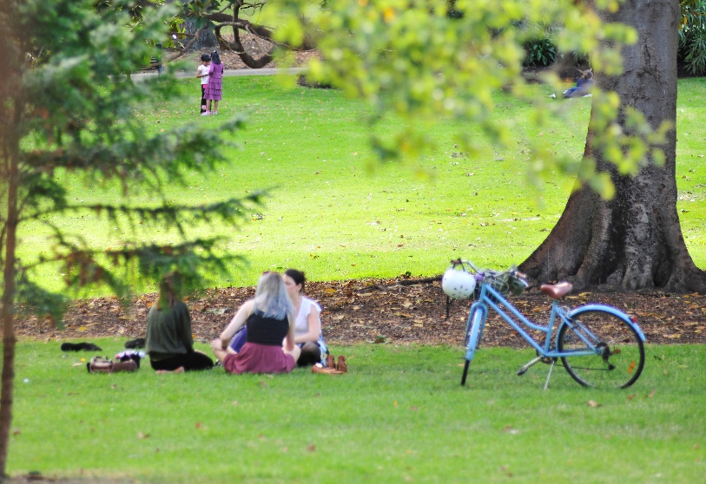
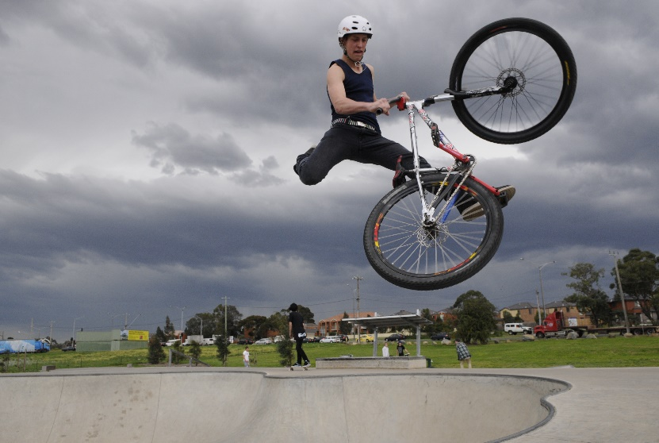
Open space: Melbourne’s new suburbs have the highest percentage in Victoria

Slide 16
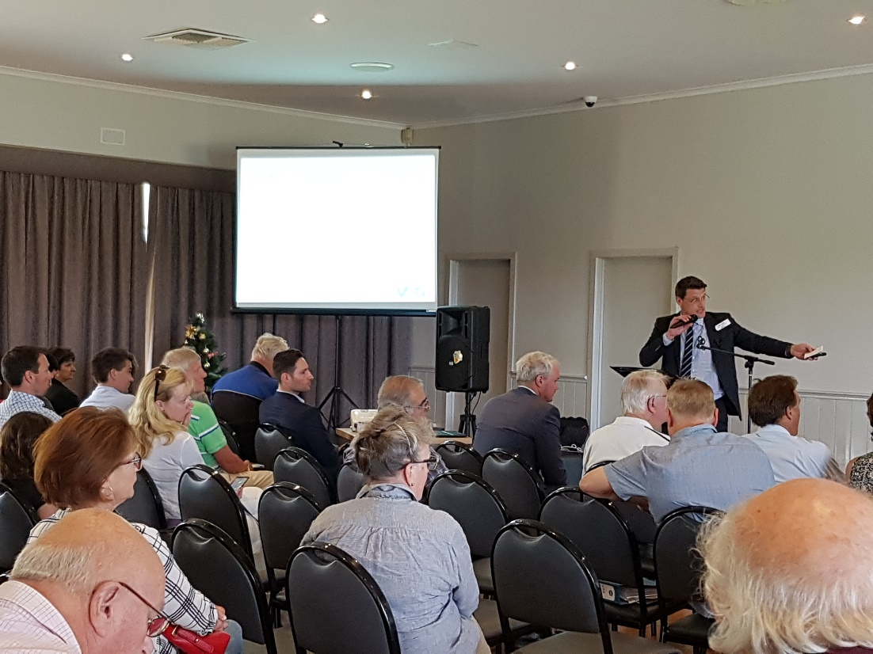
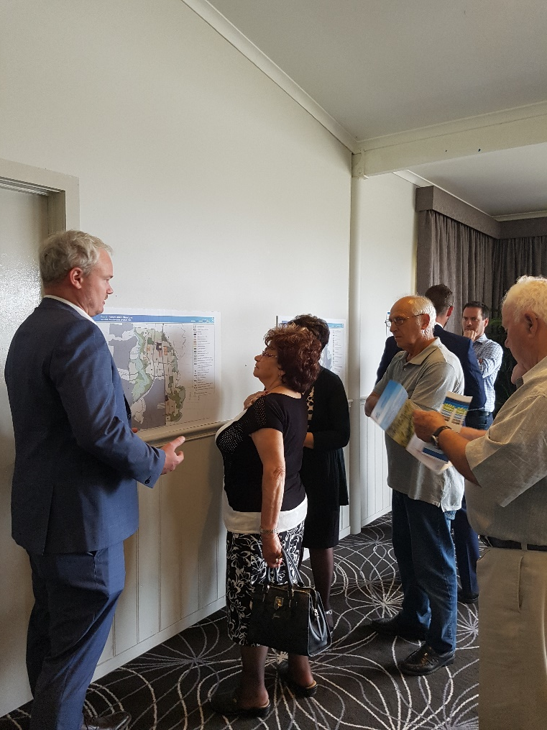
Community consultation for Sunbury South and Lancefield Road PSPs

Slide 17
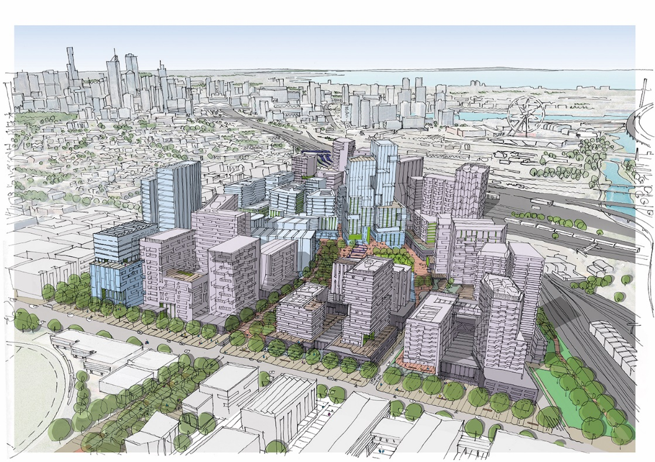
Where we work: urban renewal areas
Central Melbourne
Arden – Vision & Framework Plan
Macaulay DCP
Josephs Road DCP
Fishermans Bend Support
Dandenong/Eastern Corridor
Monash - Framework Plan
Clayton Structure Plan
Clayton Business Park
PMP Site - Clayton
Sandown Masterplan
Frankston Corridor SP's: Orm/McK/Bent
CD9 Corridor Structure Plans
Caulfield Precinct Structure Plan
Chadstone Framework Plan
Berwick Health & Education Structure Plan
Ringwood MAC revised Structure Plan
Wantirna Health Precinct Structure Plan
Northern Corridor
Broadmeadows MAC Framework Plan
La Trobe Cluster Framework Plan
Gower Street (La Trobe)
Essendon Technology Precinct Framework Plan
Mernda Town Centre Master planning
Western Corridor
Footscray MAC Structure Plan refresh and ICP
Tottenham/West Footscray Framework Plan
Sunshine Framework Plan
Sunshine Health Precinct Strategic site
Solomon Heights (Sunshine) strategic site
Watergardens Strategic site
Altona North Strategic site

Slide 18
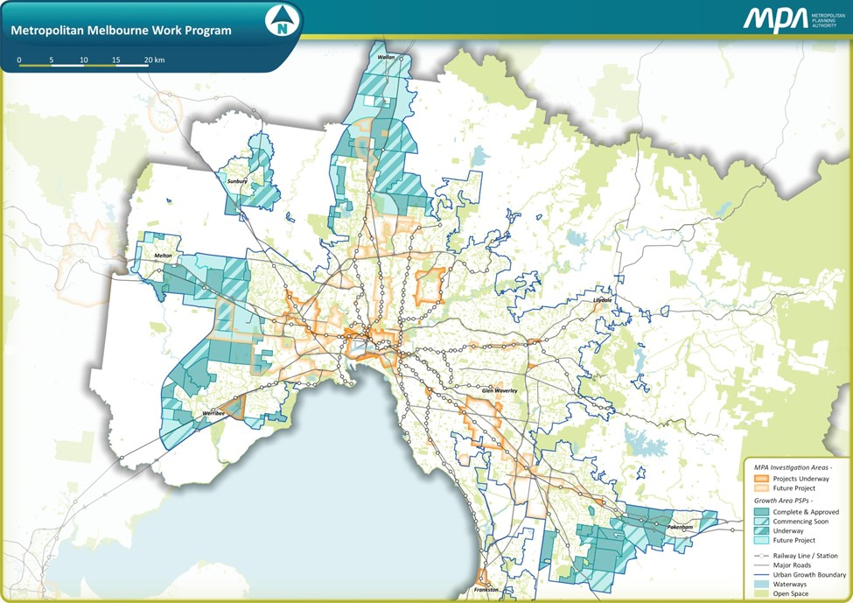
Where we work: greenfield areas
North Growth Corridor
Donnybrook/Woodstock
Quarry Hills
Wollert
EWEP - Divestment
EWEP - Ongoing planning
Lindum Vale
Merrifield North
Craigieburn West
West Growth Corridor
Rockbank
Mt Atkinson/Tarneit Plains
Plumpton/Kororoit
Kororoit (Part 2)
Aviator's Field
Werribee Junction
South East Growth Corridor
Casey Central Town Centre
Brompton Lodge
McPherson
Officer Town Centre
CREP (Officer Employment)
Minta Farm
Croskell
Clyde South
Minor Greenfield Projects
Sunbury South
Lancefield Road
Beveridge Central
Beveridge North West

Slide 19
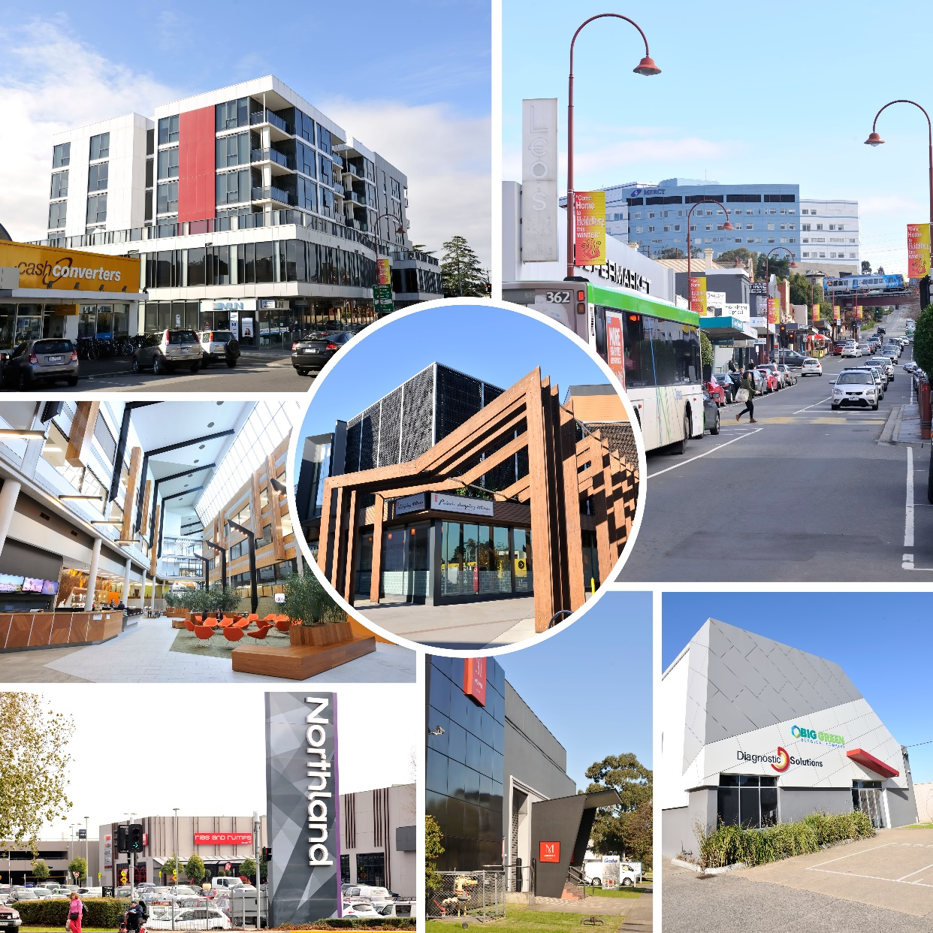
La Trobe cluster: jobs close to homes

Slide 20
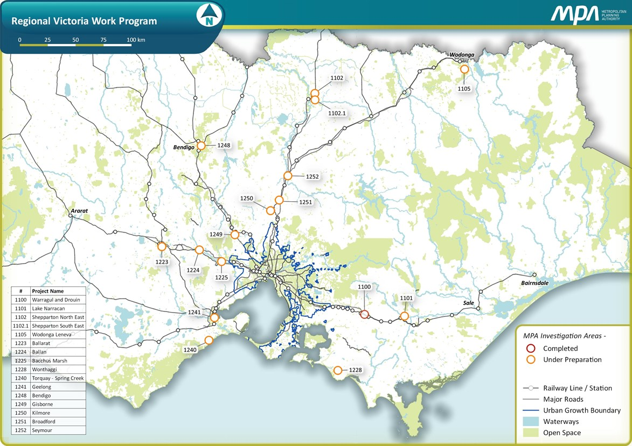
Where we work: regional Victoria
Bacchus Marsh Framework Plan
Plan Bendigo
Torquay - Spring Creek
Wodonga/Leneva
Shepparton South East
Shepparton North East
Shepparton Framework Plan
Latrobe Valley
Wallan South Structure Plan
Peri Urban Areas
Sunbury

Slide 21
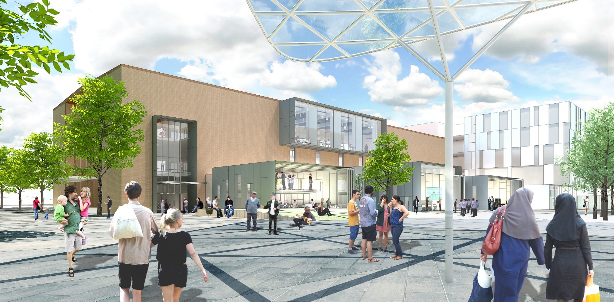
Greater Broadmeadows: urban renewal

Slide 22
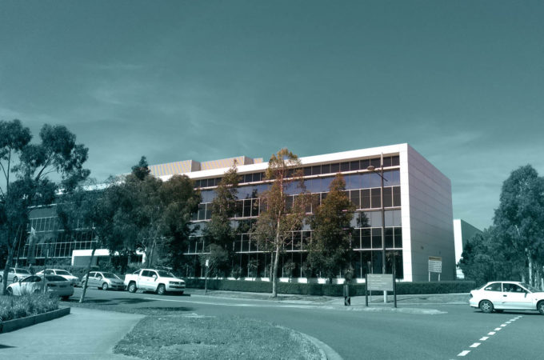
Craigieburn North Employment Area PSP: approved

Slide 23
The 10 tenets of the VPA’s approach to planning
Localising activities: minimising travel while increasing connectivity
Maintaining Victoria’s affordability advantage
Enhancing economic activity and jobs in the right places
Avoiding a two-tier Melbourne: inner vs the rest
Avoiding a two-tier state: Melbourne vs Regional
Improving design innovation, the public domain and environmentally and socially sustainable urban areas
Protecting the CBD
Planning for a different future: ageing, driverless vehicles
Streamlining planning processes and consulting with our communities
Paying for timely infrastructure and equity

Slide 24
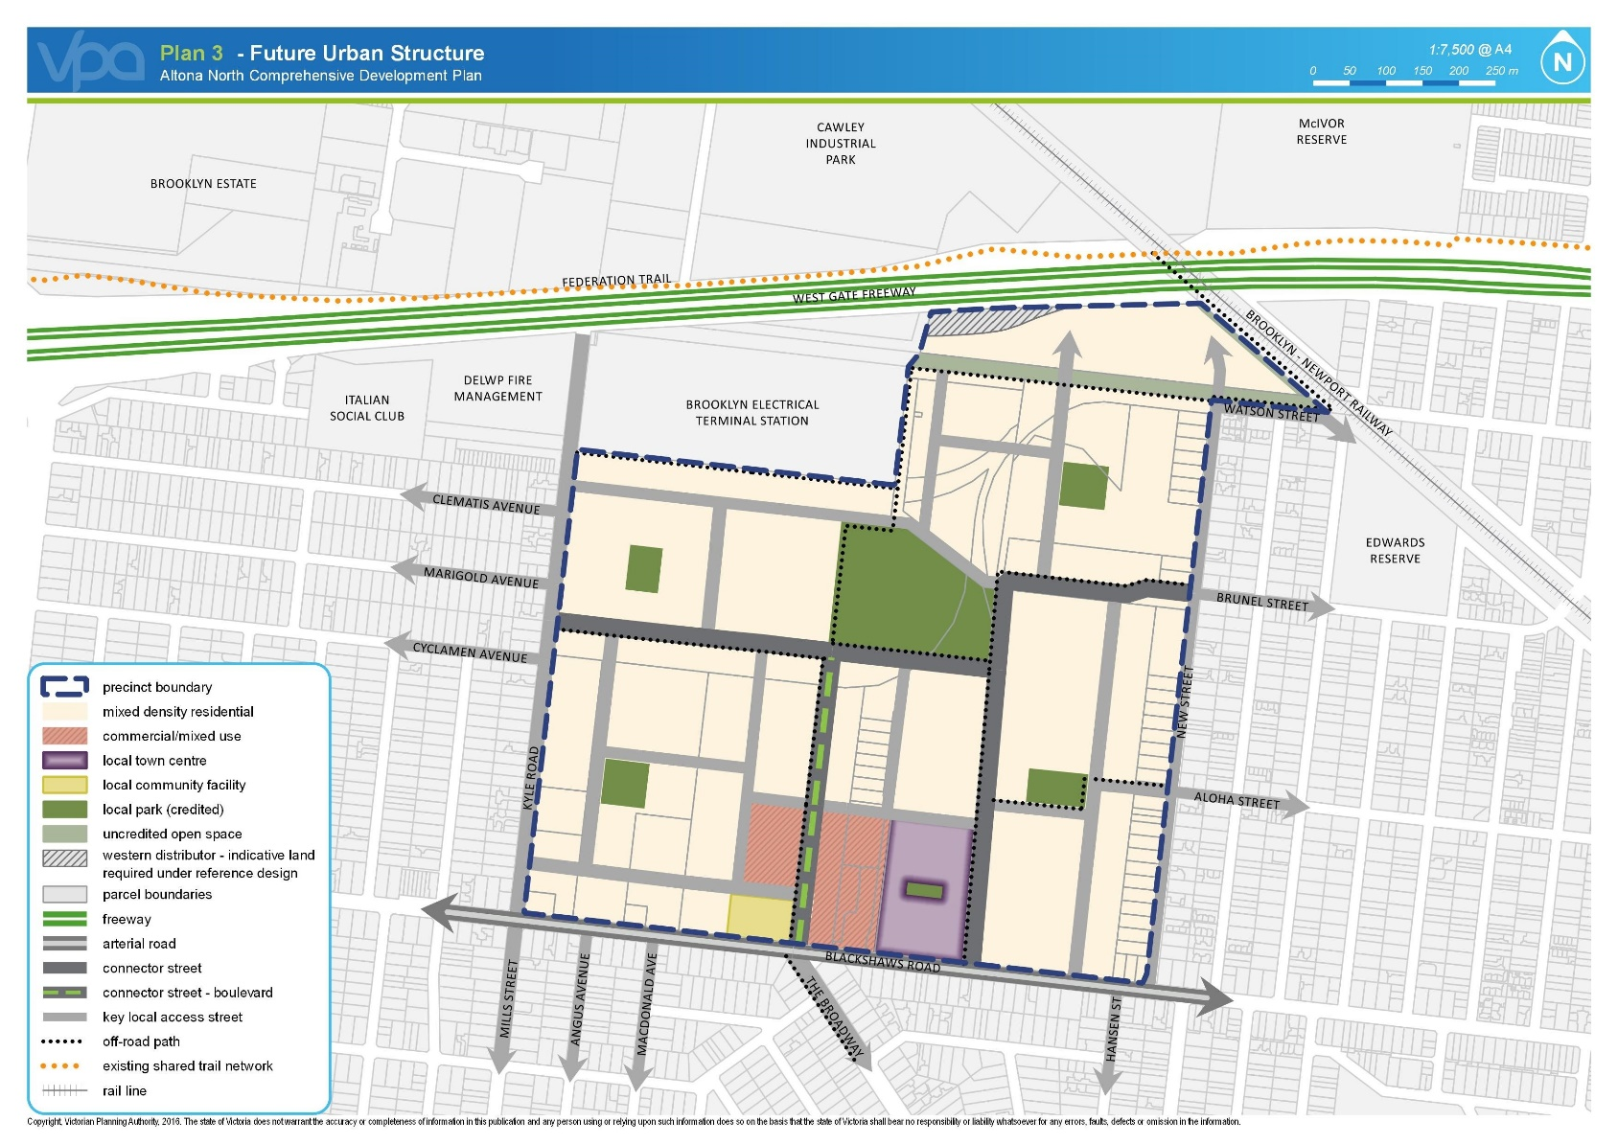
Altona North precinct: future urban structure for planned Amendment

Slide 25
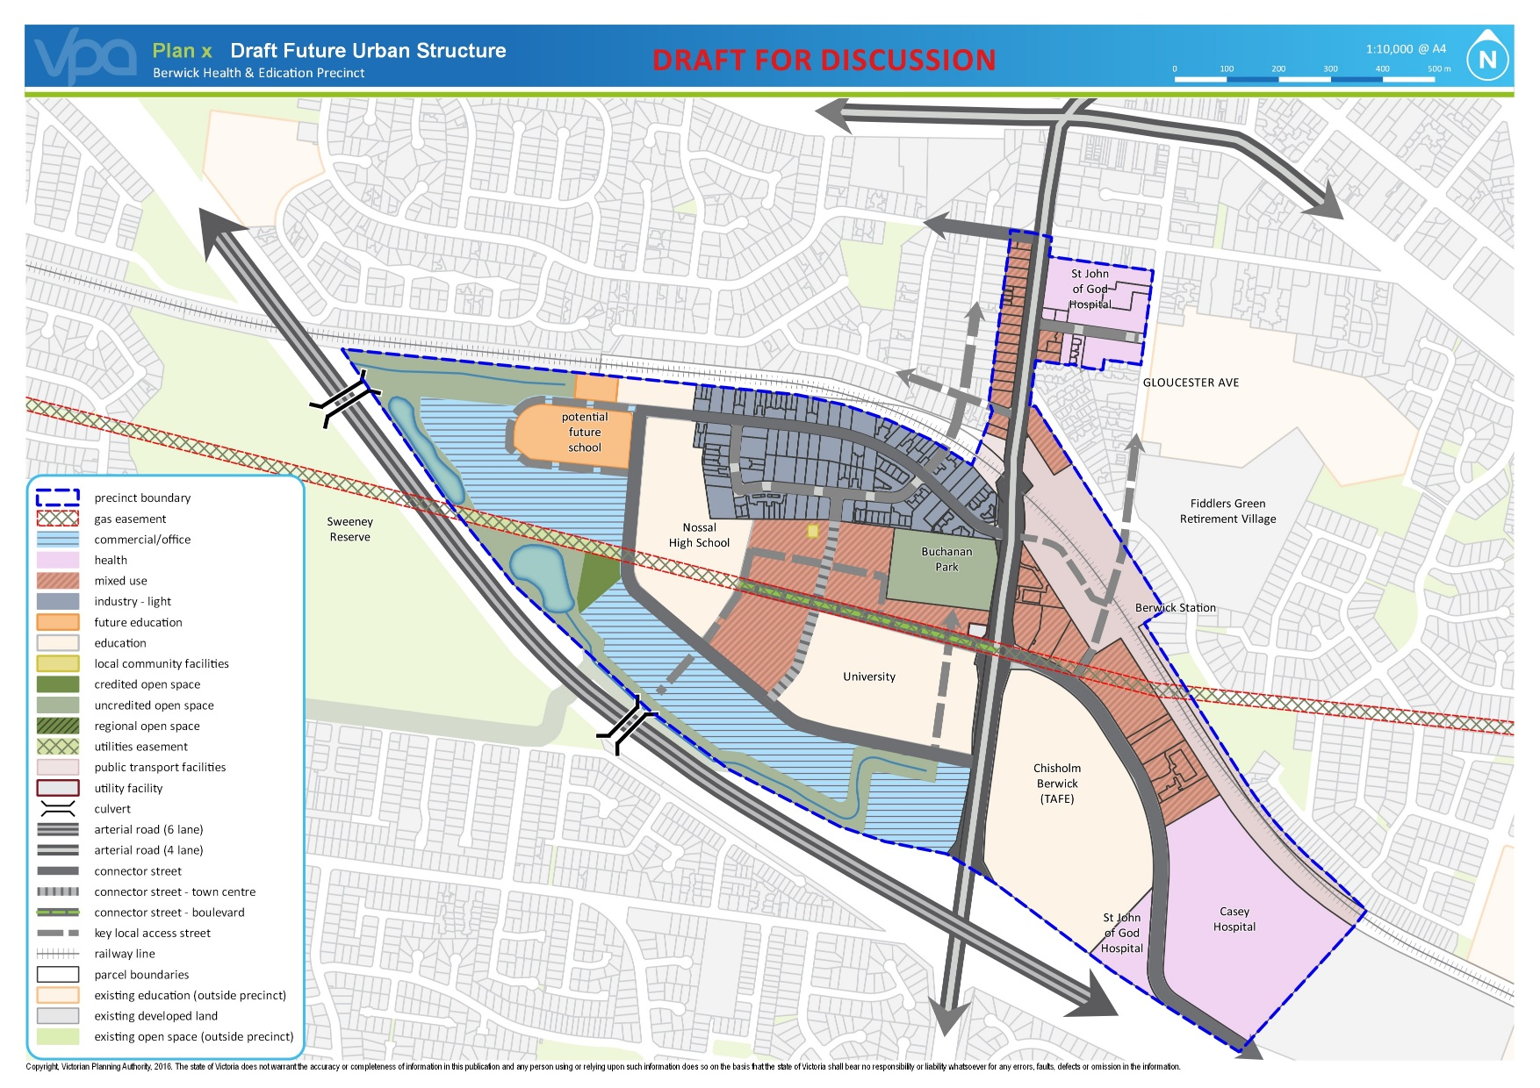
Berwick health & education precinct: creating a structure plan

Slide 26
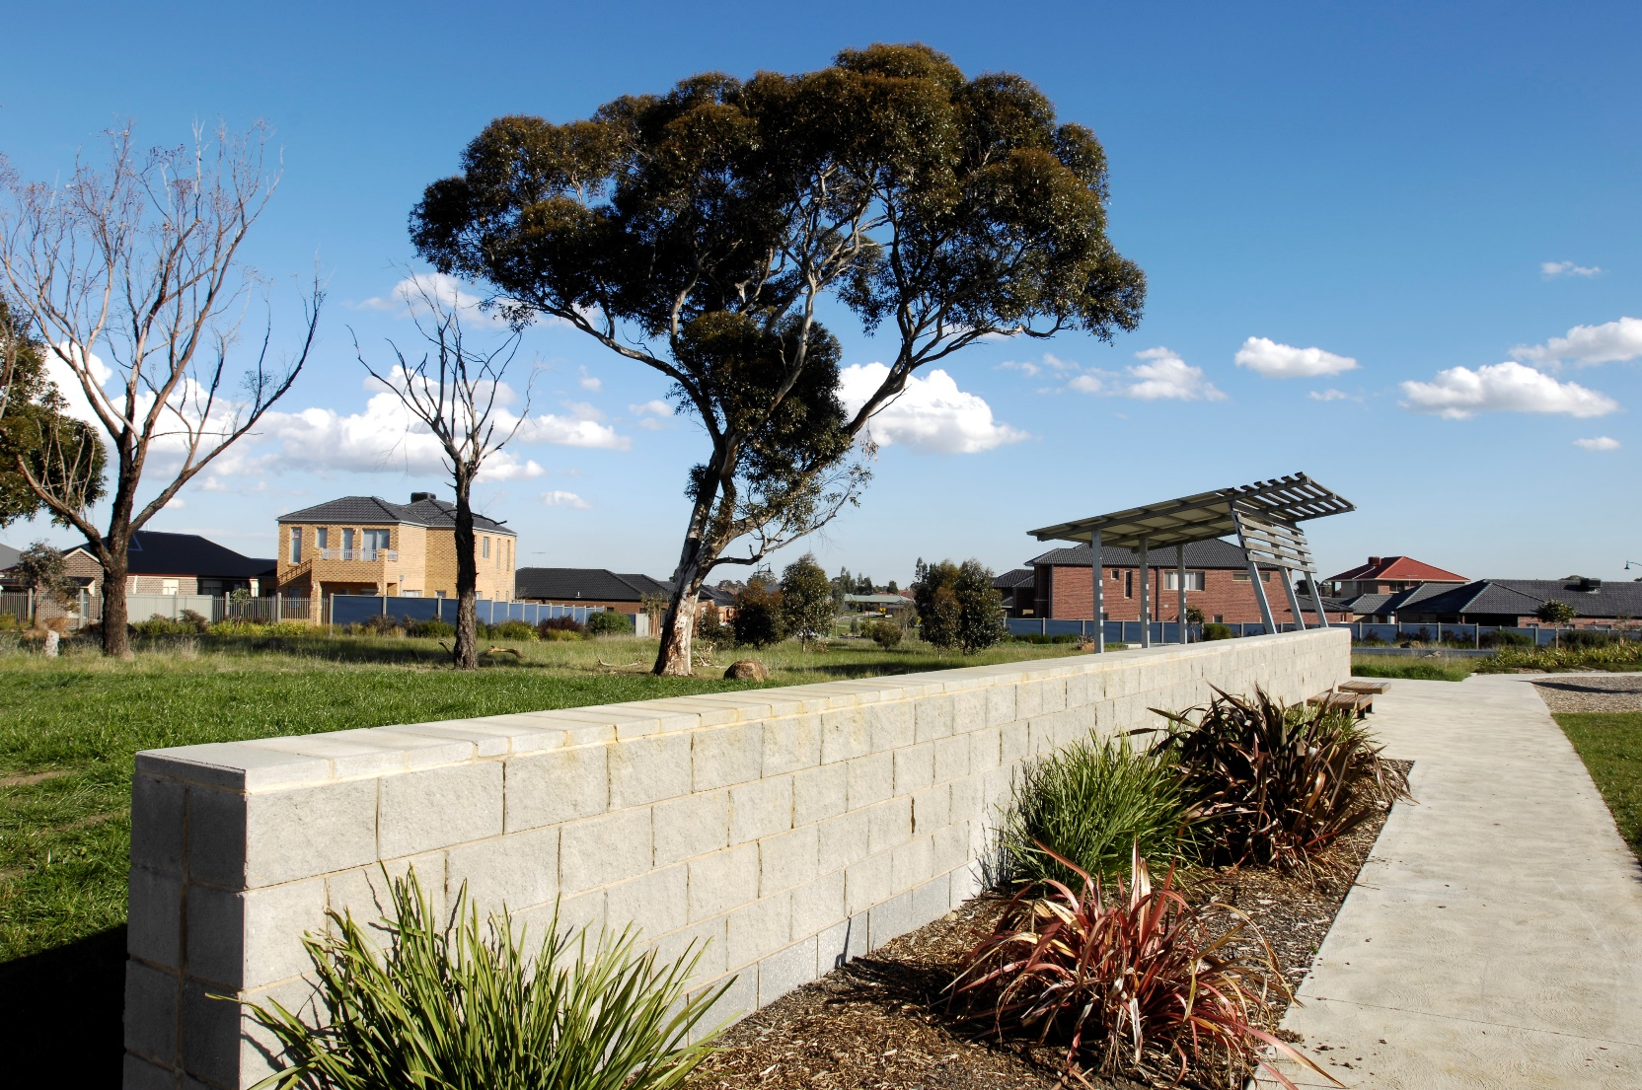
McPherson (in Clyde) PSP: released for exhibition

Slide 27

Beveridge central (in Mitchell Shire) PSP: Kelly House heritage preserved

Slide 28

Artist’s impression of the Berwick health & education precinct

Slide 29




Monash cluster: business focus groups
Monash cluster business focus groups

Slide 30

Bacchus Marsh: developing an urban growth framework

Slide 31

Minta Farm (in Casey): PSP being created

Slide 32

Fogarty Street, Arden: artist’s impression

Slide 33


Bendigo: working on Plan Bendigo

Slide 34

Jacksons Hill (Sunbury): creating a master plan

Slide 35

Donnybrook/Woodstock (in Whittlesea and Mitchell) PSP: being finalised

Slide 36
Leneva-Baranduda (in Wodonga) PSP: soon to be on exhibition

Slide 37




Broadmeadows: community consultation at the street festival

Slide 38



Arden: Draft Vision & Framework released and community consultation completed

Slide 39



Wodonga: planning the Leveva-Baranduda PSP

Slide 40

Lake Narracan (Latrobe Valley) PSP: approved

Slide 41


Consultation stats: Sunshine and Broadmeadows

Slide 42

VPA legislation: second reading has been through Parliament
“The Victorian Planning Authority will work with local government, utility providers, developers and across government to ensure that the infrastructure and services our communities require are planned for and delivered.
This planning will be based on the extensive strategic planning already done by state and local government and other stakeholders.
It will have an important focus on planning new housing in places that are not just affordable—but accessible to local jobs, hospitals and services.”
-Victorian Planning Authority Bill

Slide 43

Quarry Hills PSP: approved

Slide 44

Arden: summary of community feedback

Slide 45




Informing the public

Slide 46

Sunbury South PSP: released for exhibition

Slide 47

Lancefield Road (in Sunbury) PSP: released for exhibition

Slide 48

Brompton Lodge (in Cranbourne South) PSP: approved

Slide 49

Spring Creek, Torquay: supporting council to create a PSP

Slide 50


Plumpton & Kororoit: VPA successfully working with 70 government authorities to develop PSPs
Ambulance Victoria
Anglican Diocesan Schools Commission
APA GasNet Australia Group PTY LTD
APA Group
Ausnet Services
Australian Council for Islamic Education in Schools
Australian Council of Jewish Schools
Australian Energy Market Operator AEMO
Bicycle Network Victoria
Catholic Archdiocese of Melbourne
Catholic Education Office Melbourne
Christian Schools Australia
CitiPower and Powercor
City West Water
City of Melton
Country Fire Authority
Court Services Victoria
Department of Economic Development, Jobs, Transport and Resources
Department of Education and Training
Department of Environment, Land, Water and Planning – 5 divisions
Department of Health and Human Services
Department of Justice and Regulation
Energy Safe Victoria Environmental Protection Authority (EPA)
Heart Foundation
Heritage Victoria
Independent Schools Victoria
Jemena
Melbourne Water
Metropolitan Fire Brigade
NBNCo Limited
Aboriginal Victoria
Parks Victoria
Public Transport Victoria PTV
SP Ausnet
Sport and Recreation Victoria
State Emergency Service SES
Uniting Church of Australia
VicHealth
VicRoads
Victoria Police
Victorian Ecumenical System of Schools
VicTrack
Western Water

Slide 51





Lifting the standards

Slide 52

Teaching the planners of tomorrow: lecturing at Melbourne University

Slide 53

Creating new resources: open space portal

Slide 54



Engaging with industry

Slide 55

Casey Central Town Centre PSP: approved

Slide 56



Altona North P15: strategic site

Slide 57

Engaging through social media

Slide 58

Thank you!
The VPA would like to thank all of you for partnering with us to help plan for Victoria’s future.

